Slide 1
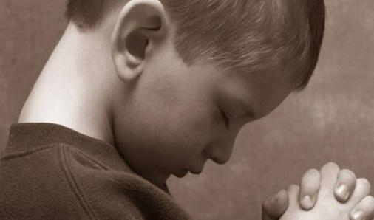
THE BAPTISM IN THE HOLY SPIRIT
WITH DICK GRUBER
dagruber@valleyforge.edu

Slide 2
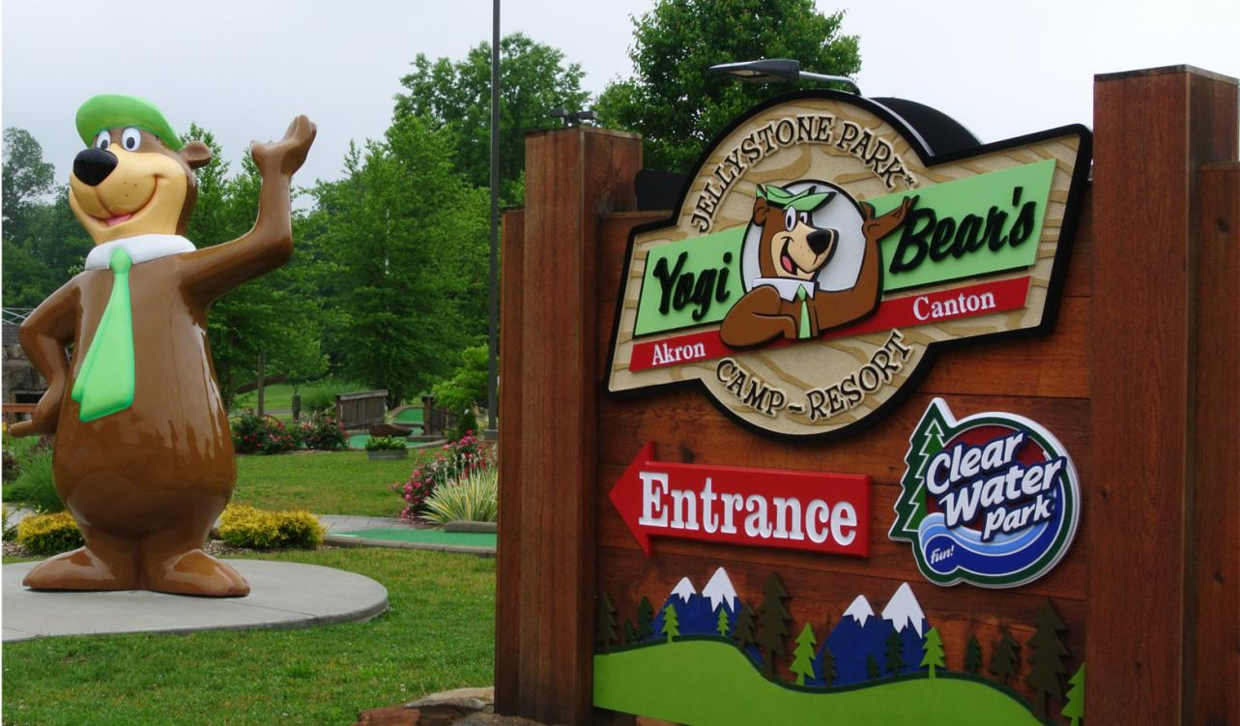
JELLYSTONE CAMPGROUND

Slide 3
THE RED POINTS
SALVATION
BAPTISM IN THE HOLY SPIRIT
DIVINE HEALING
RAPTURE

Slide 4
ACTS 4:31b
AND THEY WERE ALL FILLED WITH THE HOPY SPIRIT AND SPOKE THE WORD OF GOD BOLDLY. NIV

Slide 5
ACTS 1:5
FOR JOHN BAPTIZED WITH WATER, BUT IN A FEW DAYS YOU WILL BE BAPTIZED WITH THE HOLY SPIRIT. NIV

Slide 6
ACTS 19:6
WHEN PAUL PLACED HIS HANDS ON THEM, THE HOLY SPIRIT CAME ON THEM, AND THEY SPOKE IN TONGUES AND PROPHESIED. NIV

Slide 7
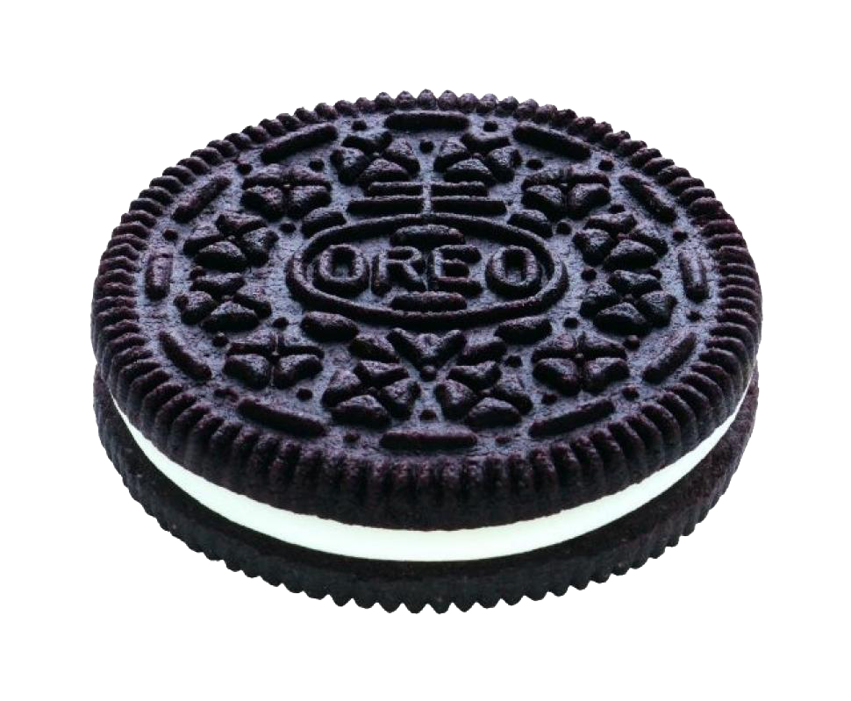
THE OREO
CREAMY FILLING
COOKIES
PRAYER LANGUGE
POWER

Slide 8
THE B.H.S. IS NOT…
…THE SAME AS SALVATION

Slide 9
THE B.H.S. IS NOT…
…SCARY

Slide 10
THE B.H.S. IS NOT…
…FOR ADULTS ONLY

Slide 11
THE B.H.S. IS NOT…
…NATURAL

Slide 12
THE B.H.S. IS NOT…
…AN EXPERIENCE WHERE TONGUES ARE OPTIONAL

Slide 13
THE B.H.S. IS NOT…
…AN ARRIVAL POINT

Slide 14
THE B.H.S. IS NOT…
…A REQUESITE FOR HEAVEN

Slide 15
WHAT HAPPENS?
WE KEEP OUR BRAINS
WE USE OUR VOICES
WE TRUST OUR GOD
WE USE OUR FAITH

Slide 16
BUT HE DOES THE WORK!

Slide 17
TIME TO PRAY
NO SCREAMING, SPITTING, SHAKING, PUSHING, PULLING, POUNDING, OR PUNCHING. WE WILL PRAY, ENCOURAGE, BLESS, AND BELIEVE.
THIS IS GOING TO BE SUPERNATURAL

Slide 18
PRAY

