Slide 1
The Changing Role of the GMA
Notes:
NOTE TO INSTRUCTOR:
This presentation was initially made at the National Royal Rangers LEAD Conference in Dallas, TX in March 2016 but is suitable for use in other settings to inform our leaders, parents, pastors, etc. on the details of this topic. Presentation notes are included with each slide. If you have any questions, please contact John Hicks, National Programs Coordinator, at jhicks@ag.org.
As always, we welcome your feedback on this topic.

Slide 2
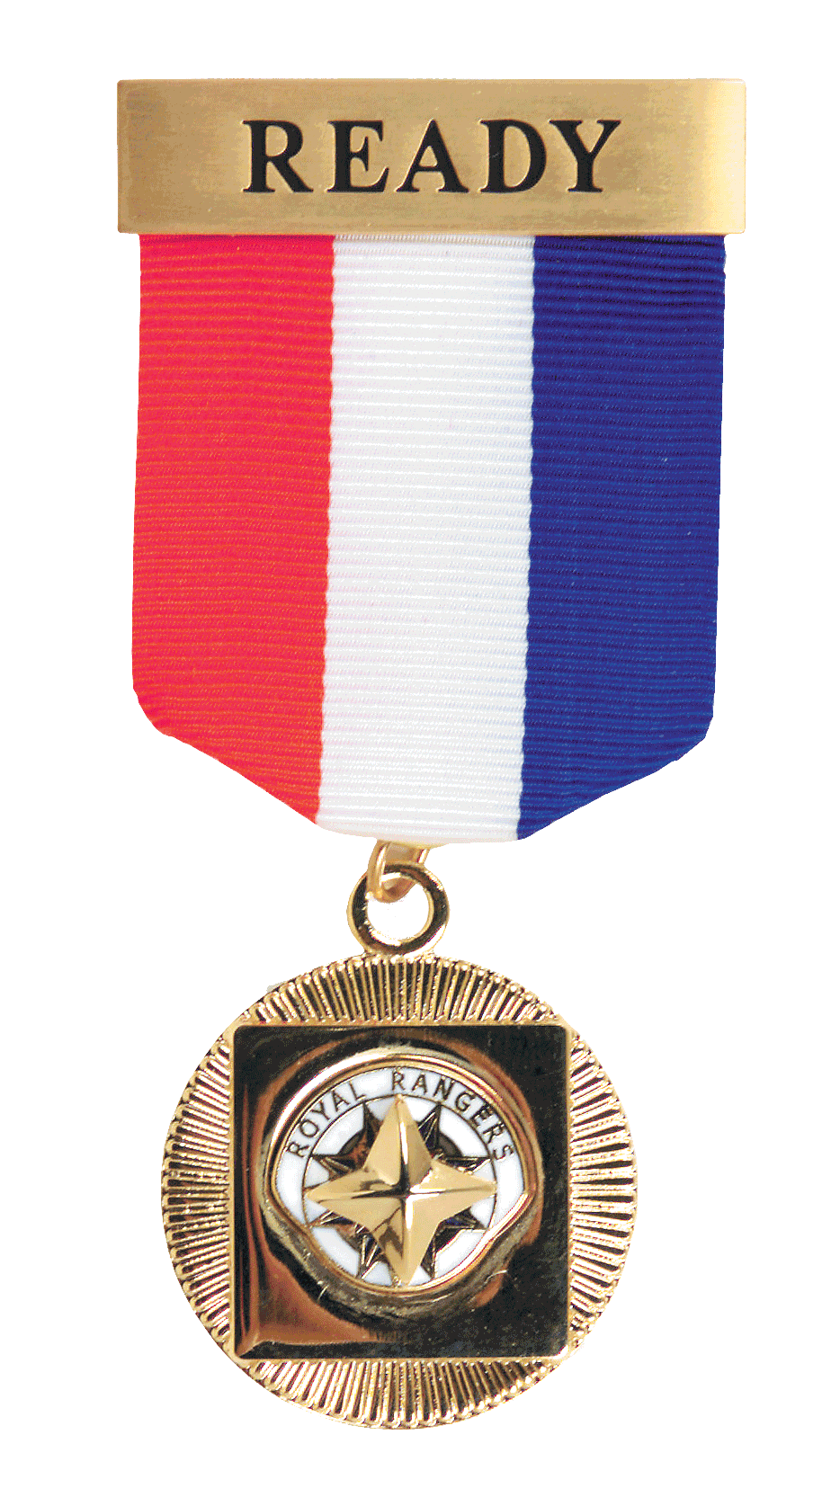
Gold Medal of Achievement
Notes:
The GMA has long held a central role in RR. First introduced in 1962, the GMA has been the pinnacle of achievement for RR boys for over 50 years. The GMA is commonly perceived by pastors, parents, alumni, etc. as the RR counterpart to the BSA Eagle Scout award and has long been celebrated as the primary achievement a RR can attain. But through years the GMA has changed.

Slide 3





Trail to the GMA before 2002
Straight Arrows |  | Buckaroos |  | Pioneers |  |  | Trailblazers |  |  | Air-Sea-Trail Rangers
5 | 6 | 7 | 8 | 9 | 10 | 11 | 12 | 13 | 14 | 15 | 16 | 17
Enter at 5 years of age
Graduate at age 18
Notes:
Prior to 2002 the GMA generally represented the completion of two age groups - Trail Blazers and Air/Sea/Trail Rangers. The first requirement for the GMA was that the boy must earn the highest award in AST Rangers, and the first requirement in AST Rangers was that he had to complete Trail Blazers. Any boy who joined RR as a AST Ranger had to go back and complete the Trail Blazer advancement trail before starting AST Rangers advancement. This meant boys typically didn't earn the GMA until they were nearing high school graduation, at the end of A/S/Trail Rangers.

Slide 4
2002 Program Changes
Straight Arrows |  | Buckaroos |  | Pioneers |  |  | Trailblazers |  |  | Air-Sea-Trail Rangers
5 | 6 | 7 | 8 | 9 | 10 | 11 | 12 | 13 | 14 | 15 | 16 | 17
Ranger Kids |  |  | Discovery Rangers |  |  | Adventure Rangers |  |  | Expedition Rangers
Enter at Kindergarten
Graduate at 12 grade/age 18
Notes:
In 2002 the RR program underwent extensive restructuring. Straight Arrows & Buckaroos became Discovery Rangers, Trail Blazers became Adventure Rangers, and Air/Sea/Trail Rangers was replaced by Expedition Rangers.

Slide 5


2002 Program Changes
Ranger Kids |  |  | Discovery Rangers |  |  | Adventure Rangers |  |  | Expedition Rangers
K | 1st | 2nd | 3rd | 4th | 5th | 6th | 7th | 8th | 9th | 10th | 11th | 12th
Enter at Kindergarten
Graduate at 12 grade/age 18
Notes:
Due to the increasing frequency of outposts not offering RR for high school boys, the GMA was moved down into AR rather than ER. In order to maintain equivalency with the pre-2002 GMA, connections between DR & AR advancement systems were created so that the 2002 GMA became the culmination of 6 years of work, across DR & AR. Any boy who joined RR as an AR had to go back and earn selected parts of DR in order to earn his AR awards (GMA), such as orange DR Bible merits & selected core (red) skill merits.

Slide 6




2002 Program Changes
Ranger Kids |  |  | Discovery Rangers |  |  | Adventure Rangers |  |  | Expedition Rangers
K | 1st | 2nd | 3rd | 4th | 5th | 6th | 7th | 8th | 9th | 10th | 11th | 12th
Enter at Kindergarten
Graduate at 12 grade/age 18
Notes:
The ER advancement system was structured in a unique way so that it would not be perceived as a step beyond the GMA, but rather as a completely separate system. This was done to reinforce the idea that the GMA was the pinnacle of achievement.

Slide 7
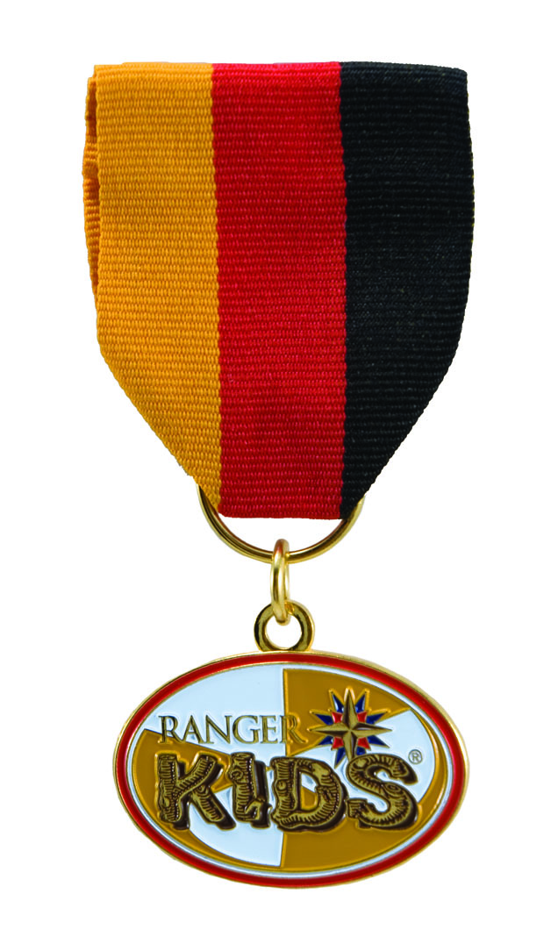


2010 Program Changes
Ranger Kids |  |  | Discovery Rangers |  |  | Adventure Rangers |  |  | Expedition Rangers
K | 1st | 2nd | 3rd | 4th | 5th | 6th | 7th | 8th | 9th | 10th | 11th | 12th
Enter at Kindergarten
Graduate at age 18
Notes:
In 2010 the program was updated again. Special effort was made to expand the variety of activities RR groups do beyond camping, and the advancement system was modified to make it more flexible, allowing outposts greater choice in selecting merits suitable for their group.
But one of the most significant changes was in the role of the GMA. In an effort to relieve boys of the necessity to work back in DR to earn their GMA, the association between the DR & AR advancement trails was removed, and the GMA became an award that represented the completion of the AR advancement trail alone. This in effect changed the GMA from representing the culmination of 6 years of work (2 age groups), as it had always been, to only 3 years of work (one age group) - making it roughly equivalent to the DR Gold Eagle and ER E3 award. This caused an inconsistency in the role & prominence of the GMA over time, and has been widely perceived "devaluing" of the award.

Slide 8
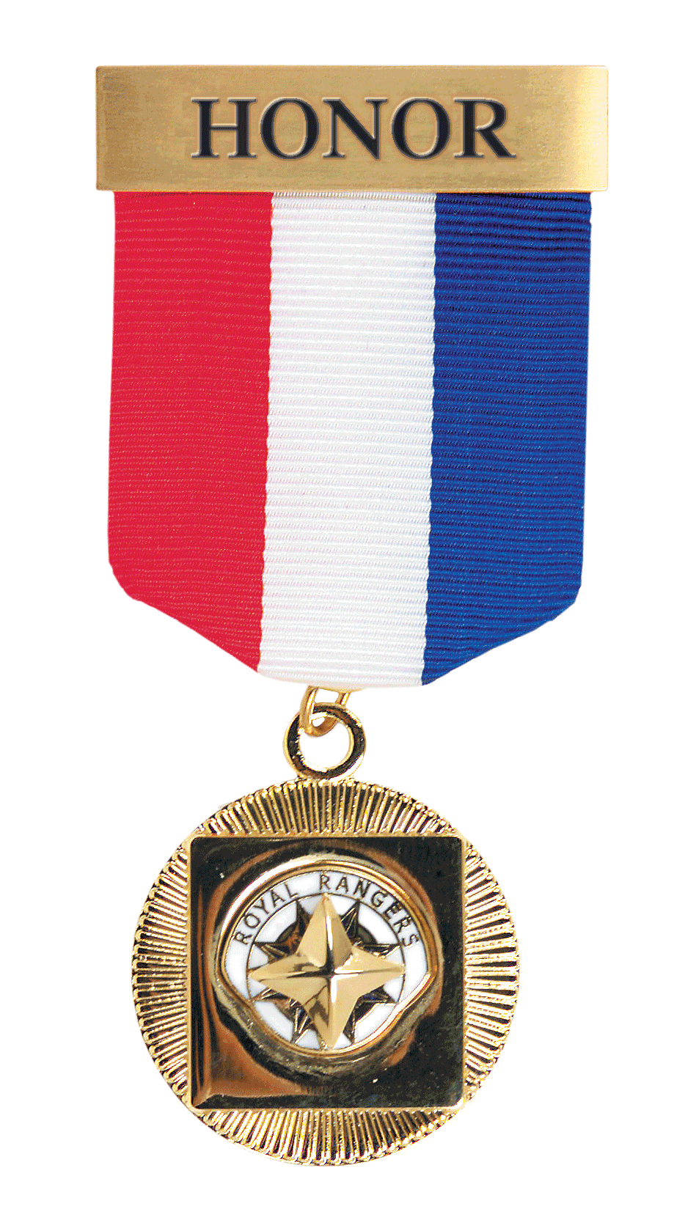
2010 Program Changes
Ranger Kids |  |  | Discovery Rangers |  |  | Adventure Rangers |  |  | Expedition Rangers
K | 1st | 2nd | 3rd | 4th | 5th | 6th | 7th | 8th | 9th | 10th | 11th | 12th
Enter at Kindergarten
Graduate at age 18
Notes:
At the same time, we created a new award - the Honor GMA. The purpose of this award was to encourage longevity - recognize boys who have completed the entire RR program, RK through ER. This new award was originally presented as a mere embellishment on the GMA, with the GMA still being considered the highest award in the program (due to the inclusion of additional requirements such as the Capstone Project). But it soon came to be commonly perceived as a completely separate and more prominent award than the GMA. The concept that the GMA was no longer the highest award in the program, coupled with the perceived reduction in value of the award, has not been well received among the RR community - parents, pastors, leaders, boys.

Slide 9

Three Key Questions
Do we have a problem?
Is it serious enough to warrant a change?
If so, HOW do we fix it & WHEN?
Notes:
For some time, we've been collecting feedback on this issue from districts, outpost leaders, parents, pastors, and boys. The common message we've received is this:
The change in the role of the GMA has not been popular.
Many don't like the reduction in the role & value of the award. The current GMA is not equivalent to the two previous GMAs, and doesn't warrant the same prestige and significance. This is particularly unpopular in settings where the GMA has become a significant tradition, such as with families where multiple sons have earned the award, or outposts where many have been presented through the years.
Although the Honor GMA is seen as a valuable award, it has effectively replaced the GMA as the most prominent award in the program, and yet is unattainable to many boys. Any boy joining the program as an AR or later will never have the option of earning it since they cannot work back in RK to earn the Gold Trail award.
Over the last 18 months the Exec Committee and our Programs Action Team has been examining this issue in an effort to determine the best way forward. We essentially had to answer three central questions:
Do we have a problem? (is this a widespread problem or just the grumblings of a small minority)
Is the problem serious enough to warrant a change? (we will pay a price either way)
If yes to both, HOW do we fix it, and WHEN?
We came to the conclusion that the answer to the first two questions was YES, and the answer to the third was “as soon as possible”. The longer we wait, the more boys we will have who are earning this intermediate form of the GMA, and the more confusion that will spread as a result of the changes. Right now, many parents, pastors, etc. are not award of the reduction in the role of the award, so a change now will have less of an impact on them.

Slide 10
Solution Objectives
Return the GMA to its historic role of prominence
Retain the intended purpose of the Honor GMA, while making it more attainable
Minimize the degree of change, as much as possible
Notes:
With this in mind, we've come up with a solution that we believe will meet three core objectives:
Return the GMA to a role of prominence within RR, comparable in significance to the past/historic GMAs
Retain the intended purpose & value of the Honor GMA, while making it more attainable for boys
Minimize the degree of change (and learning curve) as much as possible - laser surgery rather than a full heart transplant. Any change can cause a degree of frustration in the field, so we must always minimize change when we can and provide a clear justification when its necessary.

Slide 11
2016 Program Changes
Highest Award in (2) groups = GMA
Highest Award in (3) groups = GMA w/Merit
Highest Award in (4) groups = GMA w/Honors
Notes:
THE SOLUTION - Pull the GMA out of AR and award it to boys who have earned the highest award in (2) age groups. Then create an intermediate step between the GMA and the Honor GMA – the GMA with Merit.

Slide 12
Solution
Benefits
  Makes the GMA comparable to historic GMA
  Eliminates the need to “work back” in prior groups
  Boys must still be at least 12 years of age and complete the Capstone Project to earn the GMA
Notes:
Benefits of this change:
Makes it comparable to the historic GMAs (both original & 2002 versions)
Eliminates the need for boys to "work back" on requirements from a previous group to earn the GMA
RK is excluded since the minimum age for GMA has always been at least 12

Slide 13

Adventure Rangers
BMA becomes “Adventure Bronze Award”
SMA becomes “Adventure Silver Award”
GMA becomes “Adventure Gold Award”
All award requirements remain unchanged
Notes:
Since we're pulling GMA out of AR, we need to rename the awards there
We want to retain the Bronze, Silver, Gold terminology (to minimize change & make it easy to remember)
BMA becomes Adventure Bronze Award, SMA becomes Adventure Silver Award, GMA becomes Adventure Gold Award
All AR award requirements remain the same (number and types of merits required, etc.)

Slide 14









Insignia
Notes:
INSIGNIA - AR awards
Medals will be similar to current but with AR logo (similar to current DR and ER medals)
Ribbons for Year 1 & 2 remain unchanged, Year 3 becomes purple & white (purple is a primary color of AR logo)
Patches will resemble current forms, with new text
Remember – we are minimizing change.

Slide 15

Insignia
Notes:
INSIGNIA – GMA series
The GMA will remain in its current form
GMA with Merit – a STAR worn on the GMA medal and ribbon (his original GMA)
GMA with Honors – TWO STARS worn on the GMA medal and ribbon (his original GMA)
Note that the Honor GMA essentially remains unchanged, except for a change of name to better represent it as an embellishment on the GMA, not a separate award.
Its important to note that we are presenting these three awards as three forms of the same award, not three separate awards. That is, we have ONE GMA, represented in 3 forms.
Note that the GMA patch will bear no insignia for merit or honors, and no separate patches will be created, so as to avoid representing these as three separate awards.

Slide 16
Implementation & Timeline
BMA, SMA, & Honor GMA will transition as stock is replaced
GMA with Merit available immediately (3 age groups)
Through Dec-2016 boys may earn:
  2010 GMA (with Capstone Project) or…
  Adventure Gold award (without Capstone Project) or…
  2016 GMA (2 groups + Capstone Project)
Changes will be reflected in next reprint of boys handbooks (Spring 2016) and Leader Manual (Spring 2017)

Slide 17
Gold Medal of Achievement
Notes:
We believe these changes will bring the GMA back into alignment with it’s historic role in the program and will retain its significance as one of the most recognized and iconic elements of the Royal Rangers brand. We will once again be able to celebrate the GMA as the pinnacle of achievement with the program, and we will celebrate ALL GMA recipients as champions of Royal Rangers.

