Slide 1
Delving into Luke 2:52

Slide 2


Luke 2:52 – “And Jesus grew in wisdom and stature, and in favor with God and man.” (NIV)
The four GOLD points represent the four ways a boy grows; mentally, physically, spiritually, and socially.

Slide 3
OUR GOAL IN LIFE -
BECOME LIKE JESUS

Slide 4
Avoid your
“UNTIL”

Slide 5

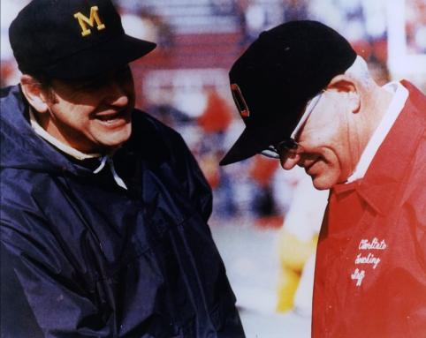
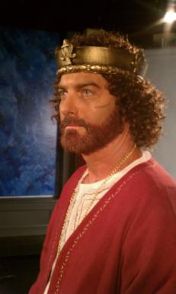
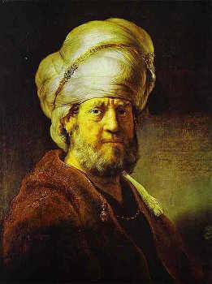

Slide 6
How to avoid your “UNTIL”
Develop a personal mission statement
Obey the “Stays”
Stay in the Scripture
Stay close to a friend
Stay away from other women
Stay alert to the tactics of your enemy, Satan

Slide 7
TABLE TALK TOPICS
When I’m tempted to click where I shouldn’t click, I…
In my relationships with other women, I insist on…
I do or don’t have an accountability partner because…
If you were to ask my kids “what kind of a dad I am,” what would they say? What would your spouse say?
I try to keep my relationship priorities as Christ, wife, family, job, and ministry in that order by…
I know there used to be a lot of rules about things that a Christian shouldn’t do. Today those seem to be blurred considerably, but I feel...
If there is one thing I could improve on to help me finish strong, it would be… (You might just want to jot this one down and keep it private.)

