Slide 1





Slide 2
KIDS

Slide 3
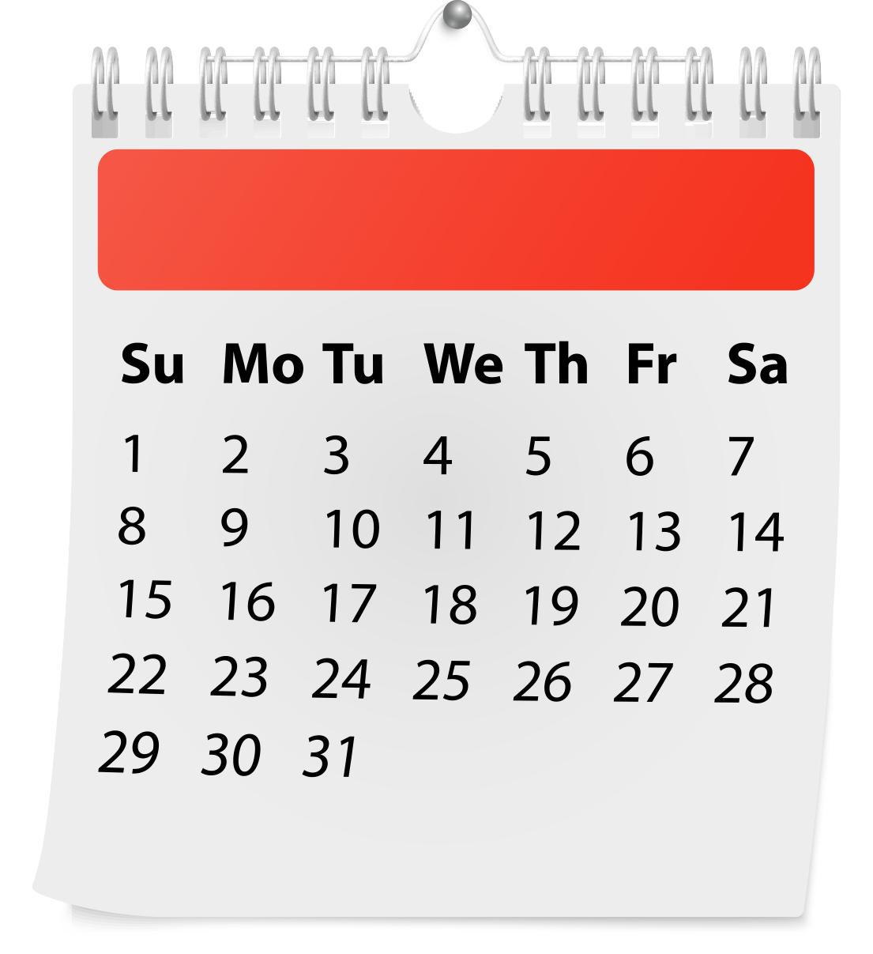

$31 in 31 days

Slide 4


$100 Challenge

Slide 5


10-10-10

Slide 6

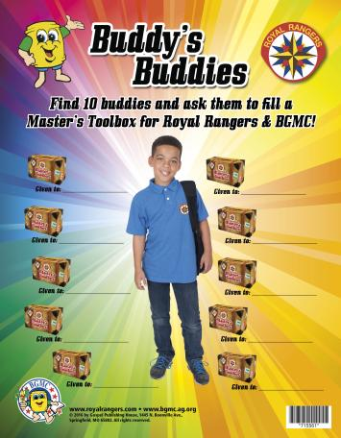

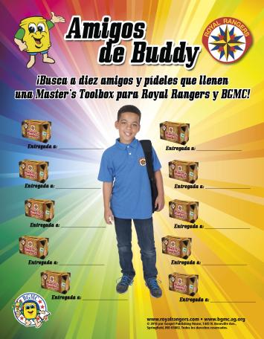
Buddy’s Buddies

Slide 7





Social Media
BuddyBarrel
BGMCAG
BuddyBarrel
Buddy Barrel
channel

Slide 8
KIDS & LEADERS

Slide 9



Bike-a-thon
Walk-a-thon
Jump-a-thon
Roll-a-thon

Slide 10

Chores,
Work Days

Slide 11


PopOut!

Slide 12
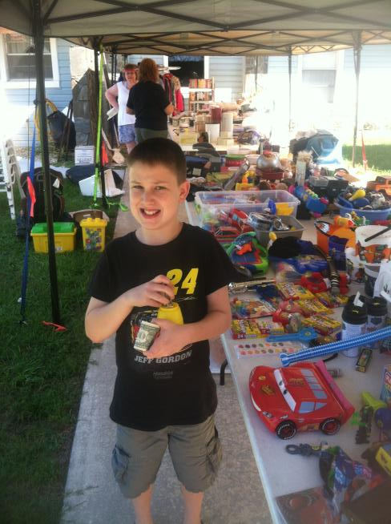

Bake Sale
Pizza Sale
Garage Sale

Slide 13

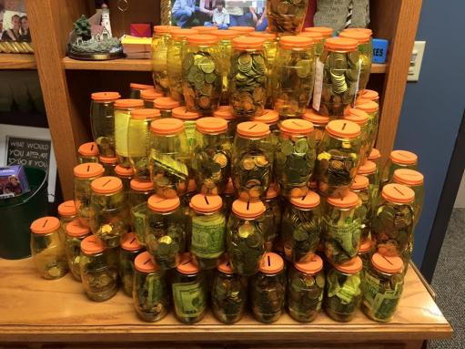
Special Barrel Days

Slide 14
LEADERS

Slide 15


Slide 16

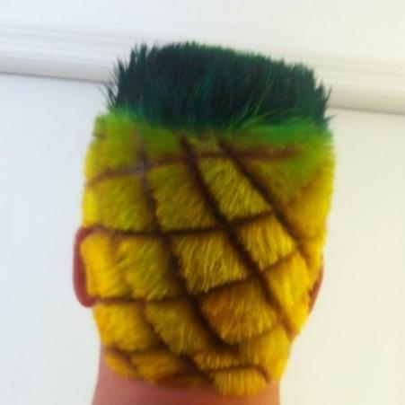
Consequences

Slide 17
CHURCHES

Slide 18
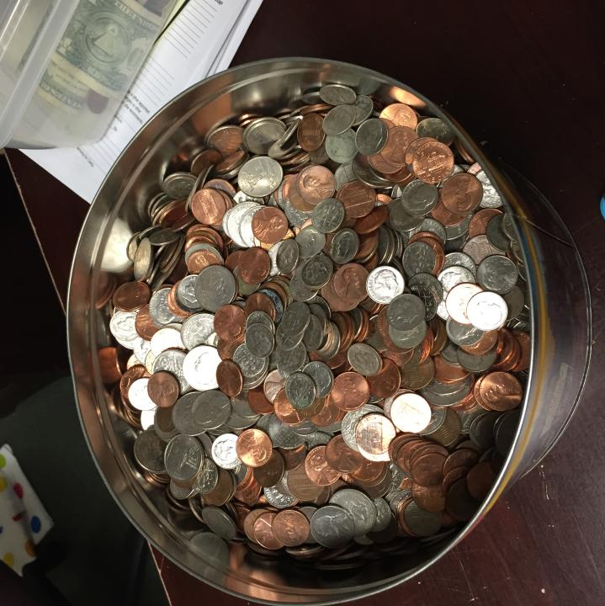

Lost Change

Slide 19

BGMC Offering Envelopes

Slide 20
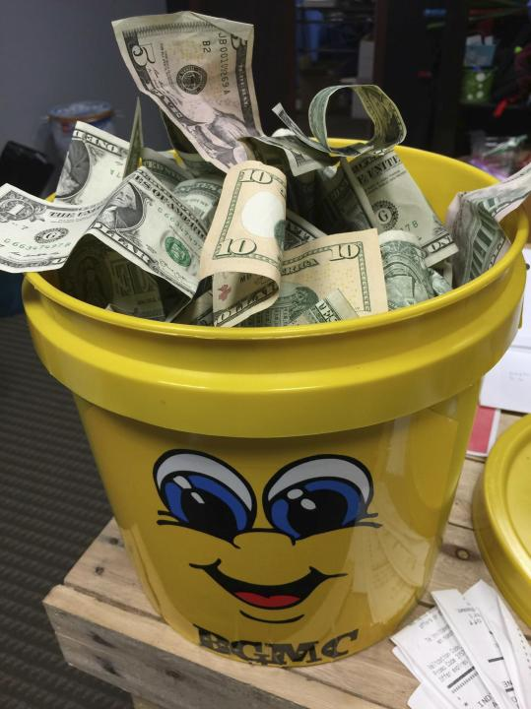

BGMC Day Offering

Slide 21
Master’s Toolbox Sunday

Slide 22

Matching Funds, Challenges

Slide 23
DISTRICTS

Slide 24
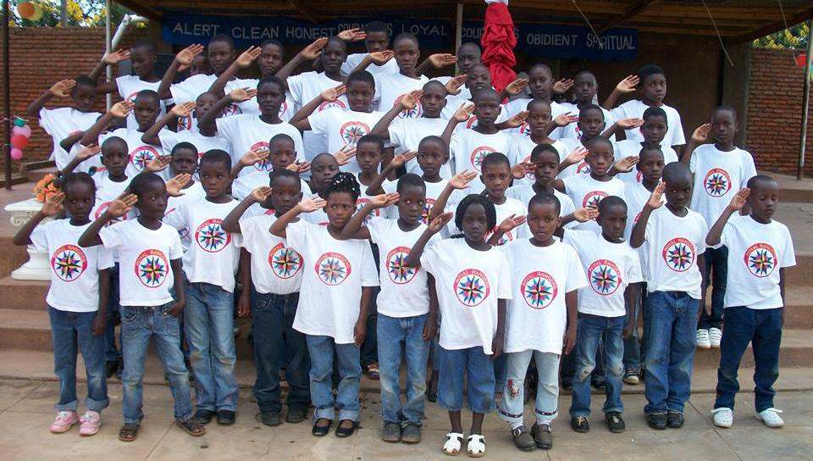

Master’s Toolbox Projects

Slide 25

Challenges,
Contests,
Banquets

Slide 26
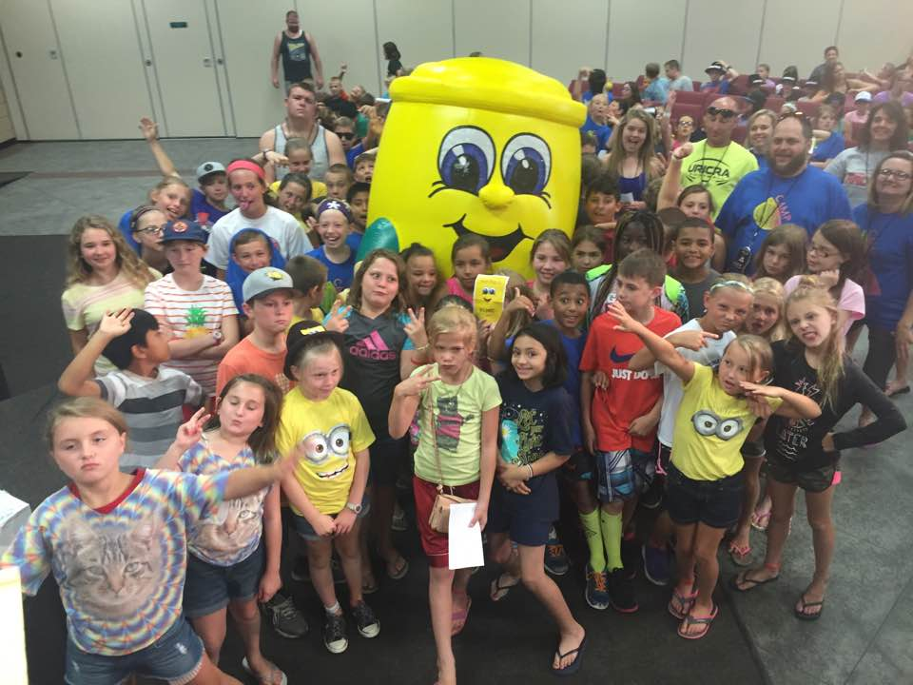

Camp

Slide 27

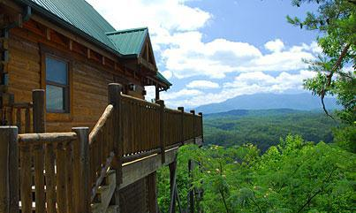
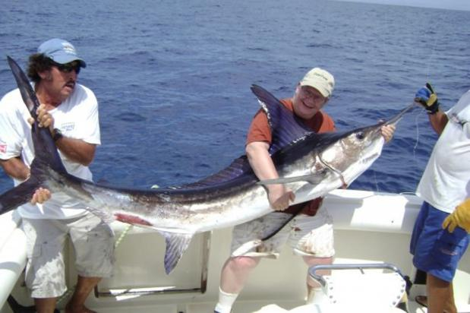
Summits

Slide 28

Buckets

