Slide 1
Online Training Opportunities
with David Morrison and Rick Barnhouse

Slide 2
Online Training Offerings
^{Ranger Safety}
^{Outpost Committee}
^{Outpost Coordinator}
^{Outpost Chaplain}
Preventing Child and Substance Abuse
Working with Boys with Disabilities

Slide 3
Our Access Points www.royalrangers.com/training/general National Royal Rangers Online Training Portal

Slide 4
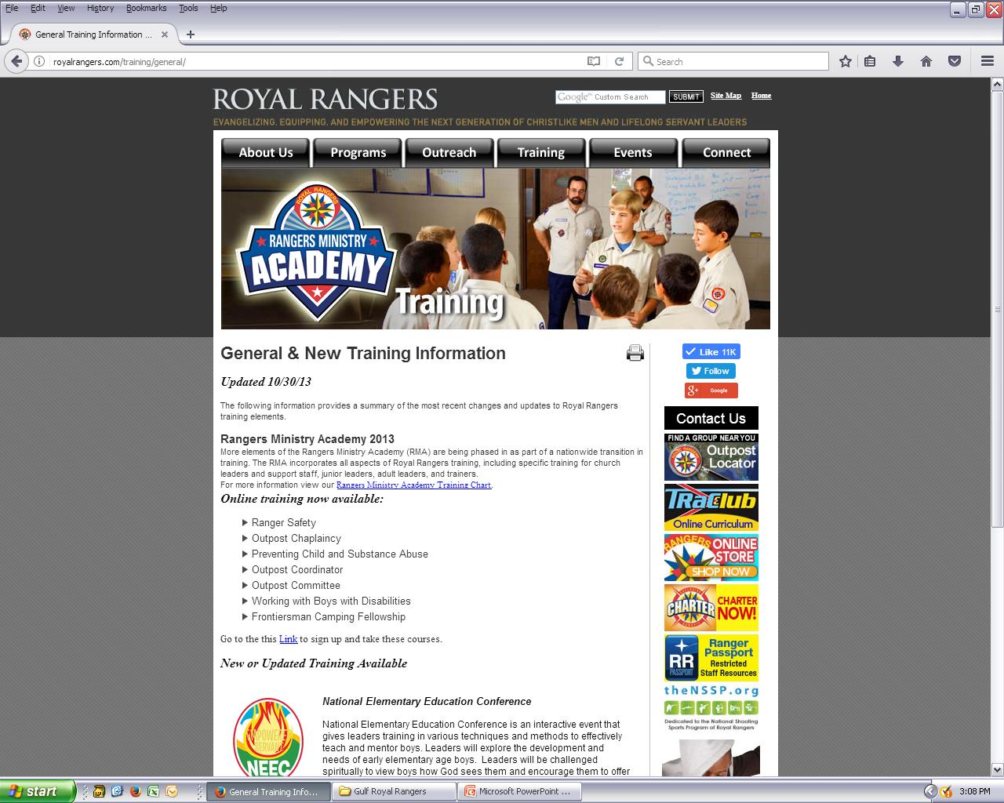

Slide 5
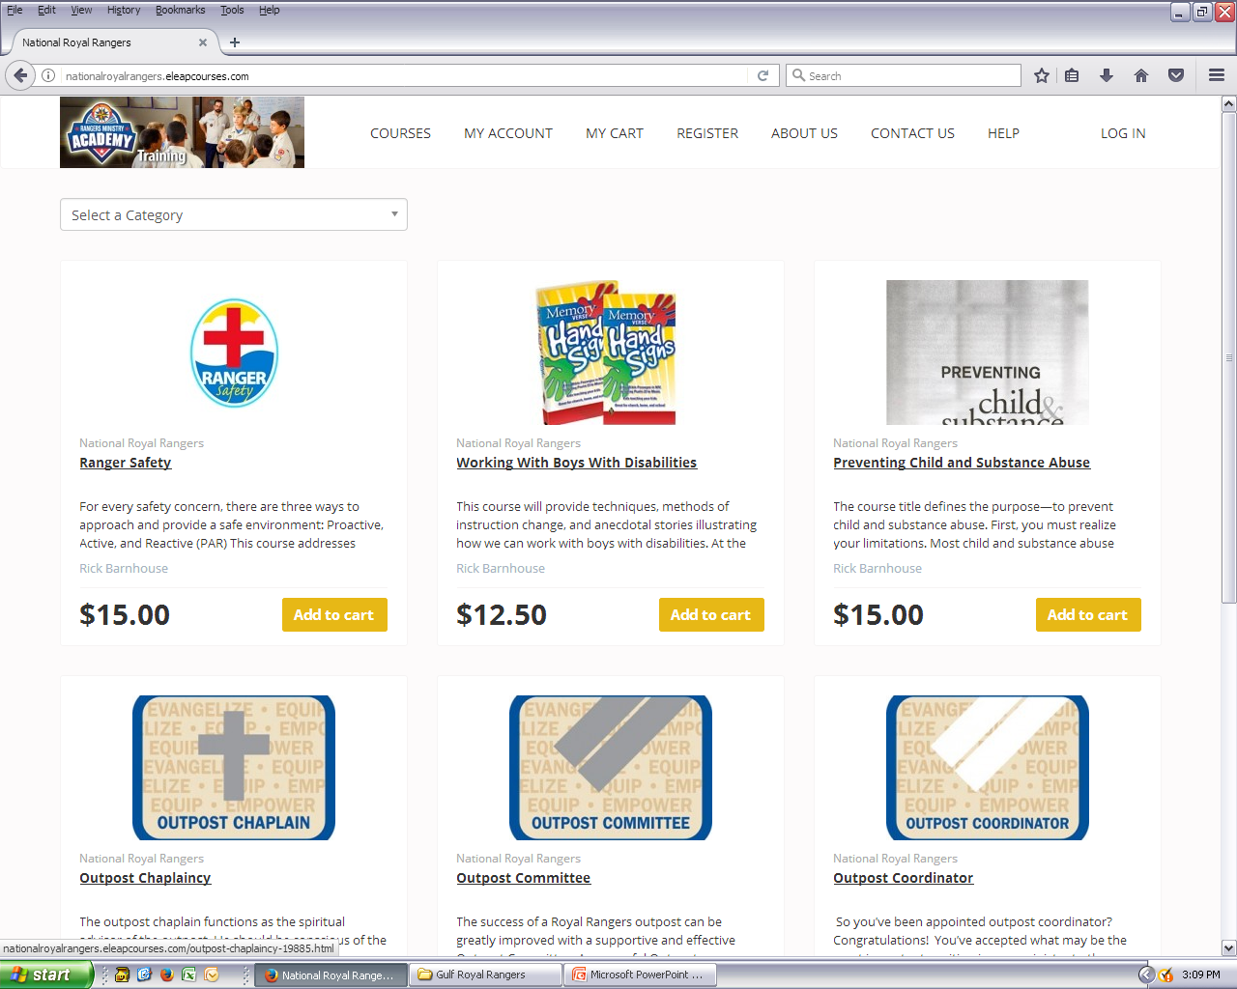

Slide 6
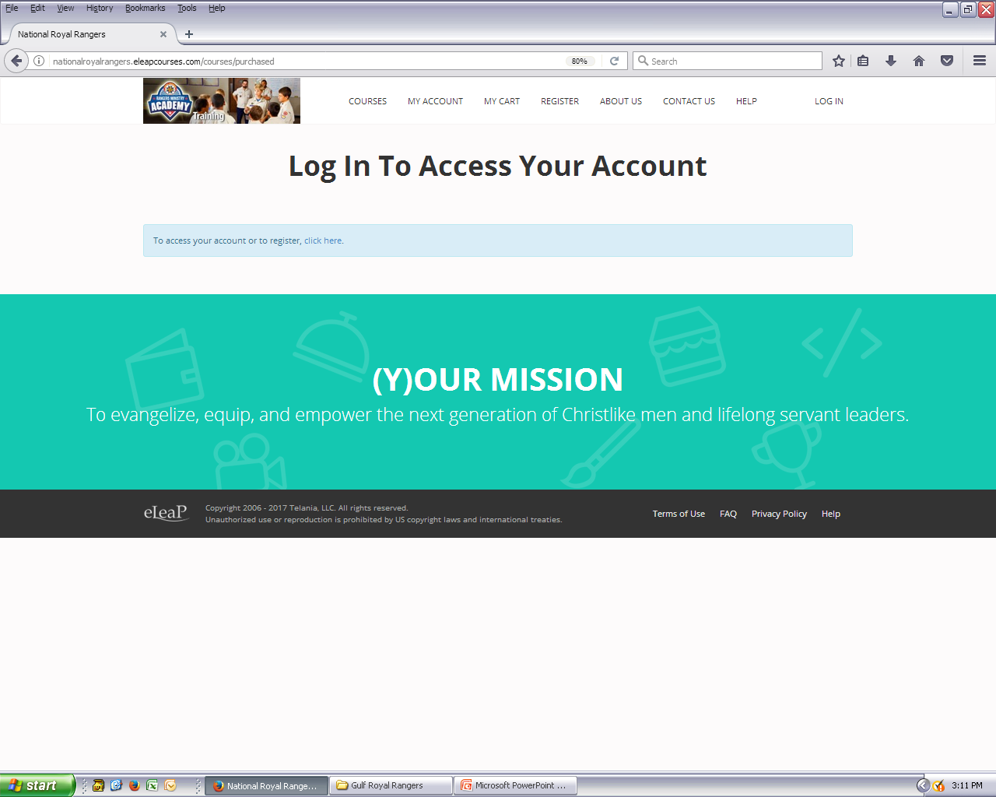

Slide 7
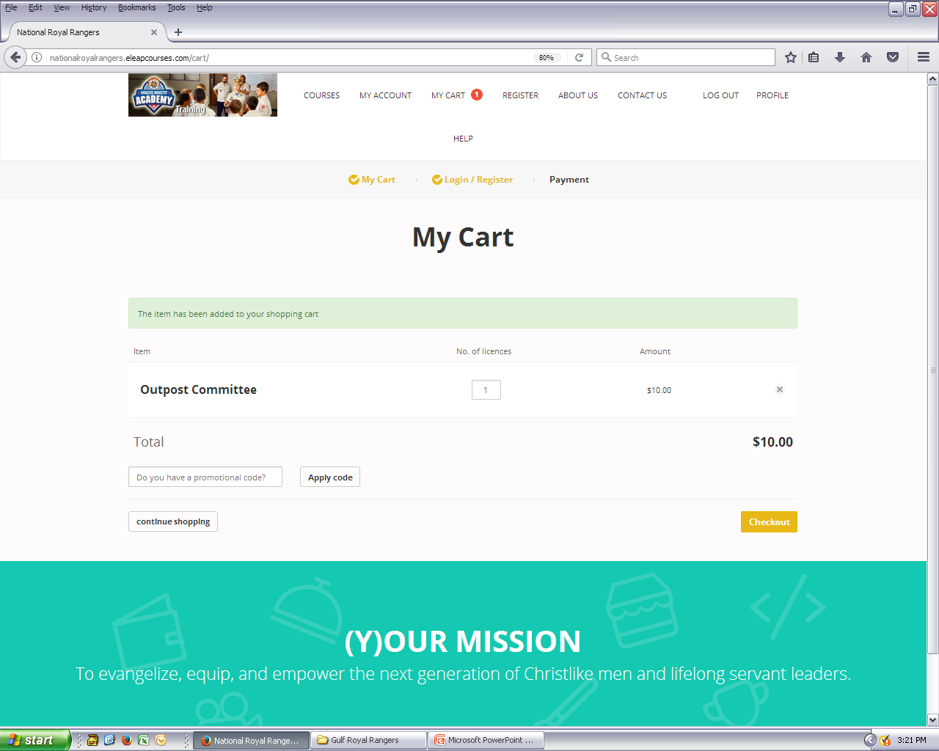

Slide 8
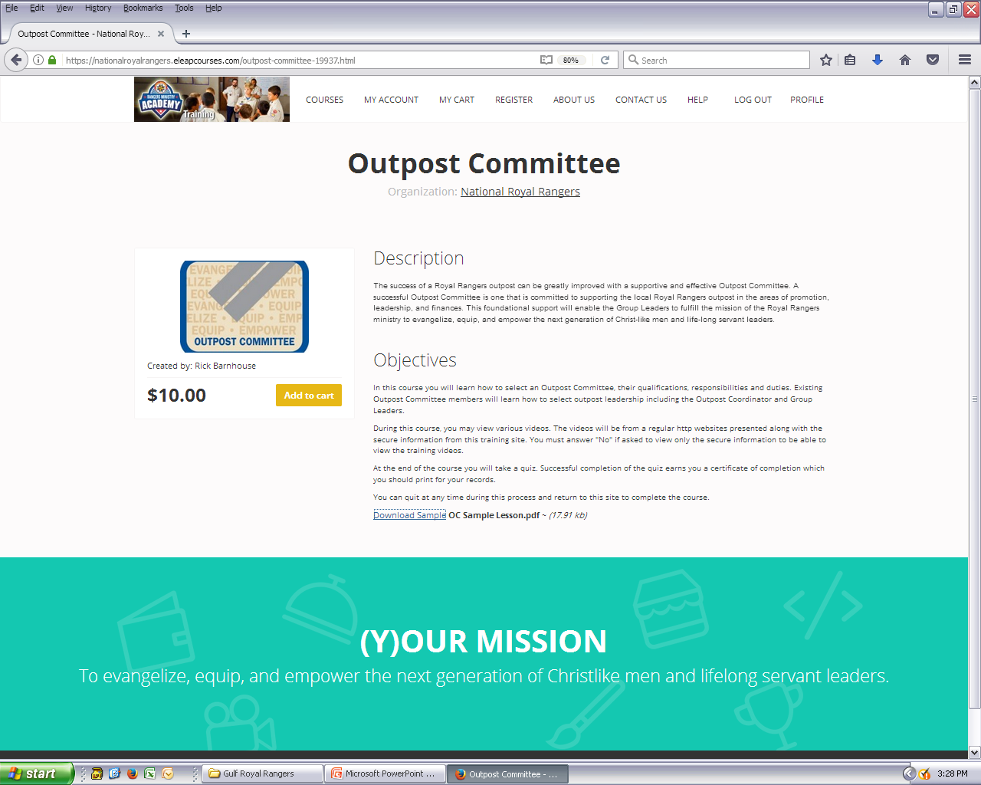

Slide 9
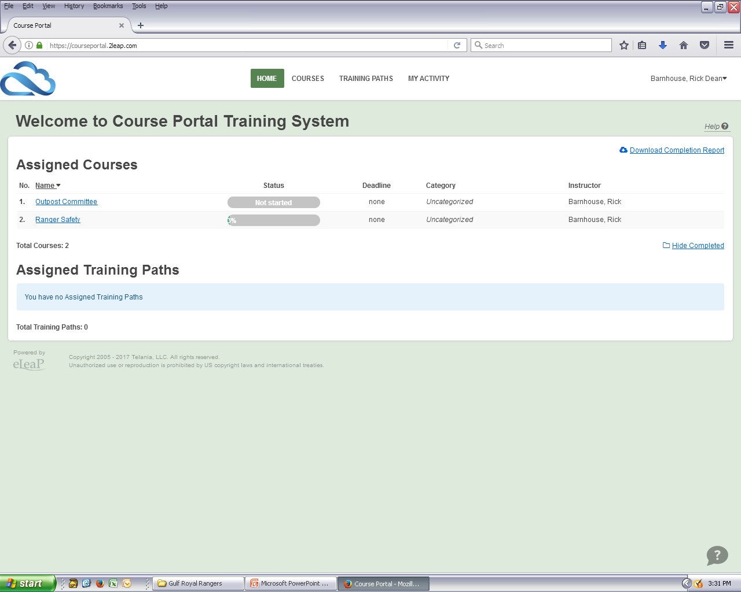
Purchased Courses
and Progress

Slide 10
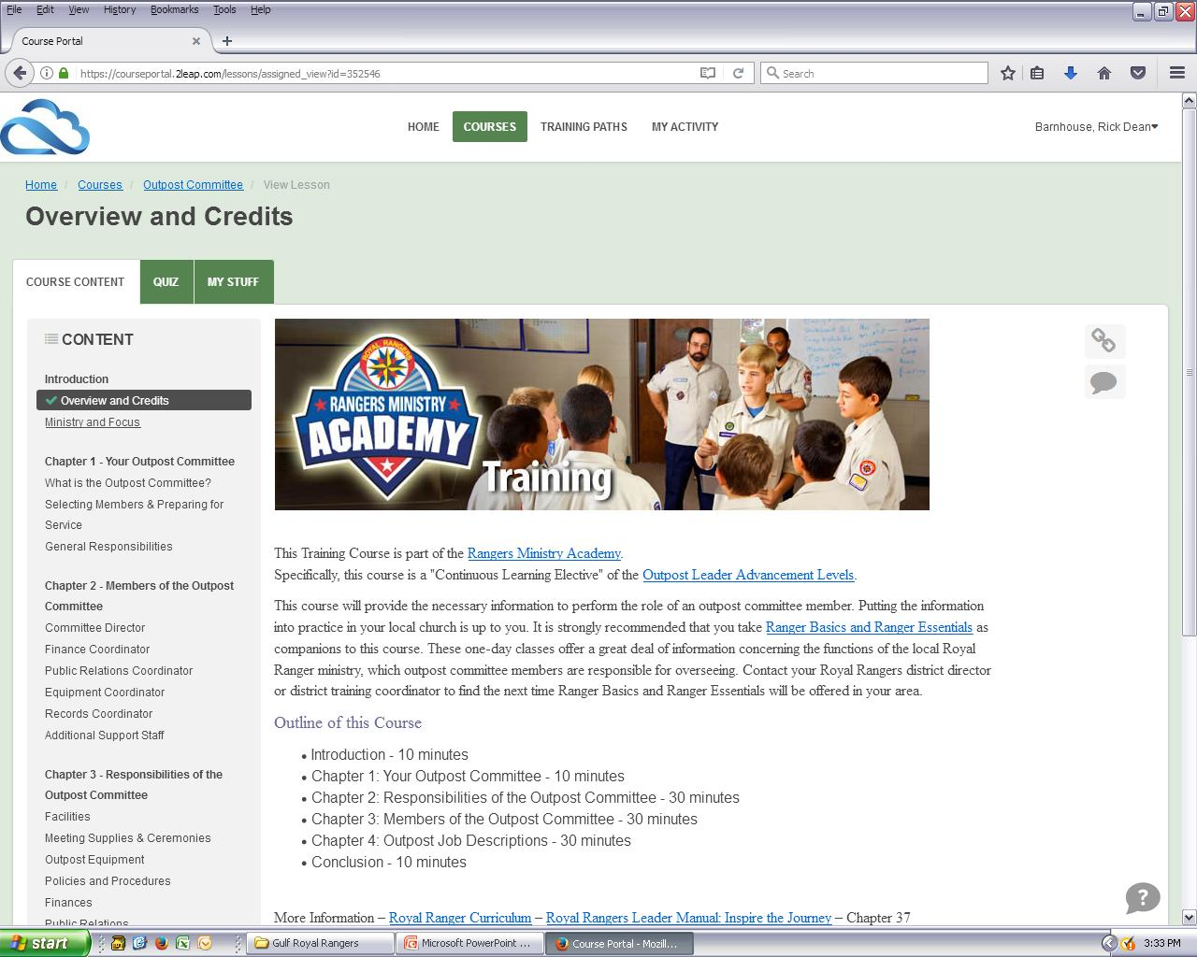
Each lesson begins with an overview, so the trainee will know what to expect.

Slide 11
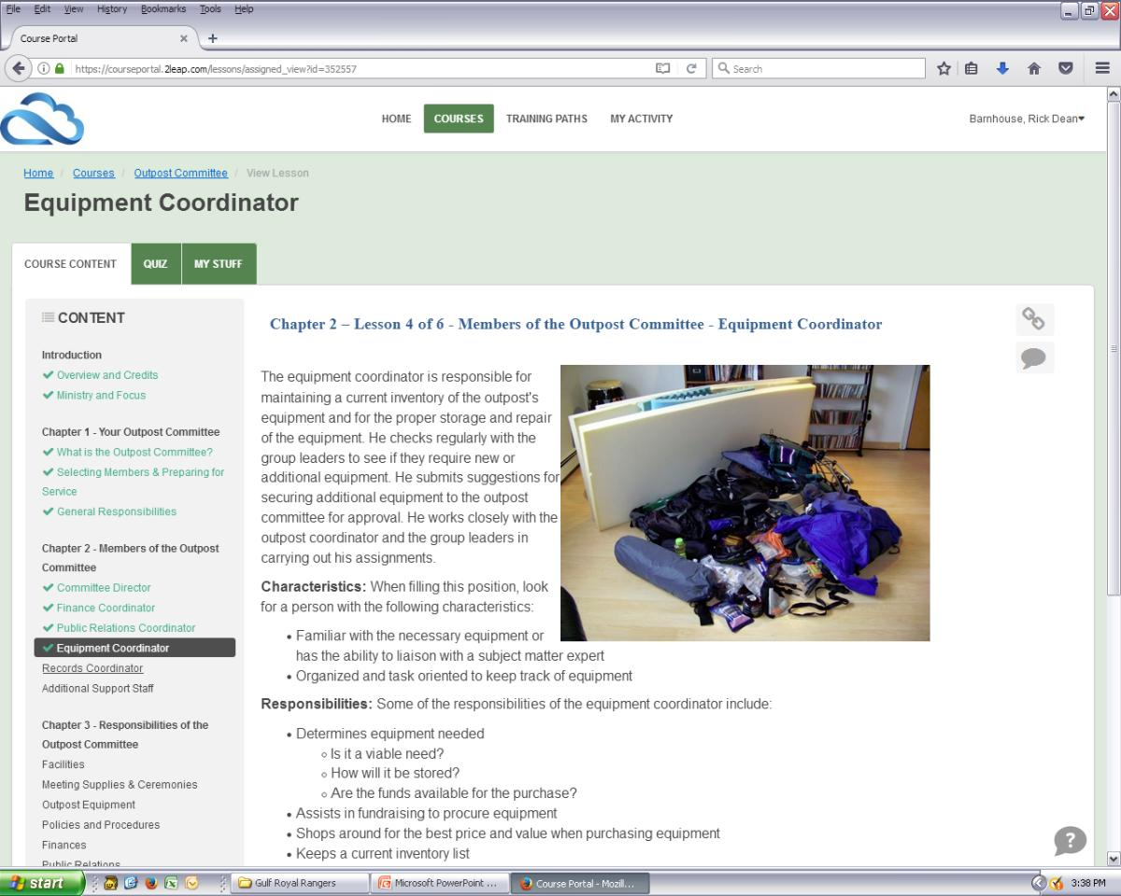
The system keeps track of you progress and checks off lessons completed.

Slide 12
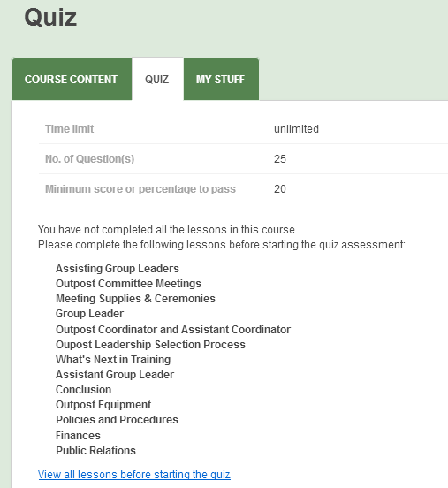
No Quizzing before you have completed the lessons

Slide 13
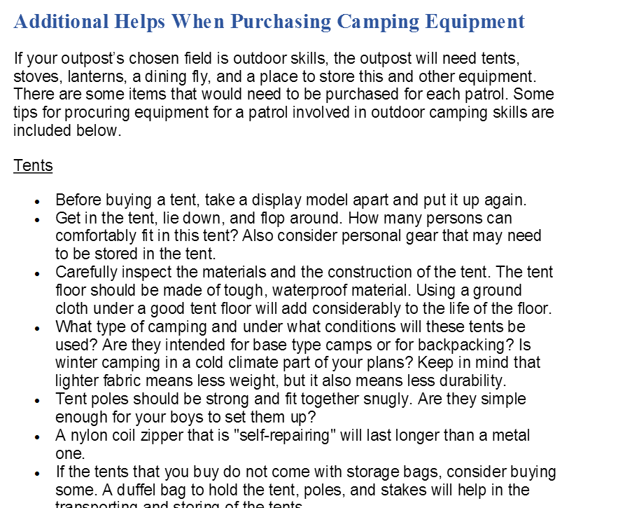
Additional files and links provide added content. They can be printed.

Slide 14
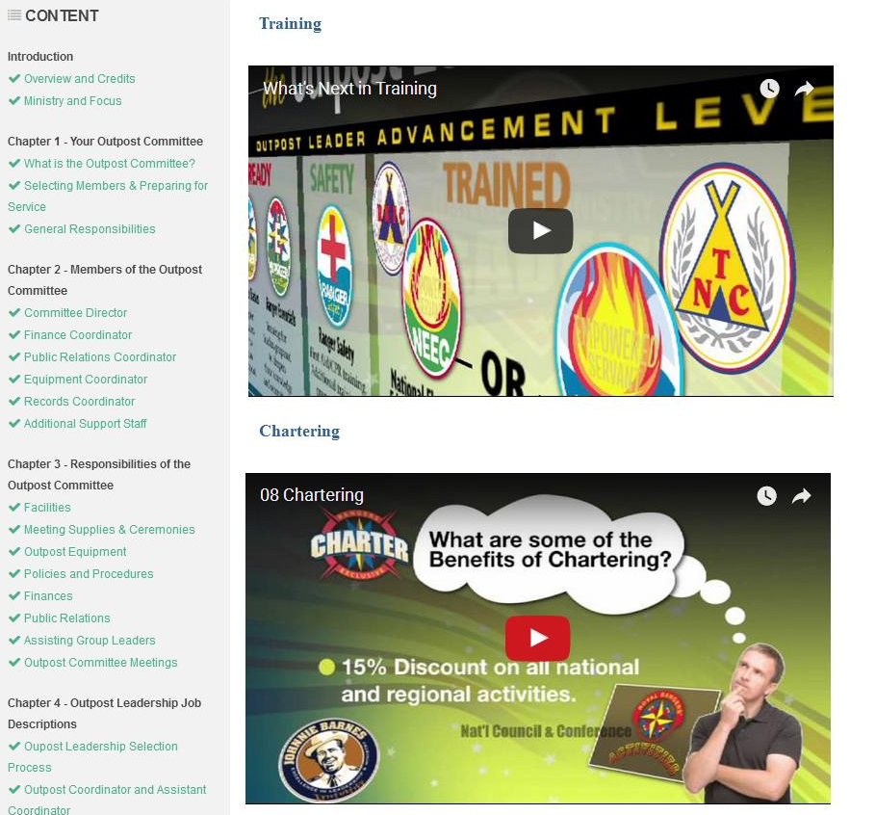
Each course ends with a recap of the training process (and the benefits of chartering).

Slide 15
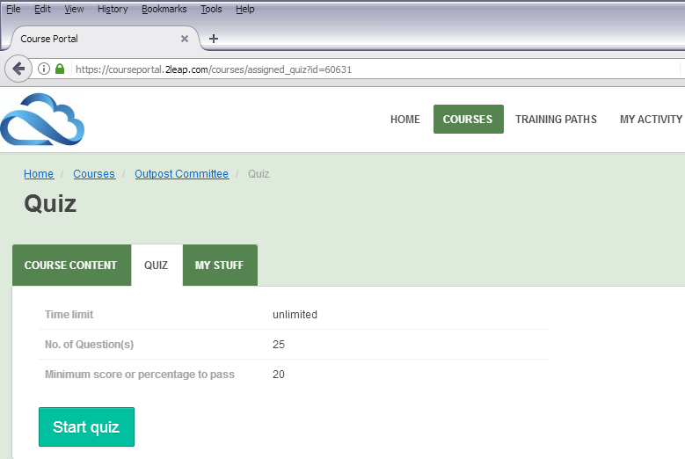
Once the lessons are complete, the trainee has access to the quiz.

Slide 16
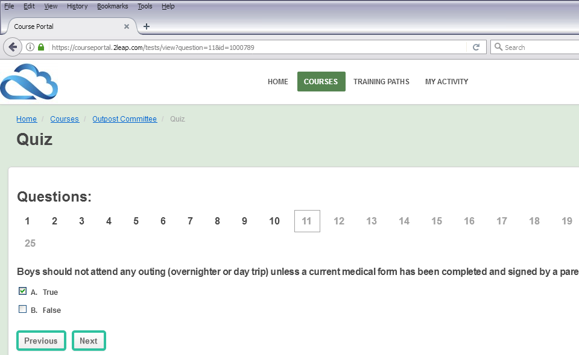
Each question is multiple choice or T/F. A status bar show the trainee’s progress.

Slide 17
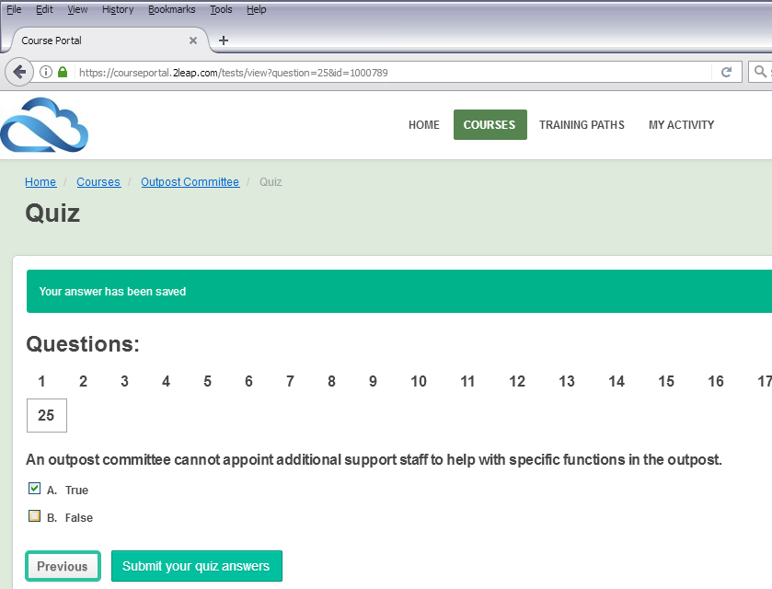
Once all questions are answered, the trainees can either go back and review answers, or submit the answers.

Slide 18
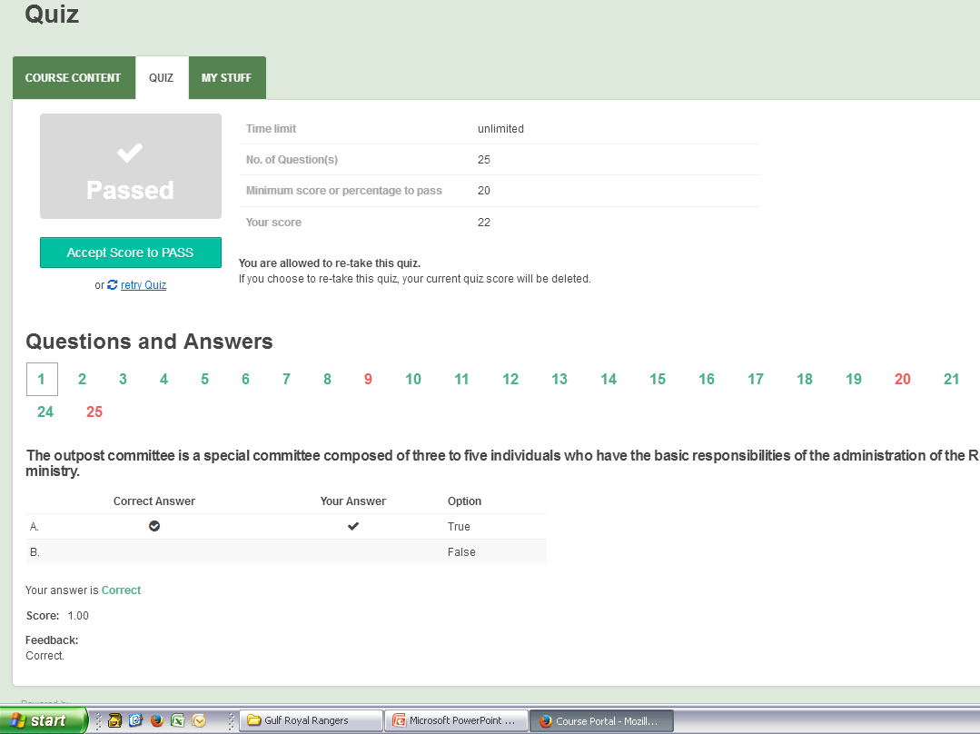
The user can review all answers, obtain feedback, look at wrong answers, accept a score to pass, or retry the quiz for a higher score (up to three times).

Slide 19
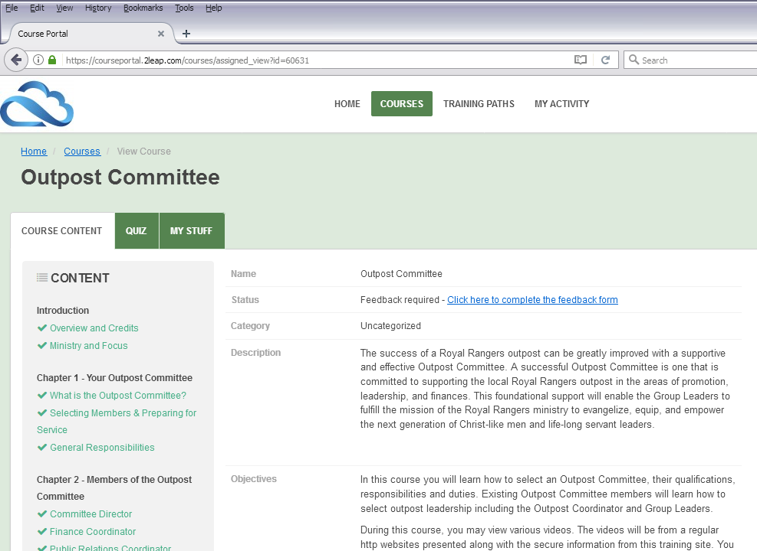
Once the user returns to the course, he or she is required to submit a feedback form before they can apply for a certificate.

Slide 20
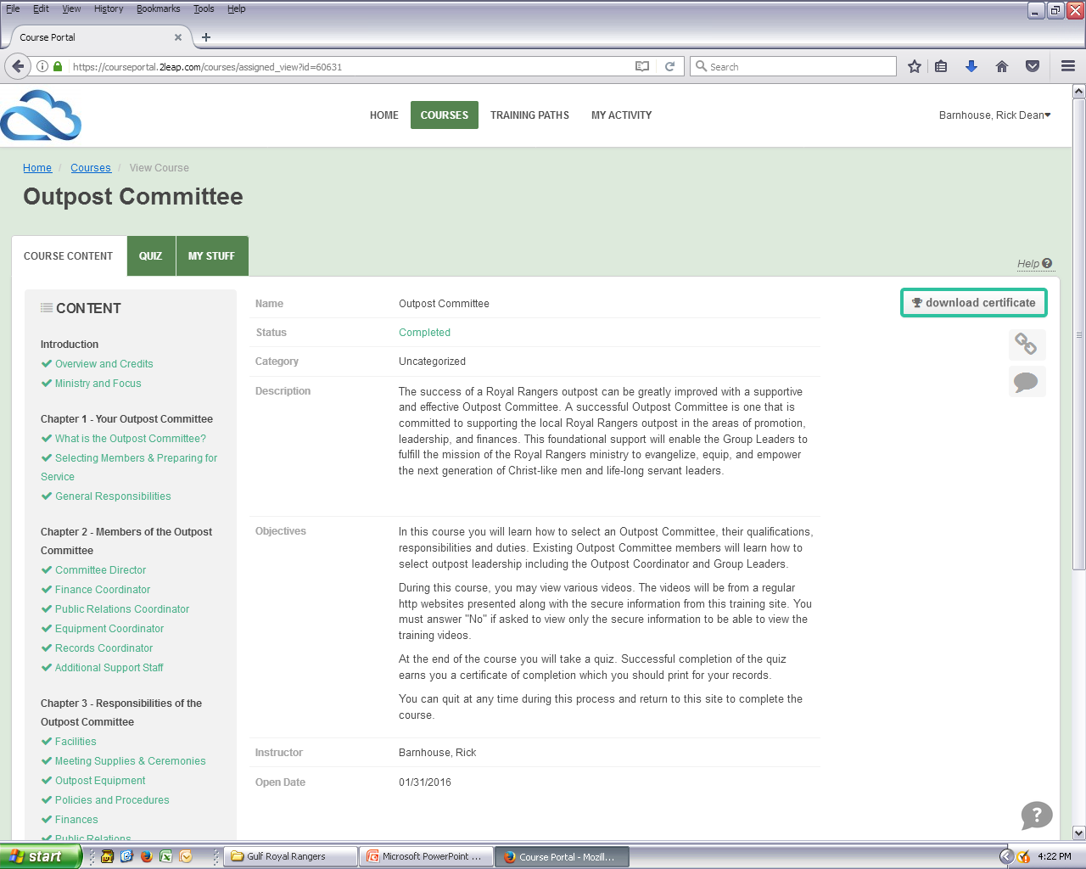
Once the course is complete, the quiz passed and the feedback given, the user can download a certificate.

Slide 21
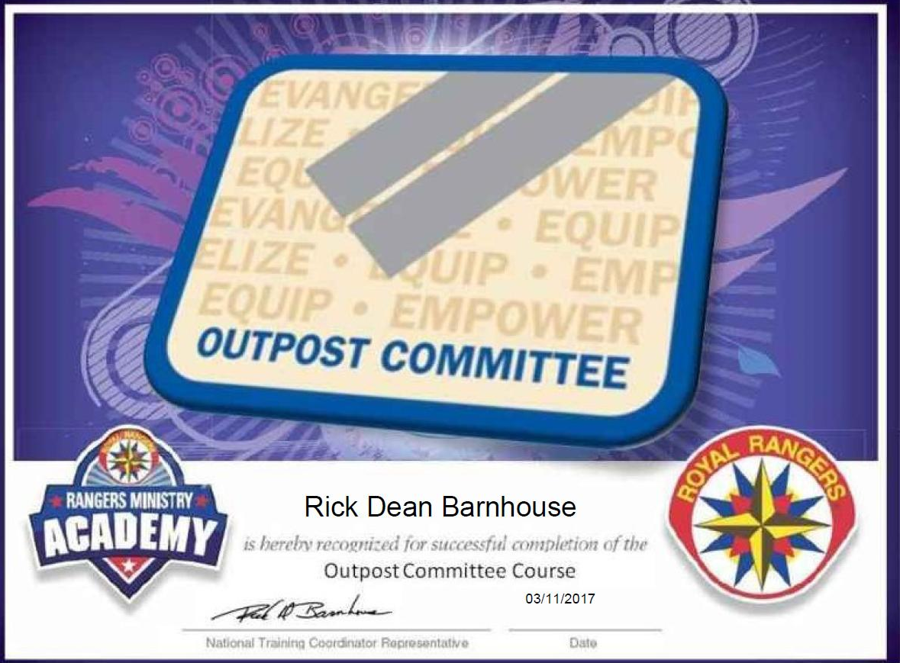
The trainee should email a copy of this certificate to his district training coordinator and /or district director.

Slide 22
Online Training
Training does not have to be completed in one setting.
Trainees may go back and continue the course or access their course for 1 year.
Trainees have up to three tries to pass a quiz.
They should not accept their results until the have a passing grade.
In the event that they accidentally accept a failing score, they can request that the test be reset through the portal.

Slide 23


