Slide 1
Building Blocks of an Effective MINISTRY TO BOYS
Notes:
Welcome, thank you for coming, introduce all presenters
If you have heard the presentation on “Capturing the Hearts of Boys and Girls”, this class will provide additional details on the key components of an effective boy’s ministry, essentially providing a next step beyond that class
Open in prayer

Slide 2
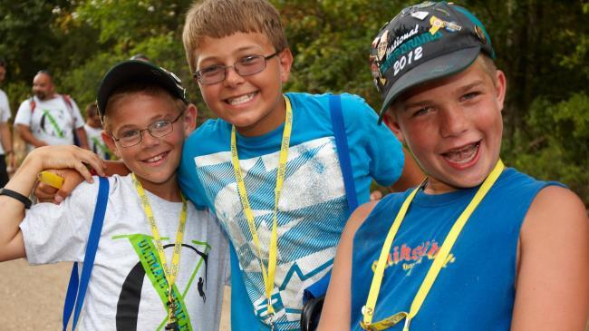
Gender Differences – Boys vs. Girls
How might you describe the typical BOY?
Notes:
Answers may vary

Slide 3

Gender Differences – Boys vs. Girls
How might you describe the typical GIRL?
Notes:
Answers may vary

Slide 4
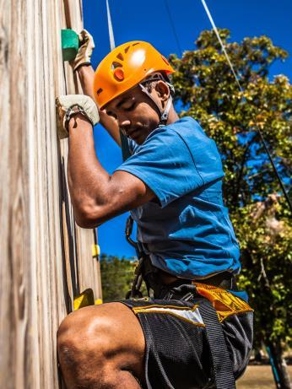
Core Competencies
Outdoor Activities
Sports
Trade Skills
Technology
Arts
Notes:
Although the interests of men and boys can very widely, we can generally categorize their activites into these five categoires. Most guys will have interests in one or more of these areas:
Outdoor Activities – camping, hiking, canoeing, boating, etc.
Sports - football, fishing, tennis, golf, etc.
Trade Skills – carpentry, auto mechanics, landscaping, etc.
Technology – computers, networking, internet, video games, smart phones, etc.
Arts – music, drama, painting, crafts, etc.

Slide 5
Core OBJECTIVES
1
2
3
CONNECT
GROW
SERVE
CONNECT with a community of Christlike men
GROW in Biblical manhood
SERVE others & make the world a better place
Notes:
In order for any ministry to boy to be fully effective in growing boys into Christlike manhood it must pursue three core objectives.
CONNECT
Fellowship - Bring men & boys together into a community of men where intergenerational mentoring takes place
Evangelism - Attract new boys (and men) and introduce them to the message of the Gospel
GROW
Develop the total boys, according to the patters of Christ (Luke 2:52) - Mentally, Physically, Spiritually, Socially
SERVE
Engage boys in living out their faith in tangible ways

Slide 6
What are the key “building blocks” every boys ministry should include?

Slide 7


1. Community of Christlike Men
A place where guys can connect, make new friends, and have fun together
Variety of activities of common interest
Connect boys with a diversity of men
Notes:
Serves as a place where guys can connect with other guys, make solid friendships, have fun together – a place to belong. Involve every man & boy in the church. Everyone has value. Everyone has a place to connect, to serve, and to grow. Build a community of men within the church
Connect boys with a variety of Christlike men (mentors, examples of Christlikeness)
Bring men & boys together around fun activities of common interest - ballgames, campouts, fishing trips, service projects, missions trips, etc

Slide 8

2. Variety of Hands-on Activity
Pre-meeting activities to channel their energy
Involve them in every aspect of the meeting
Recreation – much more than “recess”
Notes:
Hands-on activity should be included in every part of the meeting, as much as possible:
Pre-meeting activity while the boys arrive - keeps them occupied & limits physical energy buildup
Opening Ceremony - pledges, boys hold the flags & lead
Small groups (patrols) - special projects or assignments
Bible Study - group discussion, illustration, etc.
Meeting Feature - hands-on activity
Recreation - lots of physical activity

Slide 9
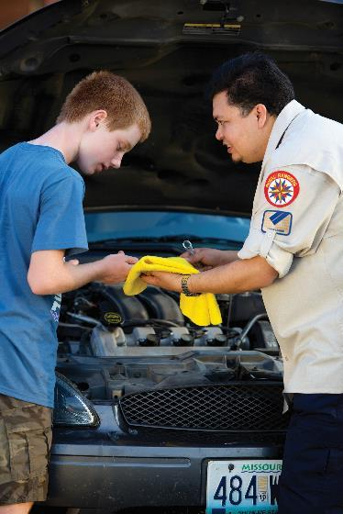
3. Life Skills Development
Variety of topics – something for every guy
Equip boys for success in life & relationships
Utilize the diversity of skills from the men in your church
Builds confidence
Notes:
Include a variety of subjects – diversity, something for every boy
Provide learning and skills development in valuable life skills for guys, things that can actually help them to be successful in life
Personal organization, time management, budgeting, leadership, interpersonal skills, relationships, health & fitness, etc.
Utilize the experience and expertise of all the men in the church, and many from the community
Builds confidence

Slide 10

4. Guy-Focused Discipleship Process
Present spiritual truths in “guy-friendly” terms
Focus on manhood qualities demonstrated in scripture
Provide a comprehensive into to the core messages of the Bible
Notes:
Present spiritual truths in guy-friendly terms – emphasize actions & service over feelings & emotions
Provide truly valuable discipleship training in Christlike manhood
Systematic, comprehensive review of all the core messages of scripture

Slide 11
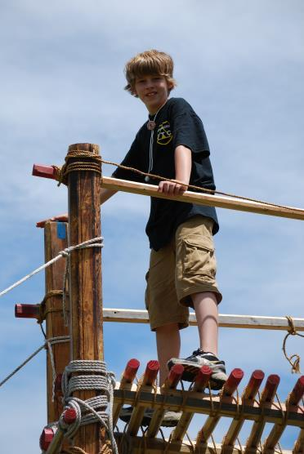
5. Leadership & Personal Development
Introduce common leadership principles
Promote the development of interpersonal skills – working with people
Personal mentoring - How to succeed in life!
Notes:
Interpersonal skills & relationship advice
Career development

Slide 12
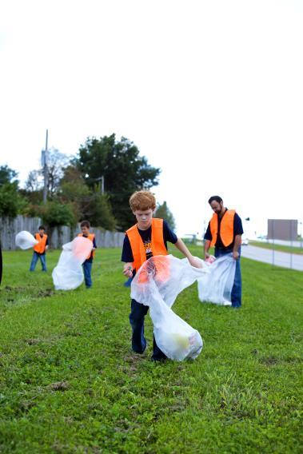
6. Service Opportunities
Live out your faith in tangible ways
Make your world a better place
Personal evangelism
Notes:
Provide a conduit or catalyst to get guys involved in leadership and service to others, to refocus their attention from themselves to the needs of others, and get them actively involved in doing real things for real people.
Involvement in other ministry areas of the church - Kids Church, Kids Camp, Fine Arts, all-church outreach efforts, work days, etc.
Local service projects benefiting the church or community
Missions trips - US and international
Personal Evangelism - I am called to serve and equipped/empowered to share what I have with others

Slide 13
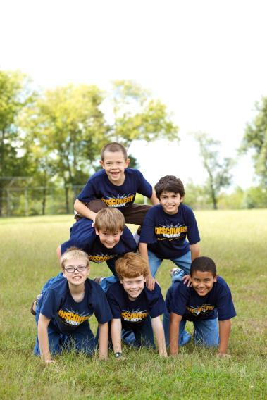
7. Group Identity
Identify as a member of this group
A sense of belonging
Take pride in being part of something bigger than yourself
Notes:
Sense of community, a place to belong (gang)
Sends the message, “You are part of something big & important”

Slide 14

8. Achievement & Recognition Process
Give every boy the opportunity to succeed
Builds confidence
Provide appropriate recognition for accomplishments
“Rites of Passage”
Notes:
Provide healthy competition
Include “rites of passage” ceremonies

Slide 15
Building Blocks for an Effective Ministry to Boys
Community of Christlike Men
Hands-On Activity
Life Skills Development
Achievement & Recognition Process
Leadership & Personal Development
Service Opportunities
Group Identity
Discipleship Process
Notes:
All of these components are included in the Royal Rangers program, but they may also be applied elsewhere. It’s not so important as to what kind of ministry you provide (Royal Rangers vs. something else), but that you provide an effective ministry for your boys.
If you’re interested in starting a Royal Rangers group visit “Startroyalrangers.com” or contact the national Royal Rangers office at “Rangers@ag.org.”

Slide 16





Q & A
Notes:
Questions?

