Slide 1


Annual Program Planning
A Resource for Royal Rangers Outpost Leaders
Notes:
The Royal Rangers program provides churches with a powerful tool for developing boys into Christlike young men. But as with any program, the full benefits are only achieved as the result of a well-planned and well-conducted process. A systematic process of planning and preparation is therefore essential to the success of any outpost.
The following represents a suggested program planning process that can help to insure your outpost is achieving the greatest results of your efforts. The process requires time and effort to complete but it will be time well spent, resulting in a program than that provides leaders, parents, and boys with a roadmap for success while minimizing the stress and challenges of trying to throw things together week by week.

Slide 2
Handouts
Outpost Annual Program Planning (article)
Sample Weekly Program Plan (spreadsheet)
Activity Interest Survey
Skills Resource Inventory
Optimal Activities List
Notes:
You should have each of these handouts in front of you. We’ll review each of them as we progress through the presentation.
The “Outpost Program Planning” article is for future reference for more detailed information.

Slide 3
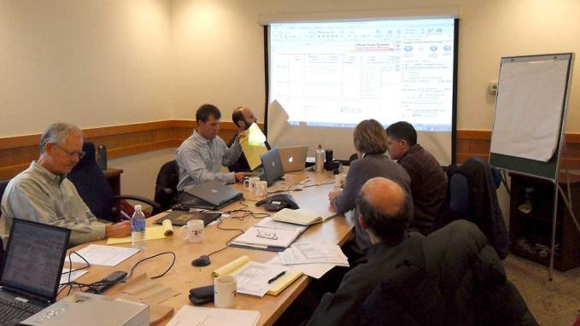
ANNUAL Planning CONFERENCE
Secluded Location – free from interruptions
Include all outpost leaders
Include junior leaders
Notes:
Begin filling out a “Weekly Program Plan” for each age group.

Slide 4

Program Planning Process
Prepare the Calendar
Review Last Year
Brainstorm Ideas
Form the Plan
Make Assignments
Get the Word Out

Slide 5

Step 1: Prepare the Calendar
Collect dates from all relevant sources & add them to a common calendar
Google Calendar
Annual wall calendar
Church events
District, regional, & national events
Community events
School events

Slide 6
Step 2: Review Last Year
Which activities went well & which did not?
Which activities do we want to do again?
Remember: Keep this review time to a minimum since the focus of annual planning should be the coming year.

Slide 7

Step 3: Brainstorm Ideas
Ideas for new activities
Nearby facilities or resources available to us
  Lakes, fish hatcheries, shooting ranges, zoo, museum, theater, etc.
What are our boys interested in?
What skills or interest to the men of our church have to offer?

Slide 8

Program Capability Assessment
BOYS
Activity Interest Survey
MEN
Skills Resource Inventory
Optimal Activities List
Notes:
Refer to these documents:
---Activity Interest Survey
---Skills resource Inventory
---Optimal Activities List

Slide 9
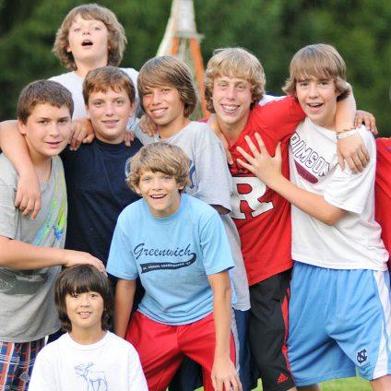
Key Point to Remember
Effective outposts provide activities in ALL core competencies of the program
  outdoors, sports, trade skills, technology, and arts.
Provide something for every boy!

Slide 10
Step 4: Form the Plan
Evaluate each activity & make selections
Define the resources needed – gear, rooms, etc.
Create an “annual program plan”

Slide 11

Step 5: Make Assignments
Enlist men to help, according to the surveys collected
Identify equipment & facilities needed and who will provide each
Enlist parents to help

Slide 12




Step 6: Get the Word Out
Google Calendar
Outpost Web Site / blog site
E-mail Newsletter
Facebook

