Slide 1
Applying the Advancement System

Slide 2


MISSION OF ROYAL RANGERS
Mentor boys into Christlike manhood

Slide 3







SEVEN METHODS OF ROYAL RANGERS
Friendship
Advancement System
Activities
Interactive Learning
Uniforms
Patrol System
Service

Slide 4
ADVANCEMENT SYSTEM
A system designed to challenge boys the way God wired them-
To conquer, to do, to relate, to have fun, to prove themselves
It is Discipleship in-
Leadership, Bible, and life-skills wrapped up in adventure, discipline, relationship, fun, and recognition

Slide 5
MAKING THE ADVANCEMENT SYSTEM WORK FOR YOU
Typical Church Setting
Available Options

Slide 6

AG CHURCH STATISTICS
13,000
58%, <100
32%, <50
<3% , >700

Slide 7
2015 AG CHURCH STATISTICS
Over 13,000 churches in the AG-USA
76% have less than 200 on Sunday AM
58% have less than 100 on Sunday AM
32% have less than 50 on Sunday AM
Less than 3% have more than 700

Slide 8
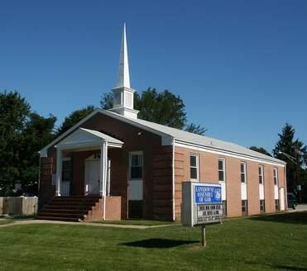
TYPICAL AG CHURCH
100 People = 10 boys & 2-3 leaders
50 People = 5 boys & 1-2 leader

Slide 9
CASE IN POINT
Imagine you are the leader of a new outpost consisting of (1) Ranger Kid, (2) Discovery Rangers, (1) Adventure Ranger, and (1) Expedition Ranger
You have (1) room available to meet in, no pre-existing gear or supplies, and a limited budget
You have (1) other leader to help you, but he’s new to the program and has never taken any training

Slide 10
ADVANCEMENT SYSTEM
The advancement system may represent the biggest challenge for smaller churches
Every age group has a unique advancement trail
Requires significant effort by leaders to prepare, teach, and track each boy’s progress
Potentially highest cost
Let’s consider the options…

Slide 11
ADVANCEMENT SYSTEM OPTIONS
Option 1 | Option 2 | Option 3 | Option 4
No Advancement | Custom Advancement | RR Merits Only | Full RR Advancement
Ignore the RR advancement system Present no awards of any kind Provide “activities” without any requirements or awards Focus on “having fun together” rather than “achieving a set of objectives” | Ignore the RR advancement system Create your own awards system (certificates, buttons, hat pins, etc.) Provide “activities” with awards by writing your own requirements Keep it fun while providing a simple achievement process | Ignore the RR advancement steps and merit color categories Teach official RR skill, leadership, and Bible merits Teach the same merit to the entire group Award RR merit patches but not advancement steps Wear official RR awards vests | Boys earn merits according to the types and colors required for the official advancement system for their age group. Boys earn periodic advancement steps and annual medals. Boys wear RR awards vests and/or uniforms as defined in RR handbooks

Slide 12
ADVANCEMENT OPTIONS - ADVANTAGES
Option 1 | Option 2 | Option 3 | Option 4
No Advancement | Custom Advancement | RR Merits Only | Full RR Advancement
Simple & easy to do Most flexible, no schedules, fixed standards, or expectations Lowest cost | Simple & easy to do No schedules & expectations (other than those you create yourself) Provides some form of achievement & recognition, as simple or complex as you choose to make it Potentially low-cost | Provides a more balanced advancement process, although in a limited format. Merits earned are “transferable” to a full advancement system later, if desired Merit materials, and award insignia are already available. Merits earned are recognized by any RR outpost | Provides the most full & balanced achievement & recognition process Enables boys to earn nationally-recognized pinnacle awards (GMA) All materials and insignia are provided, with no customization required

Slide 13
ADVANCEMENT OPTIONS - DISADVANTAGES
Option 1 | Option 2 | Option 3 | Option 4
No Advancement | Custom Advancement | RR Merits Only | Full RR Advancement
No achievement or recognition process No standard by which to gauge a boy’s progress | Requires effort to create a customized award process Awards would not be recognized outside your church or outpost | Less flexibility - leaders must teach RR merits as written and boys must meet stated merit requirements Moderate cost for merit patches & vests or uniforms | Requires a separate class for each age group since advancement trails are unique Leaders must follow a fixed schedule to insure boys will complete their advancement trail Assumes regular attendance by boys, or a potentially elaborate “make-up work” process Highest cost

Slide 14







KEY POINT TO REMEMBER
Churches of ANY SIZE can have healthy, effective Royal Rangers programs by applying the MISSION and SEVEN METHODS of Royal Rangers within the context of their church and community.
Friendship
Uniforms
Patrol System
Activities
Advancement System
Service
Interactive Learning

Slide 15





GOLD MEDAL OF ACHIEVEMENT REQUIREMENTS
Earn any TWO of the following awards
Read the entire Bible, or listen to it as an audio book
Be at least 12 years old (and not yet reached 18 years of age)
Be an active member of Royal Rangers outpost for at least 3 years
Complete the GMA Capstone Project
Discovery Rangers
Adventure Rangers
Expedition Rangers

Slide 16




GMA WITH MERIT REQUIREMENTS
Earn the GMA
Earn any THREE of the following awards
Ranger Kids
Discovery Rangers
Adventure Rangers
Expedition Rangers

Slide 17
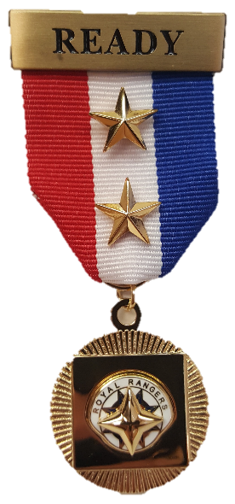
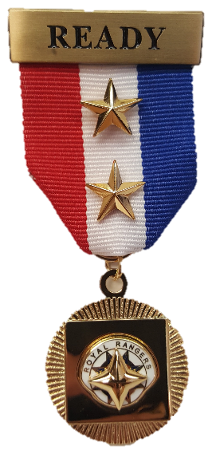
GMA WITH HONOR REQUIREMENTS
Earn the GMA
Earn ALL FOUR of the following awards
Ranger Kids
Discovery Rangers
Adventure Rangers
Expedition Rangers

Slide 18
