Slide 1
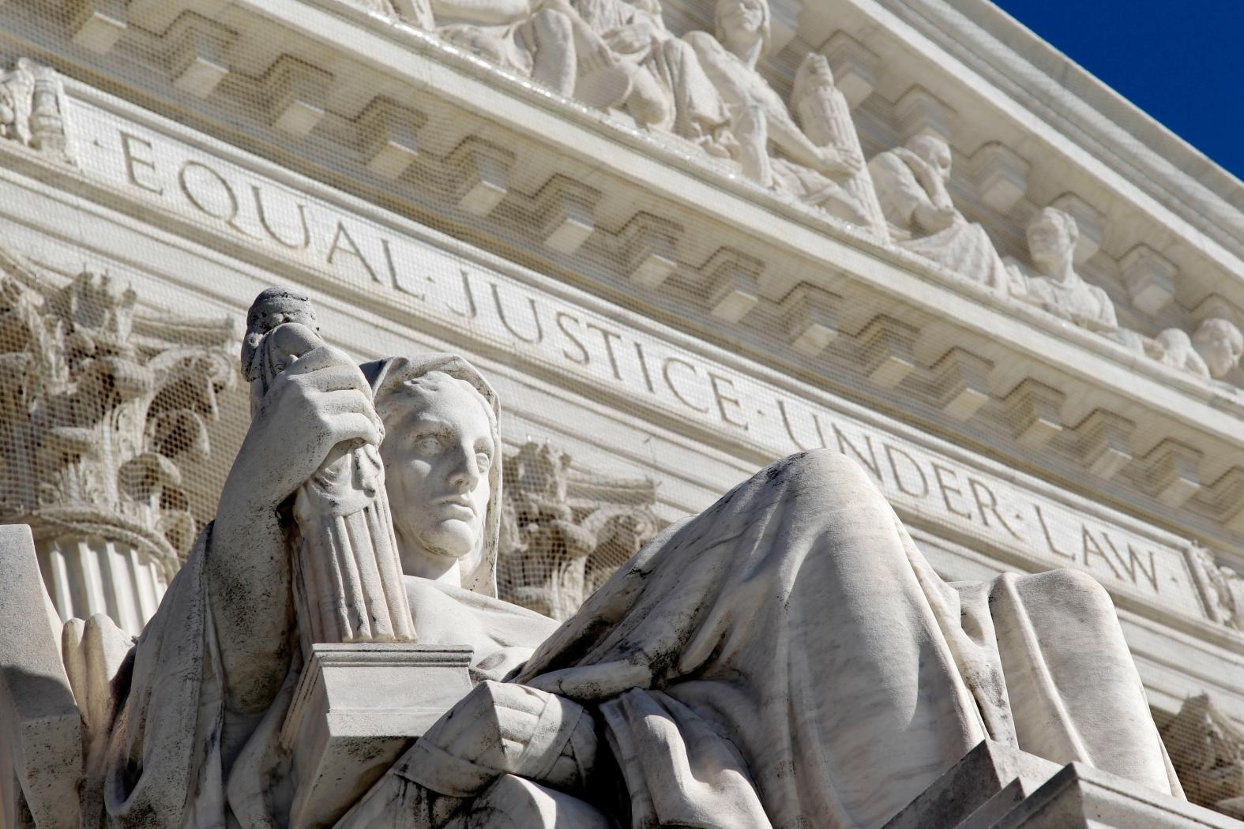
2018 Royal Rangers
National Conference
“Legal Developments in Youth Ministry”
© 2018 Richard Hammar, J.D., LL.M., CPA

Slide 2
seetheglory.com

Slide 3
Issue #1:
Litigation Review
Notes:
I was reading an article on speed reading
12,000 cases per year @ 100-page average

Slide 4
The Top 5 Reasons Religious
Organizations Were in Court in 2016
2016
property disputes 8.7%
sex w/child 8.3%
personal injuries 8.3%
insurance disputes 6.6%
zoning, clergy termination 4.5%

Slide 5
Issue #2:
Criminal Background Checks

Slide 6
a case of immense importance
background
a youth soccer league’s liability
failure to conduct a criminal background check on volunteer coaches
ordinarily no duty to protect others from criminal acts
exception:
“special relationships” including minor participants in sports leagues “based on the vulnerability of children and the insidious methods of sexual offenders,” AND
foreseeable harm
Notes:
“One human being, seeing a fellow man in dire peril, is under no legal obligation to aid him, but may sit on the dock, smoke his cigar, and watch the other fellow drown. Such decisions have been condemned by legal writers as revolting to any moral sense, but thus far they remain the law.”

Slide 7
“defendants had a duty to require and conduct criminal background checks of defendants’ employees and volunteers who had contact with children in their programs”
the risk of pedophilia in youth sports and activities
risk management
An interview.
A written application.
Obtain “institutional references” from other institutions (i.e., churches, schools, youth sports teams) with which an applicant has worked with minors.
Notes:
“One human being, seeing a fellow man in dire peril, is under no legal obligation to aid him, but may sit on the dock, smoke his cigar, and watch the other fellow drown. Such decisions have been condemned by legal writers as revolting to any moral sense, but thus far they remain the law.”

Slide 8
A six-month rule
“Benchmark” church policies by comparing them with the policies of other charities and the public schools.
Adopt a two-adult policy prohibiting a child from being alone with an unrelated adult.
A criminal background check consisting of a nationwide search of sex offender registries, and a national criminal file search. Many denominations and insurance companies offer special pricing for such checks.
NOTE: criminal records checks not sufficient (Florida case)
Notes:
“One human being, seeing a fellow man in dire peril, is under no legal obligation to aid him, but may sit on the dock, smoke his cigar, and watch the other fellow drown. Such decisions have been condemned by legal writers as revolting to any moral sense, but thus far they remain the law.”

Slide 9
Issue #3:
Child Abuse Reporting Update

Slide 10
3 Risks of Not Reporting
criminal (misdemeanor) liability for mandatory reporter
civil liability for mandatory reporter
civil liability for employing church
contingent liability for decades
expanded S/L, discovery rule
Notes:
importance of erring on side of reporting child abuse, e.g., G. Fessler’s call, advised by an attorney NOT to report, privileged communication to a pastor, a confession that he molested his stepdaughter; CA, no mandatory duty if privileged, BUT still report to avoid liability for yourself and church and to protect others; 7 state laws re civil liability

Slide 11
Civil Liability for Failure to Report: State Statutes

Slide 12
Arkansas
Colorado
Iowa
Michigan
Montana
New York
Ohio
Rhode Island

Slide 13
Civil Liability for Failure to Report: Court Rulings

Slide 14
statutes of limitation

Slide 15
44 states recognize the discovery rule in cases of child molestation
policy considerations
persistent risk
insurance policies
retention
insurance archaeologists

Slide 16
Former Penn State president Graham Spanier sentenced to 60 days in prison (plus a year of house arrest) for failing to report allegations of child abuse by Jerry Sandusky
endangering the welfare of a child by not reporting reasonable suspicion of child abuse
prosecutor: Spanier is “a failure as a leader who chose to protect the school’s reputation over the well-being of innocent children”
“I deeply regret that I did not intervene far more carefully” (Spanier)

Slide 17
“this is a fall from grace that is both unfortunate and well deserved” (sentencing judge)
2 other University officials sentenced to prison terms; one told the court during sentencing: “It sickens me to think I might have played a part in children being hurt. I am sorry that I did not do more, and I apologize to the victims.”
relevance to church leaders

Slide 18
Issue #4:
Royal Rangers Litigation

Slide 19
Churchlawandtax.com

Slide 20


