Slide 1

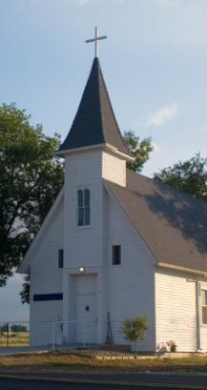


Royal Rangers Program Options
Exploring simpler, easier ways to provide gender-specific ministry to boys

Slide 2
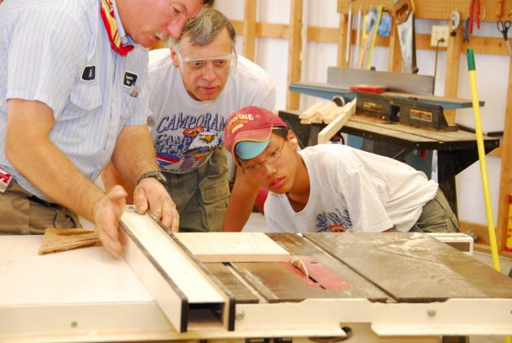
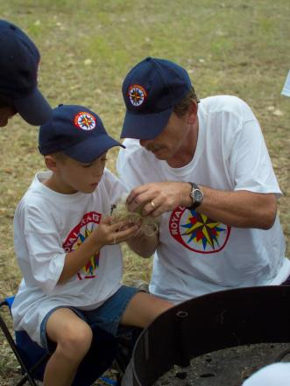
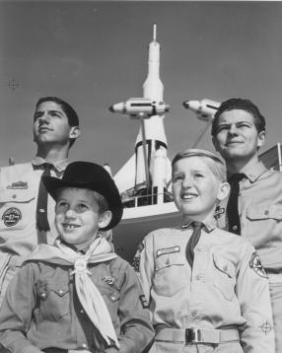
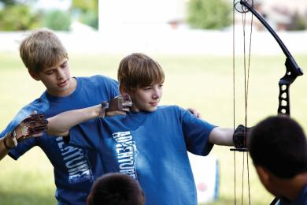
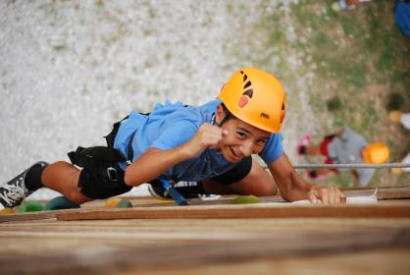
Mentoring Boys Into Christlike Manhood since 1962

Slide 3
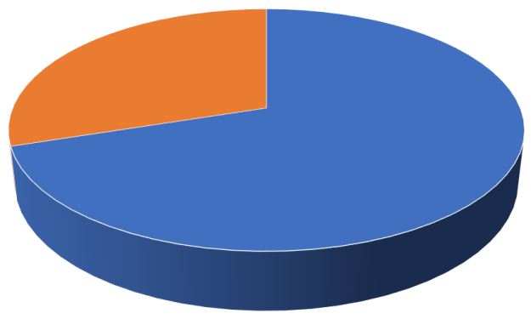
70% of current AG Churches do not use Royal Rangers

Slide 4
Common Perceptions
Too complicated & difficult to understand
Requires too many leaders, too many classrooms, etc.
Requires a lot of leader prep time each week
Expensive – awards, uniforms, gear, etc.
Inflexible – advancement schedules
Requires a lot of record keeping & administration

Slide 5
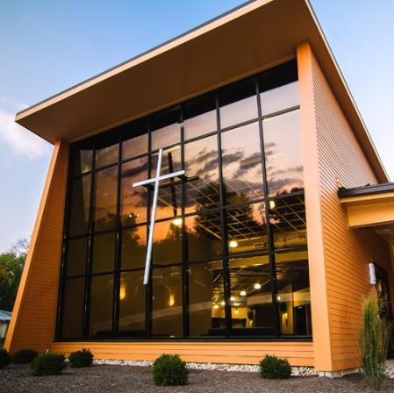
Churches commonly seek ministries that are…
Simple & easy to administer
Require limited resources – money, volunteers, facilities
Minimal weekly prep time
Flexible & customizable – suitable for churches of any size or style
Not dependent on a kid’s regular attendance

Slide 6
How can a church do “lite” Royal Rangers?

Slide 7



The “Lite” Concept

Slide 8
Features Switchboard – “dimmer switches”
Builds Relationships
Leadership Development
Variety of Activities
Hands-on, Inter. Learning
Service Opportunities
Discipleship Process
Group Identity
Weekly Meetings
District & National Events
Award Ceremonies
Patrol System
Uniforms
Advancement System
Junior Leader Training

Slide 9
Royal Rangers Lite
What’s NEW
Simplified / streamlined meeting format
Limited advancement (or none at all)
Reduced cost & resources
Easier leader prep
What’s UN-CHANGED
Gender-specific mentoring
Guy-focus discipleship process
Variety of activities to appeal to every boy
Connected to the “community” of Royal Rangers

Slide 10
A Closer Look
The simplest form

Slide 11

The simplest form of “RR Lite”
All boys together in one group
All boys work on the same materials together
Teach “skills & activities” but not actual RR merits
No awards are presented
Uniform: T-shirts & jeans
Meetings: Opening, Bible Lesson, Skill Activity, Recreation

Slide 12
“Step-Up” Options
1 RR Lite | 2 RR Lite Plus | 3 RR Limited | 4 RR Full Program
All boys in one group | Multiple groups of mixed ages | RK/DR & AR/ER groups | Separate groups
All boys work on same material | Each group works on a different skill, boys choose their group | Groups work on actual merits relevant to their group | Each group follows a unique advancement trail
Teach “skills & activities” | Teach “skills & activities” | Teach actual RR merits | Teach actual RR merits
No awards of any kind | Create your own award certificates, pins, etc.* | Present RR merits (but not advancement steps) | Merits & advancement steps
T-shirts & jeans | T-shirts & jeans, wall charts | Utility Uniforms & Awards Vests | Utility Uniforms & Awards Vests
*Only official RR awards & insignia may be worn on the Royal Rangers utility or dress uniforms or awards vest.

Slide 13

Seven Experiences / Seven Methods
Experience | RR Lite | RR Lite Plus | RR Limited | RR Full Program
Connect / Friendship
Do / Activities
Grow / Adv. System
Learn / Int. Learning
Belong / Uniforms
Lead / Patrol Sys
Serve / S&M Outreach

Slide 14
Advantages & Disadvantages
PROS:
Simple & easy
Lower cost, fewer resources
Minimal prep time
Maximum flexibility
CONS:
No advancement steps (no GMAs)
Limited junior leader development process
Content is less age-specific

Slide 15
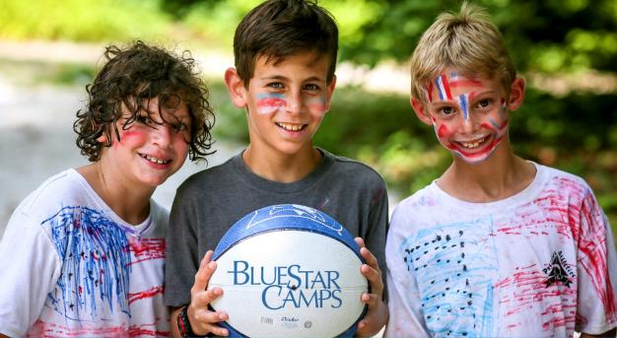

Who Needs Royal Rangers Lite?
Smaller churches
Churches of ANY size who seek a simpler solution
Churches with “stormy” Royal Rangers programs who need a more suitable solution

Slide 16
Key Points to Remember
Royal Rangers Lite is NOT a new program. It’s merely an easier, simpler way of doing Royal Rangers, for churches who need or prefer one.
Royal Rangers Lite IS Royal Rangers. Churches who choose conduct their program in this manner should still be considered to be official Royal Rangers groups.

Slide 17
Royal Rangers
Providing EVERY church with viable solution for reaching EVERY boy

