Slide 1
Starting a New Outpost

Slide 2
Overview
Quick-start Guide
Lost & Restored Visions for Manhood
Royal Rangers
The 7 Experiences
Outpost Activities
Resources

Slide 3
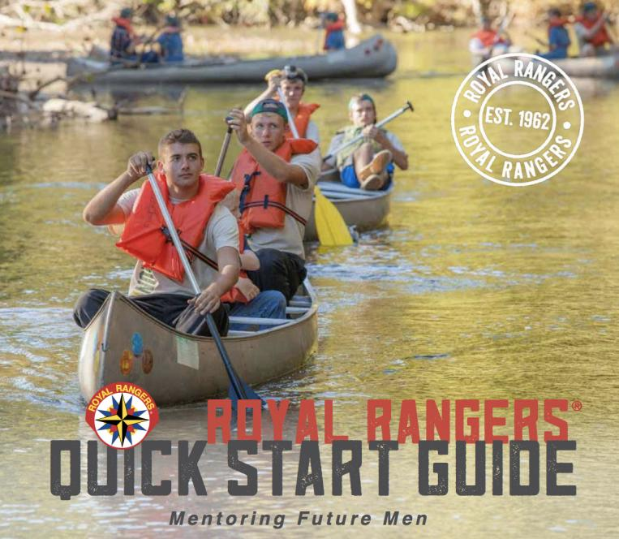
Notes:
Image above hyperlinked: http://agwebservices.org/Content/Resources/Quick%20Start%20Guide%202016.pdf

Slide 4
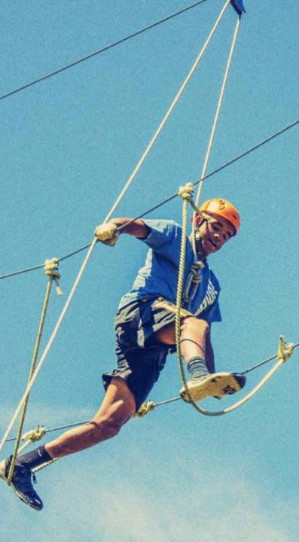
Lost Vision for Manhood
Compared to girls, boys are:
3x more likely to be registered drug addicts
4x more likely to be diagnosed as ED
6x more likely to have LD(s)
12x more likely to commit murder
Today’s situation presents many challenges, but there is a clear way forward…

Slide 5

Restored Vision for Manhood
Task
Character
Adventure
The Royal Rangers program is a platform that empowers your church to mobilize, inspire, and restore men to mentor today’s boys– tomorrow’s men– with a vision for godly manhood.

Slide 6

What is Royal Rangers?
It is an activity-based, small group church ministry for mentoring future men, with a mission to evangelize, equip, and empower the next generation of Christ-like men and lifelong servant leaders.

Slide 7
What is Royal Rangers?
Grades K-2
Discovery Rangers
Grades 3-5
Adventure Rangers
Grades 6-8
Expedition Rangers
Grades 9-12
Ranger Kids

Slide 8
The 7 Experiences
friendship – activities – advancement system – interactive learning – uniforms – patrol systems – service & ministry outreach

Slide 9
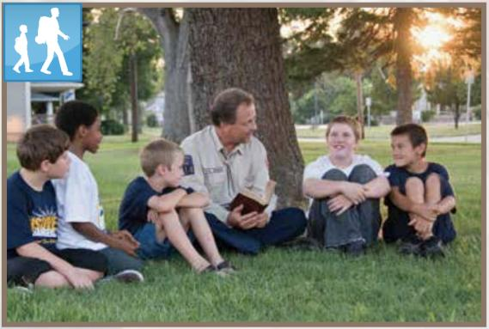
Friendship connect with a community of Godly men
1
Making it Work for You
Location
Frequency
Format
“Masculinity is bestowed. A boy learns who he is from a man and from the company of men in his life.”
– John Eldredge, Wild at Heart
Notes:
My wife often says, “You have to be a friend to make a friend.”
Introduce yourself.
Teach the boys the Red Leadership 101 – Hey, What’s Your Face!
Not only be a friend but be a mentor, leading them on their journey to Christlike manhood and servant leaders.
Men of commitment – Be fully devoted to your spouse, family, work, pastor, church, and ministry. Commitment requires self-discipline to finish the race.
Determination to start things and see them through, and responsibility to be a person people can count on.
I have Rangers who come up to me from many years ago:
(Richard L. moving away)
Boys without Dads come to us to ask questions that they will not ask their Moms.
(Ed - no dad, got into trouble, drinking)
Others centered – get known in the community as you share Jesus with them.

Slide 10
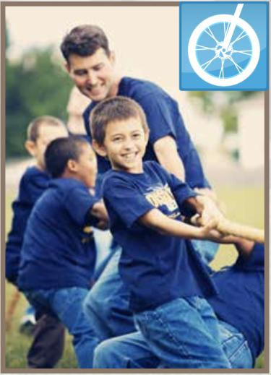
Activities do fun things together
2
Making it Work for You
Make a list of activities boys in your community have in common
Make a list of activities men in your church have the expertise to provide
Compare
“Men and boys are changed by what they experience together, not necessarily by what they are told.”
– David Murrow, Why Men Hate Going to Church
Notes:
Built a ramp for an older member of the church.
Cut brush out of a widow’s back yard.
Moved storage and helped both Pastor and Marie.
Cmdr Michael not interested but taught computer class, still there!
Simeon came to Pow Wow just to help, never missed one since
Christian lost dad, troubled, at camp needed confirmation, help cook, biscuit.
Recently we attended a Marietta College basketball game. (Josiah’s story)

Slide 11
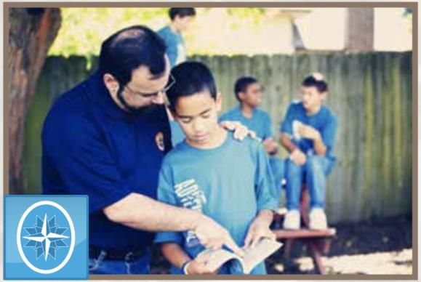
Advancement System grow in Christ-like manhood
3
Making it Work for You
Honoring boys and respecting budgets:
Medals, ribbons, patches for uniforms
Medallions, coins, certificates
The system intentionally connects the Royal Rangers discipleship process to the boy’s journey to manhood– adventure, character, and task.
Notes:
Skill Merits:
Blue representing basic skills
Green representing intermediate skills
Silver representing advanced skills.
TRaCclub is the online resource delivery system.
Leadership Merits – teaching leadership skills and teamwork.
Bible Merits – 30 are available; 15 each in grades 3-5 and 6-8
Luke lived to “earn” merits.
Simeon drifted through just to hang out with guys, all way through RR, never interested in actually “earning” merits but because we documented advancements, he found out he was just a step away from GMA!
Jonathan joined the Marines, on patrol in abandoned area found eggs and chickens, taught the others what he learned in RR – how to cook!
Someone once said I don’t want to be stuck with a Legalistic Curriculum.
I don’t think so.
It is only so IF we as leaders allow it to be.
I choose not to allow that to be the case.
I choose to allow our curriculum to be a “guideline” to making sure our boys and young men have fun and get dirty!
They think they are just having fun, so let’s just keep that our own little family secret!

Slide 12
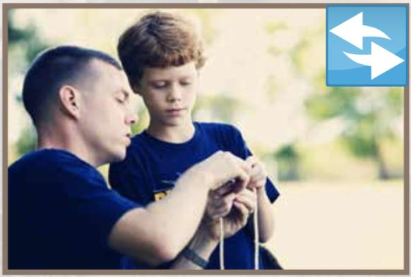
Interactive Learning learn in fun, hands-on ways
4
Making it Work for You
Built-in activities in the merit requirements
Variety of options to match boys’ interests
Boys learn best when they hear instruction, see it demonstrated, immediately do it themselves, and have the opportunity to teach others.
Notes:
Noted Christian writer John Maxwell says, “A leader must know the way if he is to show the way.”
When I was young my Dad showed me – I can do it!
Let them make mistakes (safely) but I guarantee you won’t forget touching that hot stove if you remember that it really is HOT!
Allow boys to choose what they want to do, while you are leading them in the direction to earn prescribed merits towards RR award goals.
IF we as leaders plan, encourage and lead the boys, they will grow not only in wisdom but in God’s love as well.
And you know what, so do the LEADERS!
Stories by the dozens of the “getting dirty”.
Walking to breakfast at Pow Wow, Cmdr leading around the mud, boys tramping through the mud!
Encourage boys to invite friends, earn merits, and serve others.

Slide 13
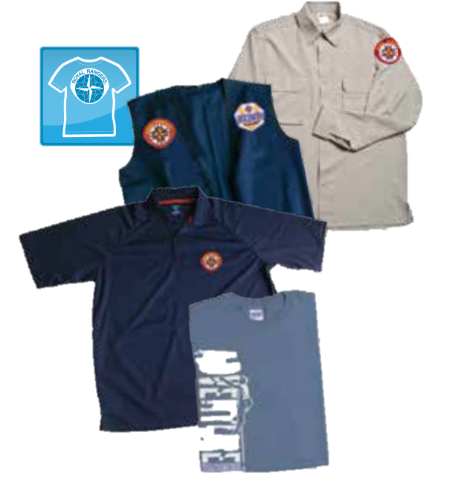
Uniforms you belong to something big
5
Making it Work for You
Creates a sense of belonging
Reflects the culture of your church
utility uniform, sports jerseys, t-shirts, awards vests
Notes:
I’m all about options!
Formal – for adult leaders only
Dress – adult leaders, ER, AR
Utility – standard, recommended for all leaders and age groups
Special – custom option for the local group, my favorite! I promote wearing our Outpost uniform – THE OP T-shirt
Cost effective, because boys grow!
Awards vests – supplemental uniform item which allows boys to display all of the awards, training patches, and event patches they have earned in their current age group. And may be worn with any of the above or by itself! Vests are a great option.
Then move up to an official RR uniform as boys get older and slow down growing.

Slide 14
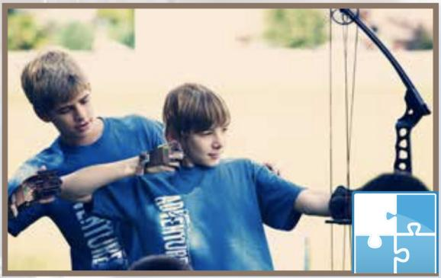
Patrol System lead yourself and others
6
Making it Work for You
Goal: Support boys as they stretch & grow as leaders
Assign boys responsibilities
Encourage boys to help plan and lead meetings, outings, and service projects
Notes:
My wife often says, “You have to be a friend to make a friend.”
Introduce yourself.
Teach the boys the Red Leadership 101 – Hey, What’s Your Face!
Not only be a friend but be a mentor, leading them on their journey to Christlike manhood and servant leaders.
Men of commitment – Be fully devoted to your spouse, family, work, pastor, church, and ministry. Commitment requires self-discipline to finish the race.
Determination to start things and see them through, and responsibility to be a person people can count on.
I have Rangers who come up to me from many years ago:
(Richard L. moving away)
Boys without Dads come to us to ask questions that they will not ask their Moms.
(Ed - no dad, got into trouble, drinking)
Others centered – get known in the community as you share Jesus with them.

Slide 15

Service & Ministry Outreach serve your family, church, and community
7
Making it Work for You
Leaders must model
Create a list of ideas to help boys at every age level know how they can impact their family, church, & community
Notes:
Ranger Derby – fun, craft, exciting, competition, strong positive relationships
Local school – Talked to Principle of nearby elementary school – we will provide precut derby car kits, school will use them as art, math, science, spelling projects. We will set up track in gym on a Saturday and race every car whether student is there or not.
Talked this up and have received donation for track, then a track was donated so we purchased a great starter and timer for track.
Auto Checkups & Maintenance Clinics – The Expedition Rangers learned to change the oil and tires on cars (Matthew’s Mom flat tire – He said no problem Mom, I’ll change the flat), Did an oil change for single Moms during Sunday morning service as a community service project and it grew into a Royal Rangers AND Men’s Ministry event!

Slide 16
Typical Outpost Activities
Weekly Meetings
Bible devotions
Regular Outings
Annual Planning
hands-on activities
recreation
student leadership development
community events
RR district events
training events
National Camporama
Service Activities
2+ per year
meet the needs of others
share Jesus
involve boys, parents, church leaders
Create a balanced annual program
Notes:
Why be typical, think outside the box!
Father Son Campout – Friends Only Campout, GI Joe Campout (be creative),
Sports Demonstrations, Clinics, and Camps – Trey asked me to watch him play football,
We took 12 Rangers to Marietta College Basketball game (Compliments of Blacks Tree Service) (Josiah said I’m not going)
Concerts and Drama – Matthew asked me to come watch him in a play

Slide 17

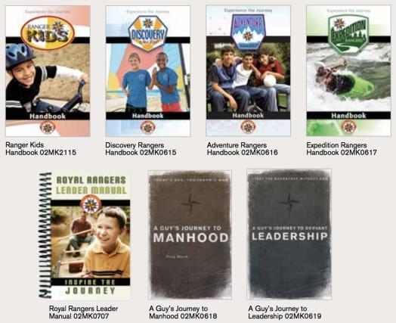
Resources for the Journey
Curriculum
TRaCclub Online Portal
Printed handbook and leader manual
A Guy’s Journey
Notes:
Budgets seem to always haunt us, so one way is to purchase one of each handbooks (unless someone wants to purchase their own) and use TRaCclub to print off the lessons you need for each meeting.

Slide 18
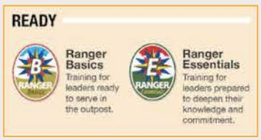

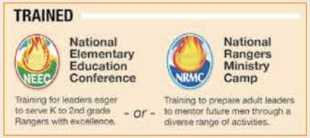

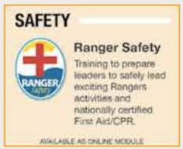
Resources for the Journey
Training
The Outpost Advancement Levels are sponsored by the district and national RR offices
4 levels of development
Notes:
Budgets seem to always haunt us, so one way is to purchase one of each handbooks (unless someone wants to purchase their own) and use TRaCclub to print off the lessons you need for each meeting.

Slide 19
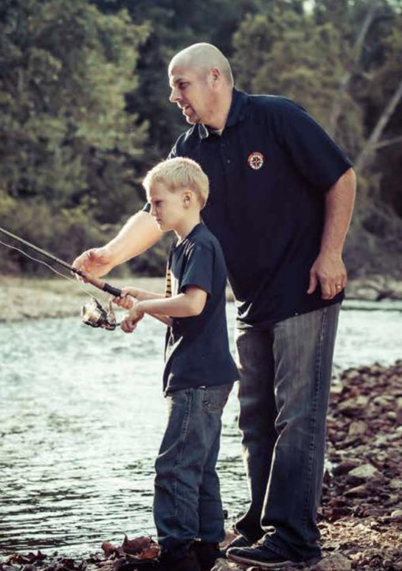
Resources for the Journey
Promotions
National RR office provides resources to help outposts promote participation inside and outside the church
Partnerships
The RR program complements the ministries of your church
National Girls Ministries
Men’s Ministries
Children & Youth Ministries

Slide 20

Notes:
Image above hyperlinked- http://startroyalrangers.com/start/
I’d like to share a story of Vision and Renewal at River of Life Church. Not just a restoration but a brand new start-up of a RR outpost. There had not been Rangers for more than 15 years, certainly not in the last 3 Pastor’s tenor. It is also the experience of church growth because of the lives of boys touched in Marietta, OH.
It sure would have been easy to sit back and rest on what had been accomplished – you know kind of retire … when I moved to Ohio. I even mentioned it to Maggie and she said, “Yeah well let me know how that works out for you.”
And of course she’s right, I cannot sit back and see boys fall by the wayside! I have a calling on my life, a scripture given to me when I asked God what He wanted me to do in ministry. Isaiah 55:4 “Behold, I have given (you) him for a witness to the people, a leader and commander to the (boys) people.”

Slide 21

STEP 1: Learn
Royal Rangers is a mentoring program for future men. We provide Christlike character formation and servant leadership development for boys and young men in a highly relational and fun environment. Our mission is to evangelize, equip, and empower the next generation of Christlike men and lifelong servant leaders.
Notes:
In our case I have 40 years’ experience, so I’m very familiar with the ministry.
Accomplish the mission – to evangelize, equip, and empower the next generation of Christlike men and lifelong servant leaders.
Vison that includes the evangelism of today’s boys and the discipleship of tomorrow’s godly men.
Win your Pastor over:
Pastor Ted – Territorial Rendezvous, took him before he was a RR. This past spring he completed his Wilderness advancement.
Pastor George – went to meeting about the drug epidemic in WV and OH and was passionate about restoring the young men who had life controlling addictions. I said to him, “If we start the RR ministry in your church we could help prevent this from happening to them before it starts.” He said, “I know very little about RR, but you do, OK, let’s do it.”
One man said to me that you cannot do Rangers in that neighborhood, those boys have no money, and there is no way they can pay for anything. They are rough kids. I said those are exactly the boys that ‘need’ Rangers.
RR Leaders MUST support the pastors’ vision, not think RR is the only ministry that is important. Serve your pastor and the church; help serve or cleanup at potlucks, setup at events (Easter spread the eggs, Thanksgiving deliver the turkeys

Slide 22
STEP 2: Enlist
Cast the vision.
Promote & explain the program.
Define the parameters for leaders.
If potential leaders are hesitant to make open-ended or long-term commitments, ask for short-term commitments.
Information concerning the leadership positions in RR and the duties and responsibilities of each can be found in the Royal Rangers Leader Manual.
Notes:
Communicate with Pastor, ask who he would suggest
Talk to the men and/or women
Explain the requirements of leadership
Background checks are a must

Slide 23
STEP 3: Equip
Conduct an informational meeting & orientation
Gather your team together for a time of learning & vision casting
Explain the mission & purpose of the program and the role each leader plays in accomplishing that mission.
Focus on instilling your vision and inspiring your team to see the possibilities for all God can do to impact your church & community through your RR program
Do not overwhelm new leaders with too much information early in the process
Notes:
Get them involved in Leadership Training – at Life360 we had 21 students and 17 were from our church (Cmdrs and Pastors). At ROL we had Pastor G and 2 leaders for RB.
Training for Leaders, and boys.

Slide 24
STEP 4: Plan, activities & budget
Define the mission and objectives for your RR program
Define the specific attributes of your program – uniforms, leadership titles, group structure, meeting day-time-location, etc.
Plan your first year program for all groups
Determine how you will promote your program, keeping parents & the community informed of ongoing progress and upcoming events
Notes:
Have a pre-meeting, church or at home to be more relaxed and welcoming.
Bring ideas to your boys, then let them help you choose the events they want to do, much better results.
BB guns, basketball, what interests Your boys?!
Well organized
Develop a calendar that includes church activities and outreach, local events, area, district and national RR events.
Use the calendar but be flexible
Incorporate local events
Join other outposts, Areas, District, National
I asked, “What is my budget?” Pastor said, “I will establish a checking account for RR, whatever you put into it is yours.” I will work with that, don’t get stuck in a box!
I shared our new outpost plan with my Mom, she donated her aluminum can money for our charter
Others have caught the vision, and share not only financial needs but in other ways as well, especially the victories!

Slide 25
STEP 5: Resources
Basic Essentials
TRaCclub
Royal Rangers Leader Manual
Royal Rangers Program Poster
Advancement Awards Chart
Notes:
Hyperlinked image to resources
Ask for donations, don’t be bashful
Start fundraisers
Use whatever you get, donations of money, supplies, etc.
The more others see your excitement and that you use what God provides, you will get more
Something scriptural about that – shaken down and overflowing…

Slide 26

STEP 6: Promote
Promotional Resources
General Promo Brochure
Personal Invitation Card – Elementary Boys
Personal Invitation Card – Teen Boys
Royal Rangers Program Poster
Royal Rangers Promo Poster
Notes:
Talk it up at church, tell friends, family, work
Posters
Yard signs
Flyers
Handouts
Postcards

Slide 27

STEPS 7 & 8: Launch & Maintain
Make sure your first meeting is a good experience for everyone
Include opportunities for everyone to get to know one another
Provide a clear vision
A guide for your first 3 meetings is available to assist you
Notes:
Launch
Plan a day way in advance
Make a big deal out of it
Welcome the boys
We started with only 1 boy in our church
2 came first night
Next week, 2 more came
Now sometimes 10 or more!
Maintain
Produce desired results – Providing boys with a fun environment (by activities), growth (by the advancement system), as well as leadership skills and others.
Plan and conduct exciting meetings and activities in which the boys will learn.
Establish constant and regular communication with Pastor, Cmdrs, boys, parents, and other leaders.
We call or text Pastor from every event with updates on what is going on
Use newsletters, emails, phone calls, social media (Facebook, etc)

Slide 28
Q&A

Slide 29
Recommended Readings
Wild at Heart ~ John Eldredge
Raising a Modern Day Knight ~ Robert Lewis
Bringing Up Boys ~ Dr James Dobson
Guys Journey to Manhood ~ Doug Marsh
Guys Journey to Servant Leadership ~ Doug Marsh

