Slide 1
Unpacking TRaCclub

Slide 2

What is it?

Slide 3
The Rangers Curriculum Club - RR online resource delivery system
This is your go to place for just about everything you need for your weekly meeting.
Weekly Meeting Guides
Skill Merit Activity Guides
Bible Lessons
Leadership Merits
Boys’ Worksheets

Slide 4




Tracks
Leader
Resources
Notes:
These are the tracks that are available in TRaCclub.

Slide 5
Leader vs. Group
What is the difference?
Leader Track: bonus material and resources for any leader
Group Track: age group curriculum – leader lessons plans & boy worksheet pages
Notes:
This is a common question received at the national office. This slide explains the difference between the Leader Resource Track and the Group Tracks.

Slide 6
What do I get w/Membership?
1 year of curriculum per classroom
48 Weekly meeting Guides (RK, DR, & AR)
16 Achievement Awards (RK only)
16 Bible merits (DR & AR only)
48 Spirit Challenges (ER only)
15 Skills merits (DR, AR, & ER)
3 Leadership merits (DR, AR, & ER)
Each item is a credit to be used.
Notes:
There is confusion on what a year’s membership means.
Some think that means access to everything in TRaCclub for a year.
However, there are limits on each age group for what is in the year membership.
That information is listed on the home screen for each age group.

Slide 7
How do I sign up?

Slide 8
Go to tracclub.org
Click Purchase or Setup Account button
Click Purchase Now
You will need:
A valid credit/debit card
Name and email address of user you are registering
Outpost number and District OR GPH Acct. #
Used to verify charter discount!

Slide 9
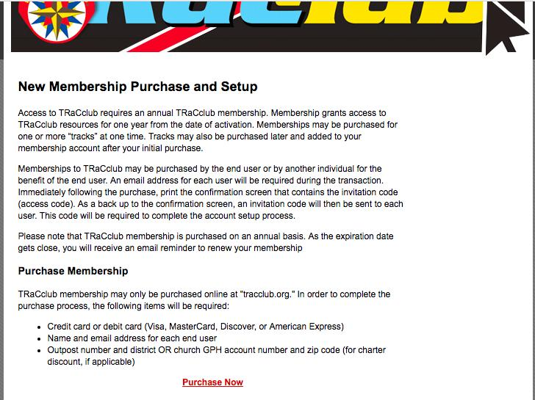
Click Here!

Slide 10
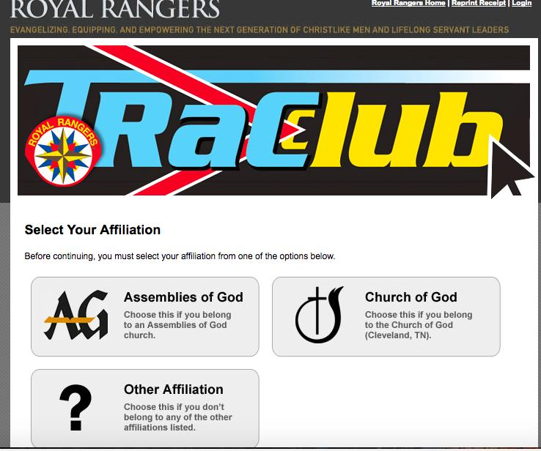
Notes:
Church of God church that charters in the AG district:
In these instances, the church affiliation listed in the charter database (COG) will not match the district name (AG district) the church is chartered in.
They will not be able to get their discount because the verification programming can’t find them.
They need to call or email (rangers@ag.org) the national office for their charter discount to be refunded.

Slide 11
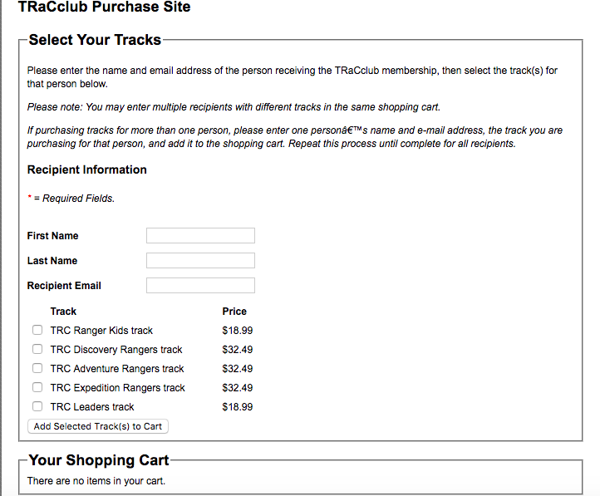
Use the information of the person who will access the track
Don’t forget to add the tracks to your cart.

Slide 12
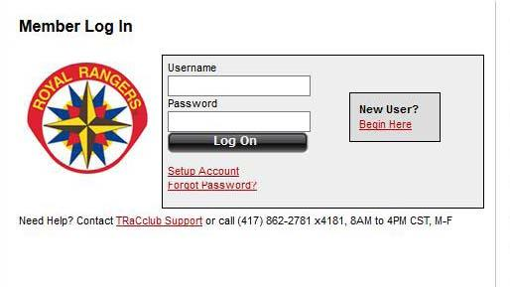
I Purchased my Track(s)...
Now, check your email for your invitation code
Once you have it, click on set up account
Notes:
This is short cut to the Purchase or Setup Account button. The Setup link on this page will bring people to the Login Screen.

Slide 13
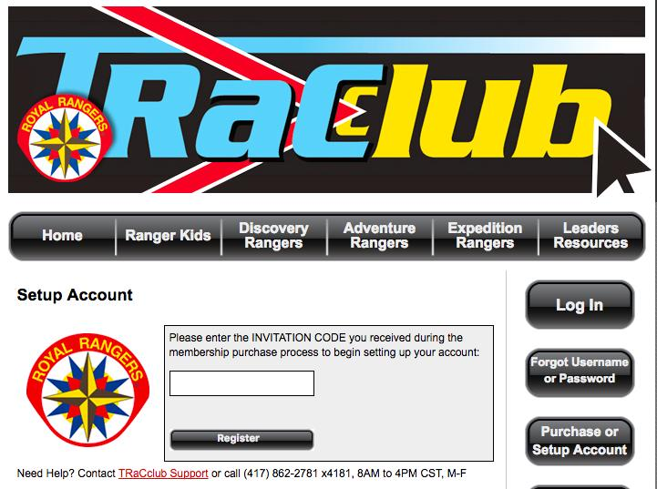
Enter the code as it appears (all capital letters, numerals, & dashes).
Click here to activate
Notes:
It is imperative to enter the code as it appears (all capitals letters, numerals, and dashes).
If the user copies and pastes the code, he needs to be sure there are no spaces at the beginning or end of the code.

Slide 14
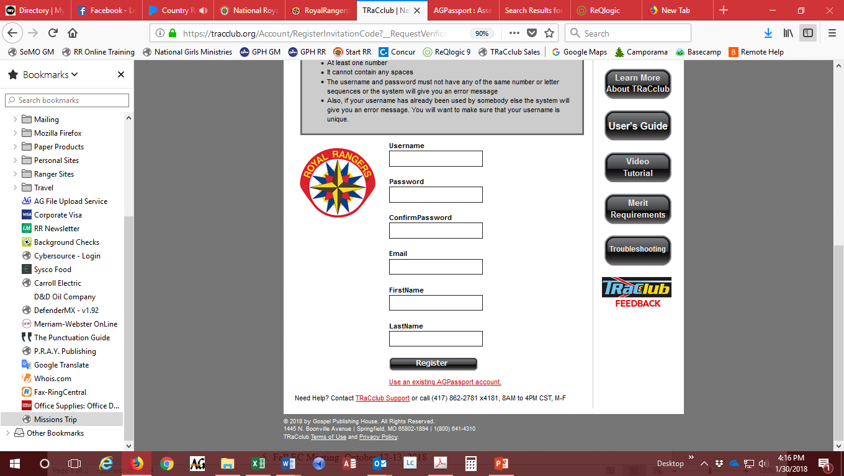
Notes:
Hints that may be easy for leader to remember
User name hint: some form of the church name
Password hint: Rangers+OP# (Rangers105) (This format meets all of the criteria for the password.)
User name & Passwords are case sensitive. They way they are entered during account setup is the way they have to be entered every time!!!
Email: AGPassport runs in the background of TRaCclub to provide user name and passwords.
They updated there system in the fall of 2016 to only allow an email to be used 1 time.
The error code for using an email that is already in use in AGPassport is “Error Code 308.”

Slide 15
Create a user name & password. Add an email and name to the account.
What Name on should be on the Account? The name of the account becomes the copyright holder of the curriculum. This should be the church.
Notes:
Account name is a big issue when a leader leaves the church and the account is in his name.
It becomes especially difficult if he leaves under less than good circumstances.
Always encourage the account be in the church name.
(Exception: If the leader buys the curriculum exclusively for his personal use and doesn’t get reimbursed by the church.)

Slide 16
First Assembly of God
Springfield, MO

Slide 17
Click “Register.”
Accept the Terms of Use.
Welcome to TRaCclub page.

Slide 18
How do I use my Membership?
Each time you activate an item, you use a credit that is tracked on the Dashboard (counter). When you reach 0, you have used all your credits for the year.
Notes:
Once an item is activated, it can be viewed or printed numerous times throughout the term of the membership.
However, it only uses 1 activation credit.

Slide 19
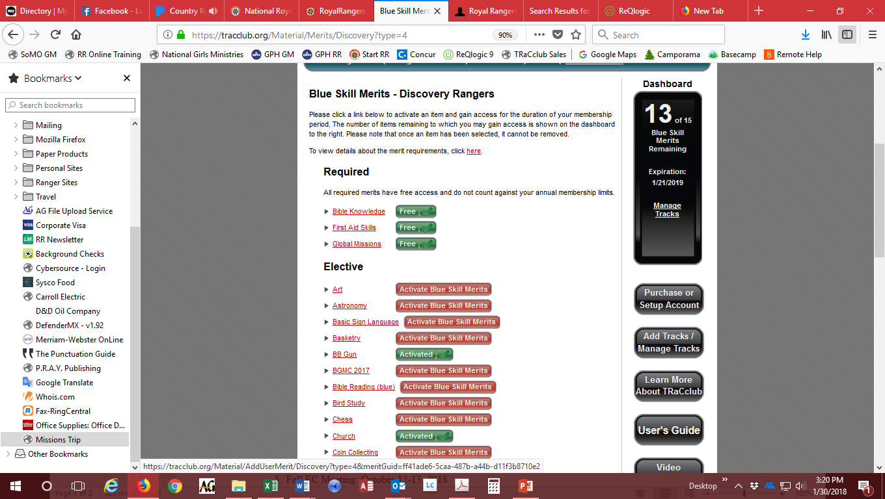

Slide 20
Now that I have all of this amazing material, what do I do with it?

Slide 21
Step 1: It all starts with planning
Before TraCclub, leaders would have to spend many hours preparing for the meeting.
Most of that time was spent researching the information needed for skill merits and writing Bible studies.
Now, leaders can spend their time focused on effectively mentoring the boys.
That planning starts early.

Slide 22
Planning for the year
Spend time with the Group Leadership Team (men and boys) before the year starts.
RK Planning
Pick a year (Elk, Wolverine, Courgar) and follow the weekly meeting guide.
You can do the same year for K-2.

Slide 23
Planning for the year continued
Plan the following for DR/AR/ER
2 Leadership Merits
4-6 Skills merits (depending on how many meetings you have)
Include 1 Required Merit
6-8 Bible Merits (30-40 lessons), 30-40 Spirit Challenges for ER
Make sure you are tracking what you do (Navigator is a huge help!)
Prevents boys from repeating merits
Notes:
Look at requirements before activating. Talk about what this looks like in an outpost not in full program mode.

Slide 24
Planning for the weekly meeting
You need to have a GLT Meeting prior to the weekly meeting
Most of the time, this is at the end of the night
Review what went well, what didn’t go well
Plan for the next meeting using the meeting guide

Slide 25
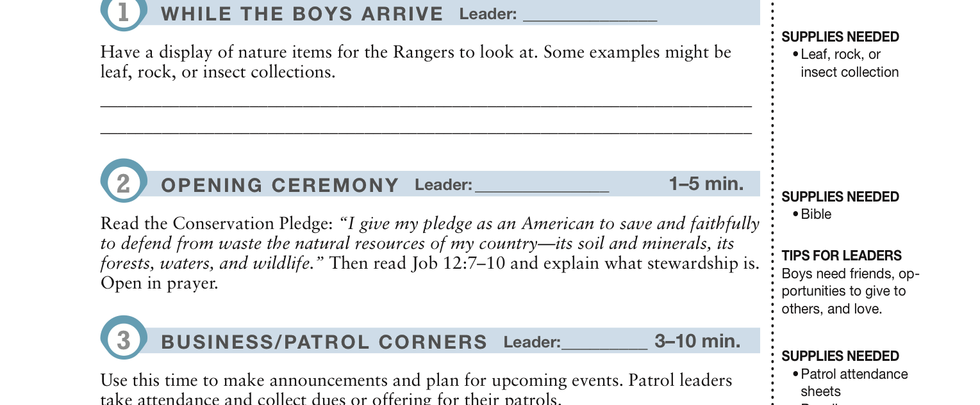
Assign the leader
What you need
Read these! They help.

Slide 26
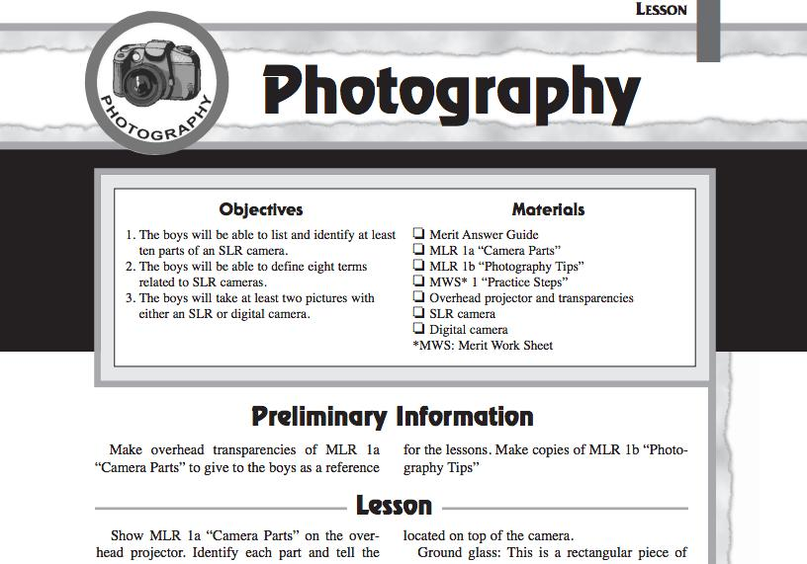
What you need for the lesson

Slide 27
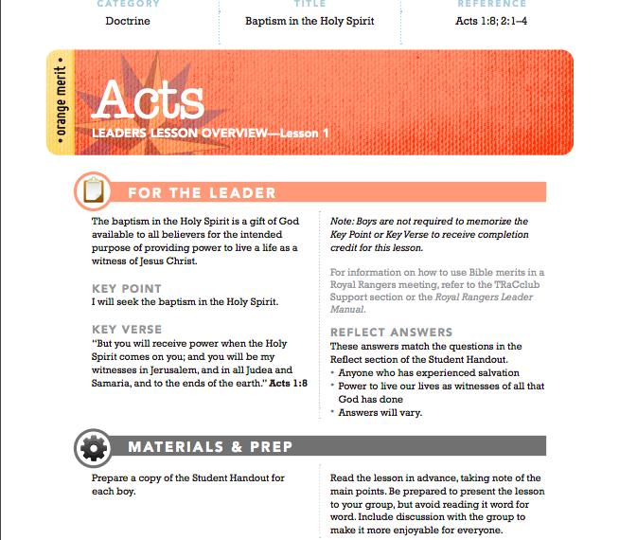
Big picture
Key information for you
What you need
Notes:
Read this before the meeting!!! You will engage the boys on issues they face today and need to be ready.

Slide 28
Application
Get into groups of five
Take 7 minutes and plan our meeting for next week
Pay attention to the strengths of the leaders in your group
Include boys in age appropriate leadership

Slide 29
Step 2: Meeting night
Remember, all of these resources are guides. Don’t read them word for word.
Make sure you teach what is there, but make it your own.
Boys do not want to be read to all night
You also do not need to do all of the teaching, let the boys teach also
Be as hands on as possible
Have fun!

Slide 30
Step 3: Leader’s Resource Track
Age group Tracks are the key to your weekly meeting.
The Leader’s Resource Track is the key to the long term growth and success of your outpost.

Slide 31
How to use the Leader’s Resource Track
Junior Leadership Foundations: This is how you teach your boys about leadership in the local outpost
Helps with training and boy leadership selection
Resources: Devotions, games, crafts
Preventing Child and Substance Abuse

Slide 32
Challenges, Questions, & Secrets
Lost Password
Can’t Login
Old Leader Name on Account
Forgot User Name
Out of Access (credits)
Leader Manual vs. Leader Track
Merit Requirement Button
Notes:
Lost Password: If the email address has only been used for 1 account in AGPassport, use the forgot password link to reset the password.
This is usually not the case.
Can’t Login: There are a couple of reasons.
Usually this is a browser issue. I generally have people use Mozilla Firefox for TRaCclub, and they seem to have the issues the other browsers have. If you don’t want to use Firefox, the browser is most likely an old version that needs to be updated. If that browser is updated, it should solve the problem.
The user name and password are either being typed in wrong (case-sensitive) or are just wrong.
Old Leader Name on Account:
If the relationship with the former leader is good, then wait until the tracks expire. When you purchase the memberships for the new year, create a new account in the church’s name.
If the relationship is not good, call the national office.
Forgot User Name: Call the national office. It may take a while to figure it out, but we can usually find the user name.
Out of Access (credits): There are a couple of reasons why you would run out of access
Running more than 1 classroom from a single track. This will cause the user to run out of access part way through the year. One solution is to contact the national office to have the current membership expired early, purchase the new membership, and add it to the account. Another solution is to set up an account for each classroom.
A leader has opened merits that will be used that year. See Merit Requirement Button info.
Leader Manual vs. Leader Track: These are different. The Leader Manual explains Royal Rangers, the groups, advancement, structures, etc. to the leader. The Leader Resource Track is bonus material that any leader can use—attendance records, extra artwork, get to know your Ranger forms, gear checklist, camping or outing checklists, etc.
Merit Requirement Button: Most well kept secret on TRaCclub. When you click this button, it takes you to royalrangers.com where all of the skill merit requirements have been listed since 2002. You can open any of these to see what requirement will be taught. (This is not lesson plans or answers.) Once you determine shat skill merit you want to teach, you can open it in TRaCclub.

