Slide 1


Slide 2

Royal Rangers Leader Manual
2019 Edition

Slide 3
Key Features
Full-sized 8.5” x 11” format, 3-hole punched
Separate 3-ring binder – multi-purpose use
Core content printed, supplemental on TracClub
2-year membership to Leaders Resource Track
Minimal color & artwork - easy printing of updates
Pages numbered by chapter
Notes:
This new manual follows the format we presented in the last two national conferences:
---Full-sized, 3-ring binder format – allows for easy updates
---A separate full-color binder is also available for use with the manual and/or as a separate binder for TracClub content, outpost records, etc.
---Core RR content is included in the printed manual, with supplemental content being available online via TracClub (includes TracClub code for 2-yr membership)
---Updates will be posted online in TracClub as they are released
---Minimal color & artwork to reduce the cost of printing updates & supplemental materials at home
---Pages are numbered by chapter (rather than continuous) to facilitate updates without renumbering the entire manual

Slide 4
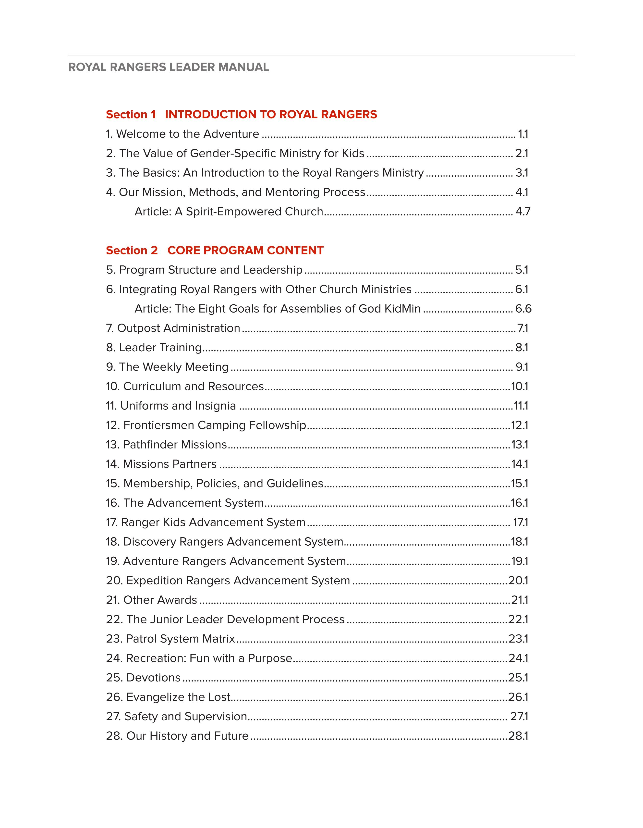
Table of Contents
Intro to Royal Rangers
Core Program Content
Supplemental Content on TracClub
Notes:
Content organized into (3) sections
---Intro to RR – program overview without all the details. Suitable for a pastor, etc. who wants a basic intro to the program.
---Core Program Content – important details for RR leaders
---Supplemental Content on TracClub – use as needed

Slide 5

Section 1
Welcome to the Adventure
Value of Gender-Specific Ministry for Kids
The Basics – an intro to RR
Mission, Methods, & Mentoring Process
Notes:
Chapter 1 - Establishes that RR is a ministry, fulfilling a valuable role in the larger mission of the church
Chapter 2 - We must provide an answer to the “why” or we become irrelevant to church leaders. Why is gender-specific ministry important? Why should I care?
Chapter 3 - Covers all the core aspects of the program in one concise place

Slide 6
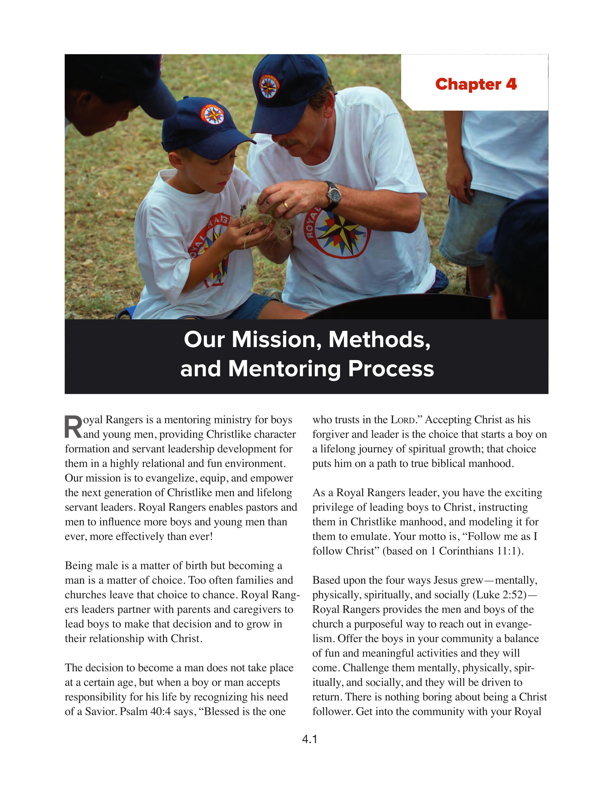
Chapter 4
Revised Seven Methods
  Pages 4.2 – 4.4
Mentoring Process
  Page 4.2 - hear, see, do, teach
Discipleship Model
  Page 4.5
  Comprehensive roadmap for mentoring & discipleship within RR that aligns with Acts 2 process
Notes:
Chapter 4
---Revised Seven Methods
---New “Mentoring Process” – hear, see, do, teach
---New “Discipleship Model” – our roadmap for discipleship in RR
---Acts 2 article

Slide 7
Section 2
Core Program Content

Slide 8
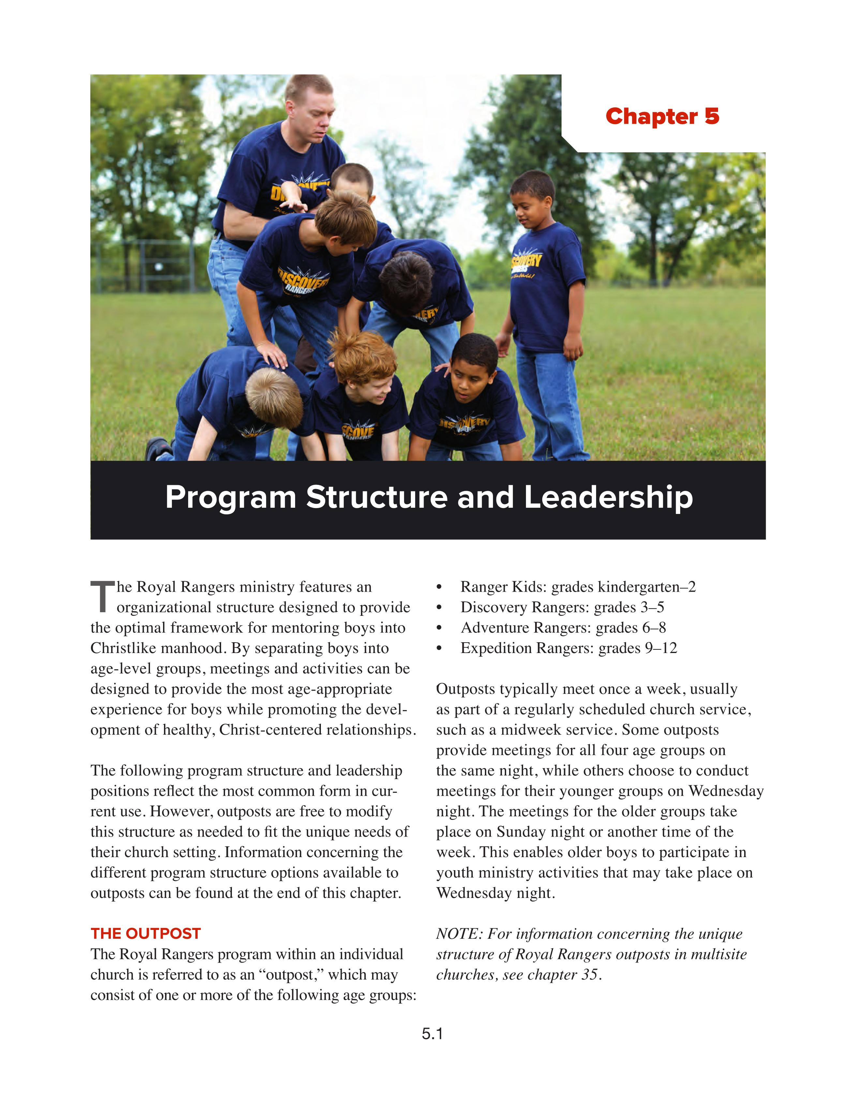
Chapter 5
Sexual Morality Statement
  Page 5.6
Alternate Outpost Structures
  Page 5.6 – 5.9 (“RR Lite”)
Minimum Program Requirements
  Page 5.9

Slide 9
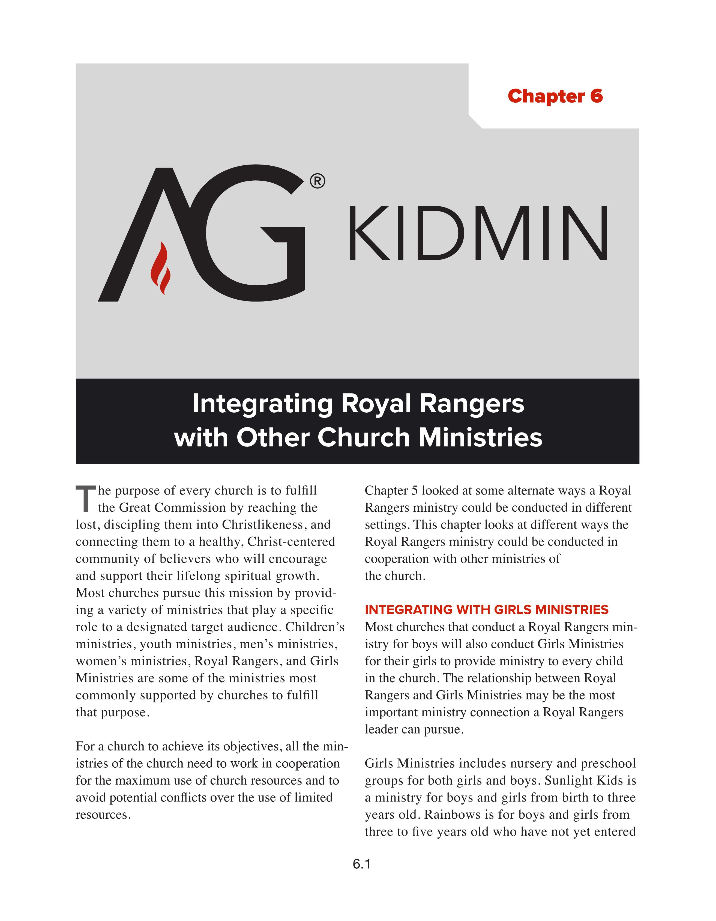
Chapter 6
Integrating RR with Other Church Ministries
  Girl’s Ministries – Plan A, B, & C
  Children’s Ministries
  Youth Ministries
  Men’s Ministries
  Eight Goals for Kids

Slide 10
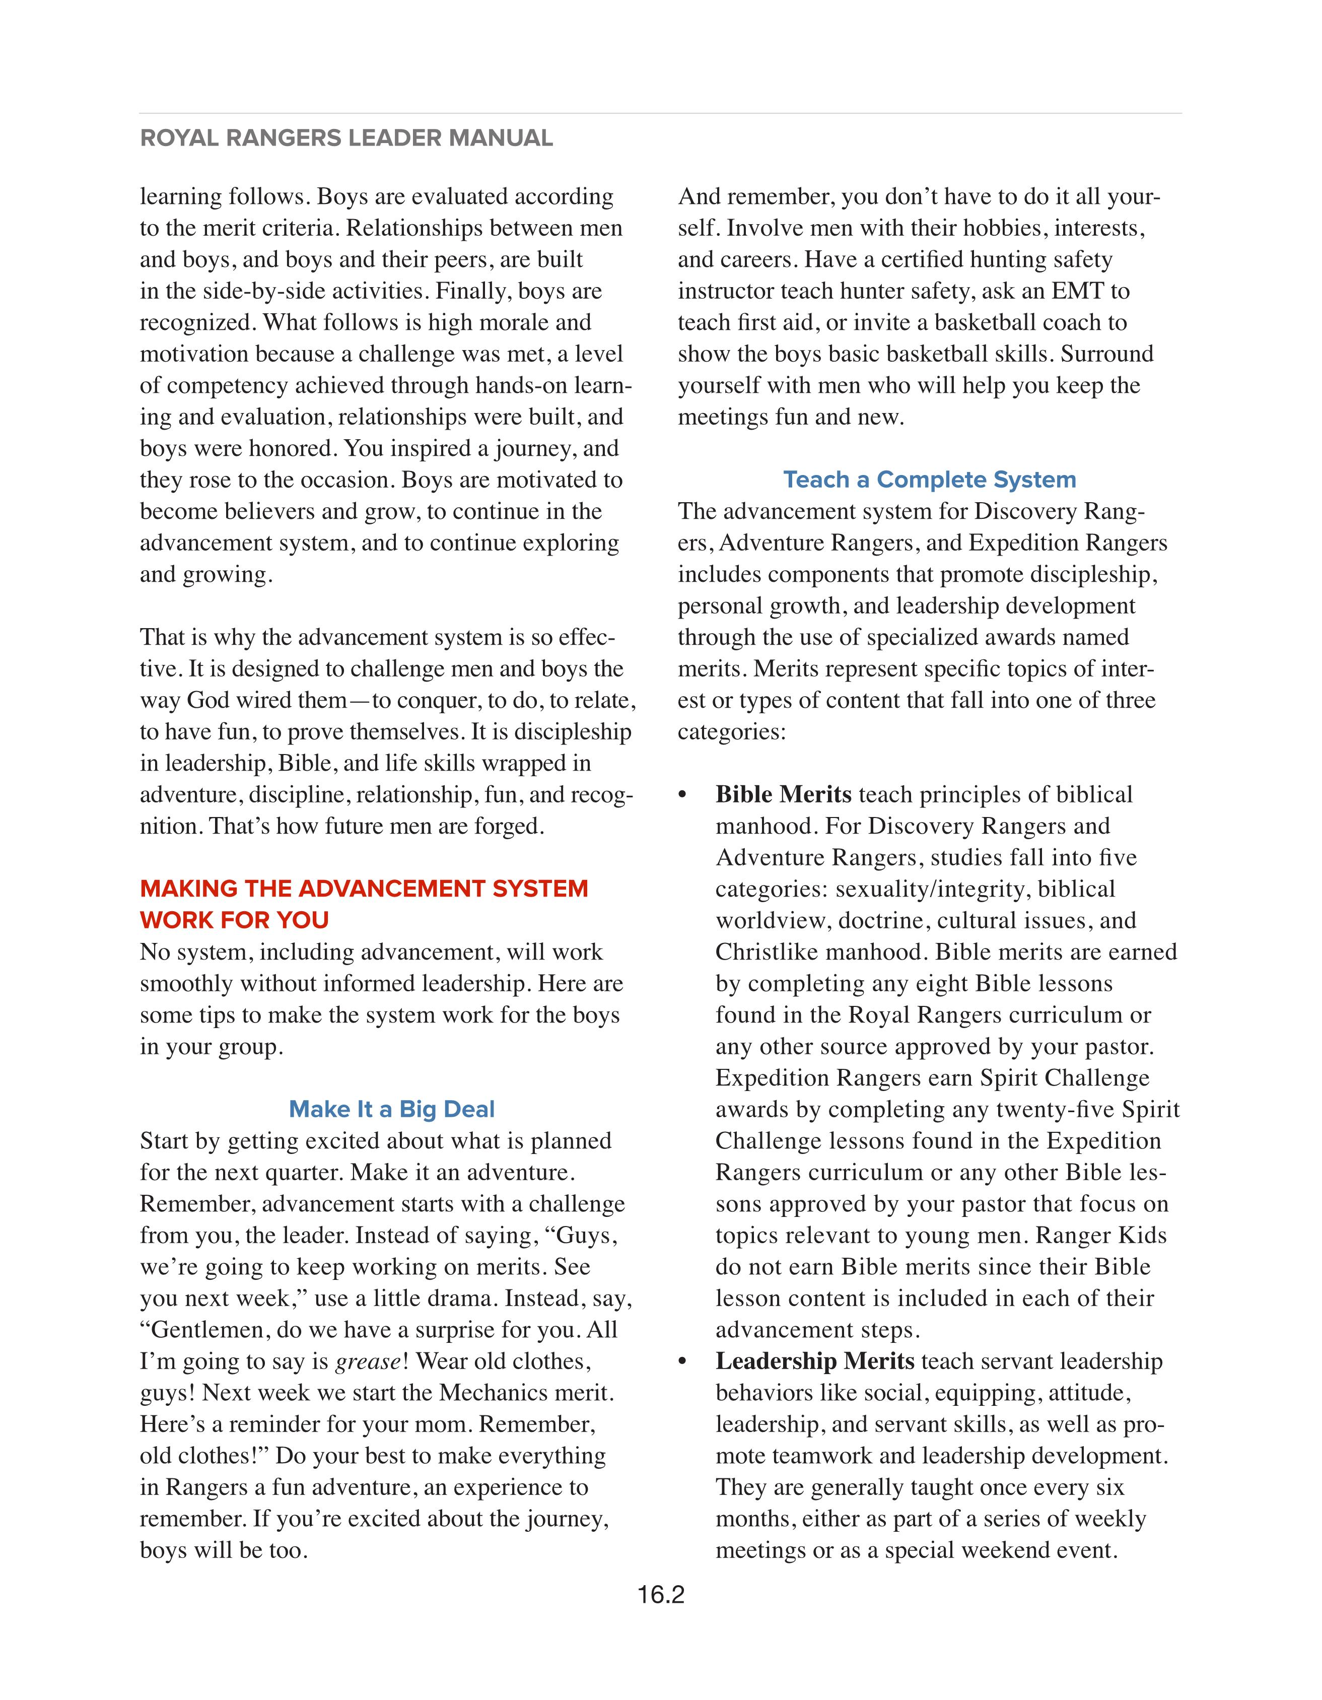
Chapters 7-22
No significant changes
  Training, advancement, uniforms, junior leaders, FCF, etc.
Bible & Leadership Merits
  Page 16.2
  Any Bible lesson, any leadership lesson
Notes:
A significant update has been made in relation to Bible merits and Leadership merits. Details can be found in the programs update presentation.

Slide 11
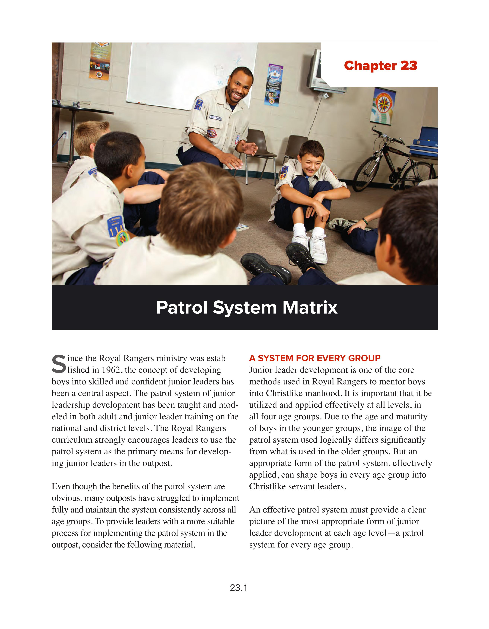
Chapter 23
Patrol System Matrix
  This concept has not yet been fully integrated into all other aspects of the program or content in this manual – work in progress
  Patrols of Excellence, Group Leadership Team, Annual Planning Retreat, etc.

Slide 12
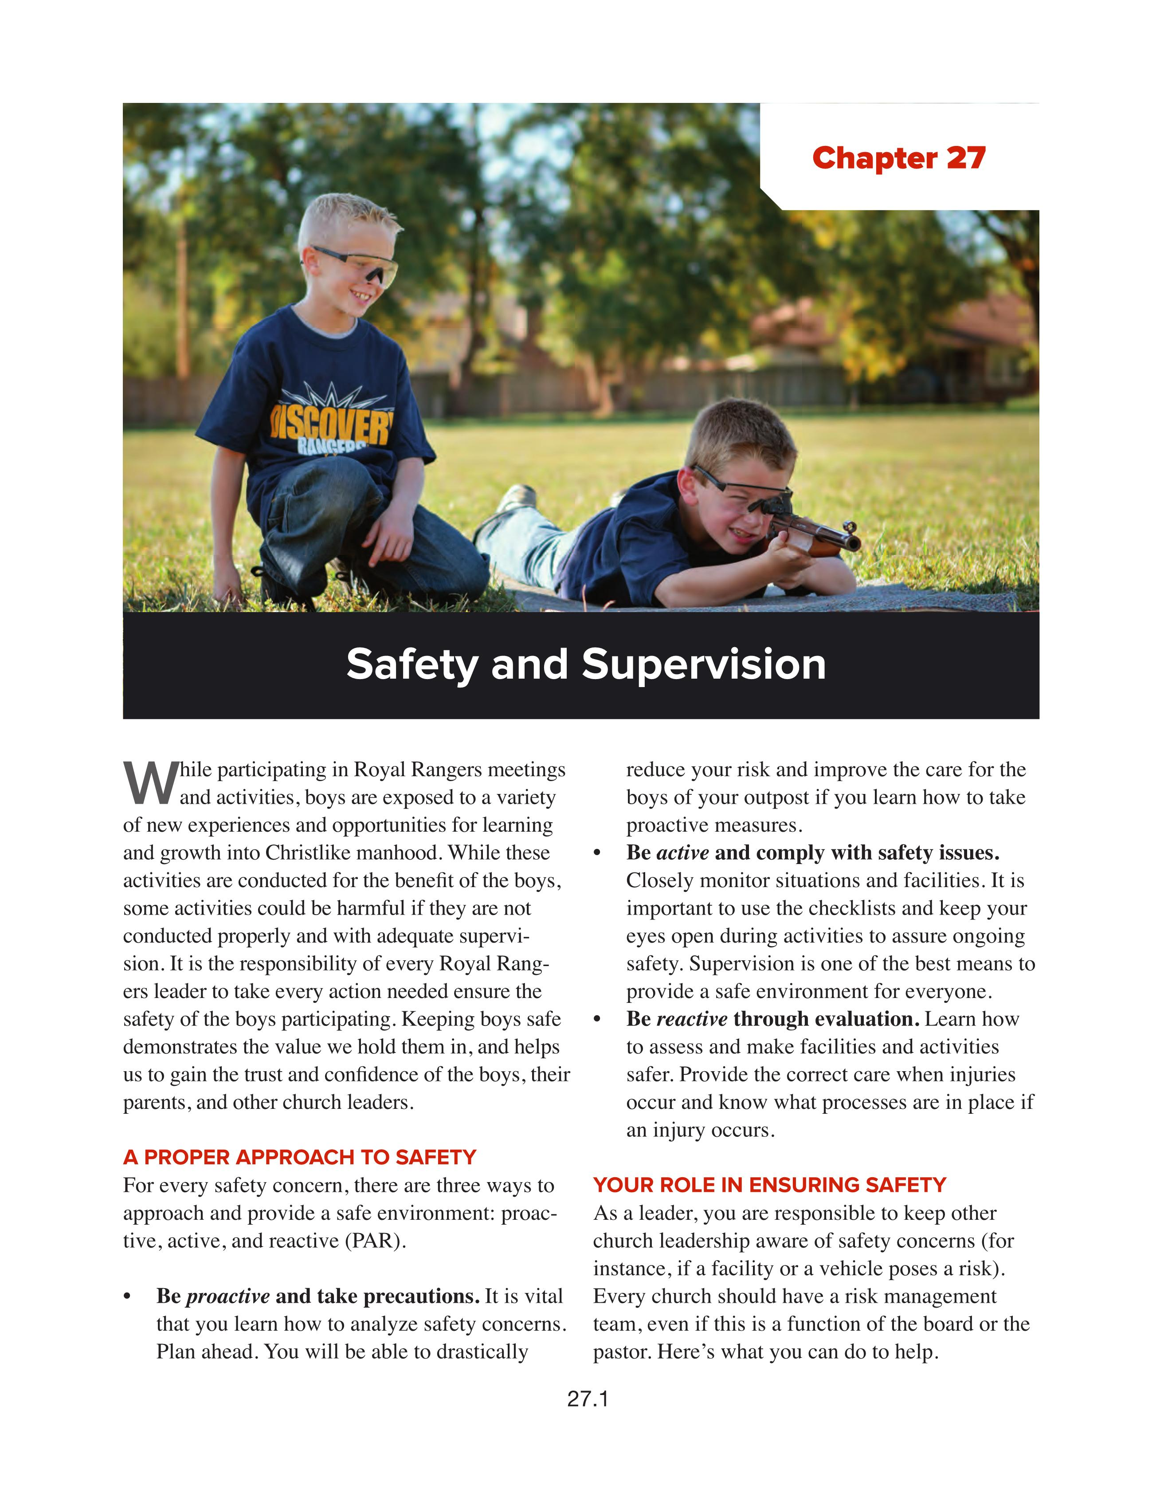
Chapter 27
Safety & Supervision
Completely reworked in cooperation with Richard Hammar (legal counsel for AG)
  Transportation & Vehicles
  Managing the Risk of Child Molestation

Slide 13

Section 3
Supplemental Resources
Notes:
Note that all the material in section 3 can only be found on TracClub. It is not printed in this manual.

Slide 14
Appendixes
Leader’s Advancement Logbook
Patch & Pin Placement Guide
Glossary
Index – only on TracClub

