Slide 1
Recruiting Men to mentor boys
Understanding Men, The Church and how to facilitate their union

Slide 2
Ratio of woMen to men in Avg Church

Slide 4
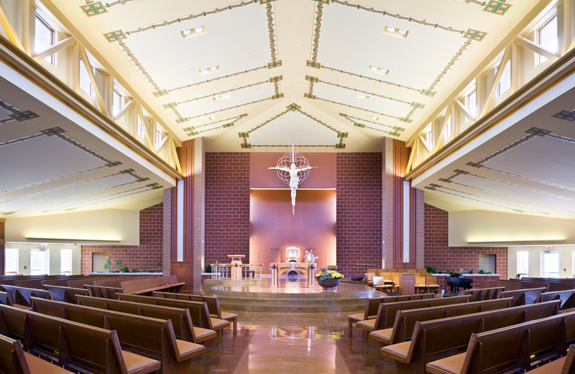

Slide 5
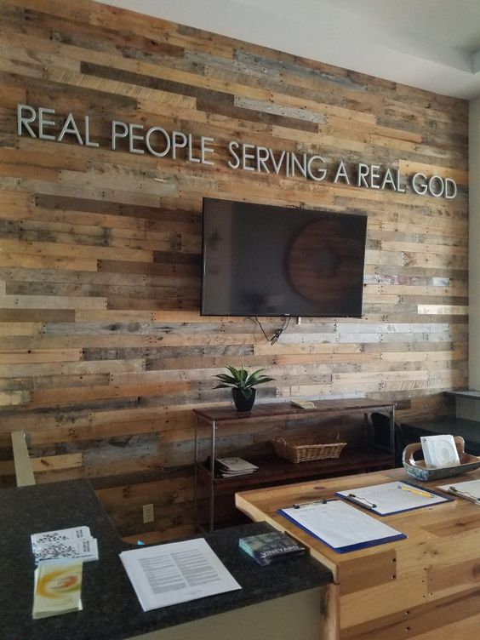
Decorating with Men in mind

Slide 6
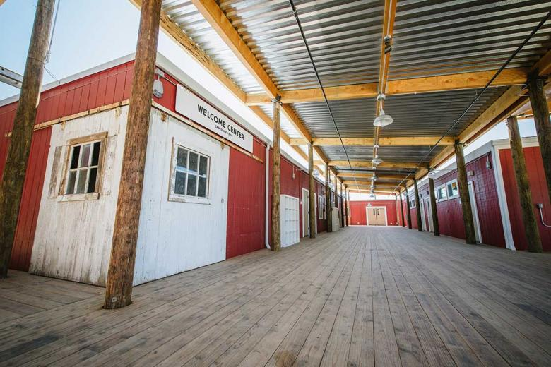

Slide 7
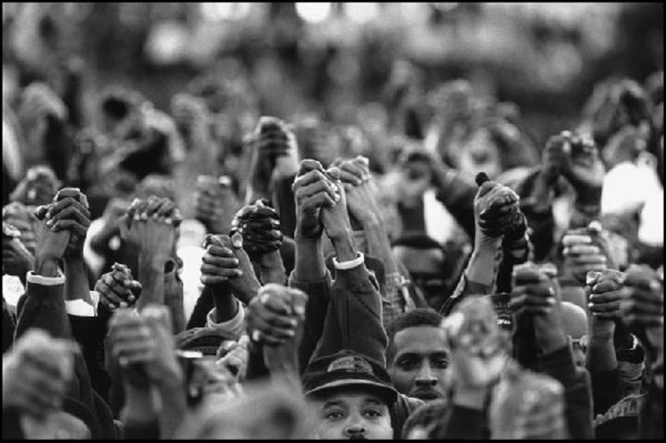
RECRUITING MEN...
1. EMPHASIZE MEN
WORKING WITH MEN –
Men build relationships “side by side”
with other men
CREATE A COMMUNITY
COMMUNICATE HOW MEN ARE MAKING A DIFFERENCE
AFFIRM THEY ARE GROWING IN THE RIGHT DIRECTION

Slide 8
RECRUITING MEN...
2. ENCOURAGE MEN WHO
ARE ALREADY INVOLVED
TO INVITE OTHERS

Slide 9
RECRUITING MEN...
3. ALLOW MEN TO
GET INVOLVED
A LITTLE AT A TIME
Don’t overwhelm with need
Keep it simple
Focus on their skills/abilities
Limit time commitment of initial ask
Allow men to gain comfort/confidence then commitment will come

Slide 10
RECRUITING MEN...
4. PROVIDE OPPORTUNITIES
FOR MEANINGFUL
SERVICE
What skills are represented by the men in your church?
How can you find out?

Slide 11
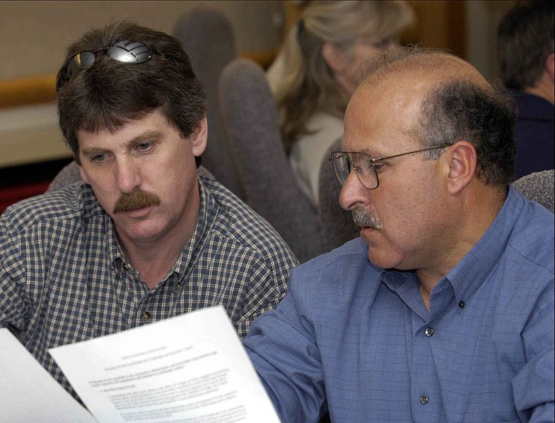
Recruiting Men...
5. PROVIDE
LEADERSHIP
AND
PERSONAL
DEVELOPMENT
Life Skills
Interpersonal Skills

Slide 12
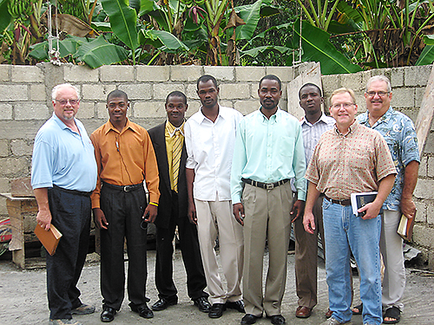
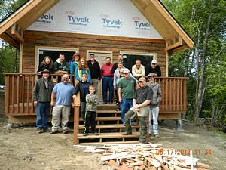
RECRUITING MEN...
6. INSPIRE THEM WITH
A VISION OF A LARGER
PURPOSE.
- Spiritual Fatherhood
- Together We Can Change the World

Slide 13
RECRUITING MEN...
1. EMPHASIZE MEN WORKING WITH MEN – CREATE
COMMUNITY
2. ENCOURAGE MEN WHO ARE ALREADY INVOLVED TO
INVITE OTHERS
3. HELP MEN TO GET INVOLVED A LITTLE AT A TIME
4. PROVIDE OPPORTUNITIES FOR MEANINGFUL SERVICE
TO OTHERS
5. PROVIDE LEADERSHIP AND PERSONAL DEVELOPMENT
6. INSPIRE THEM WITH A VISION OF A LARGER PURPOSE

