Slide 1
The Platinum Rule®
Simple Steps for Improving Communications™
Developed by:
Dr. Tony Alessandra & Dr. Michael O’Connor
with Scott Zimmerman
Delivered by:
Your name here

Slide 2
3 Simple Steps…
Recognize and embrace your natural behavioral style, and;
Identify another person’s behavioral style, and;
Adapt your behavior to lower interpersonal tension while increasing trust.

Slide 3
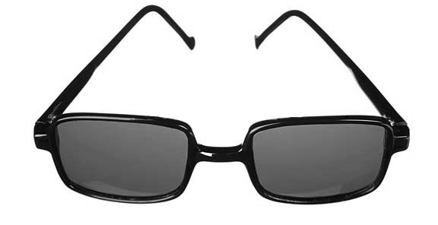
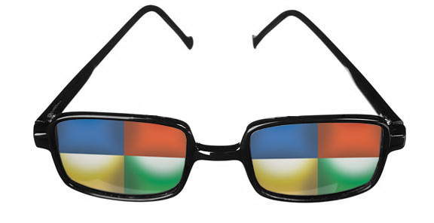
Seeing the World Through a New Lens

Slide 4
Specific Application of The Platinum Rule…
Today, we will learn how to apply adaptability to improve ___________.

Slide 5
Outcomes of Increasing Your Adaptability…
(You must customize this section)
Increase in team morale
Lowering tension within the office
Deeper understanding of other’s needs and fears
Lower staff turnover

Slide 6
“In medicine, prescription before diagnosis is malpractice …
… in business, it’s suicide!”
— Dr. Tony Alessandra

Slide 7
“When the only tool you have is a hammer,
everything starts looking like a nail.”
— Mark Twain

Slide 8
“The Golden Rule”
“Do Unto Others as You Want Done Unto You”

Slide 9
The Platinum Rule…
“Do Unto Others as They Want Done Unto Them!”
Or…
“Treat Others the Way They Want
(and Need) to Be Treated!”

Slide 10
Lower Interpersonal Tension & Increase Trust
Know your own behavioral tendencies
Recognize the behavioral style of another person
Adapt your communication style

Slide 11
TPR is Different from “Personality Tests”
Both prescriptive and descriptive
People change behaviors
Can be learned and applied immediately

Slide 12
The History of “Styles”…
1921
Carl Jung: Psychological Types
William Marston: Emotions of Normal People
1928
Isabel Briggs & Katherine Myers: MBTI
Walter Clark & John Geier: DISC
1950s
1960s
Merrill & Reid: Social Styles
1980s
Dr. Tony Alessandra: The Platinum Rule

Slide 13
Four Basic Styles
Director
Socializer
Relater
Thinker

Slide 14
So, What’s Your Behavioral Style?
Now it’s time to take/review your assessment…

Slide 15
Recognizing Another’s Behavioral Style
Verbal: The actual words they use.
Vocal: The way they say the words; rate-of-speech, inflection, intonation and emphasis.
Visual: The way they subconsciously communicate their intentions through body language, facial expressions and gestures.

Slide 16
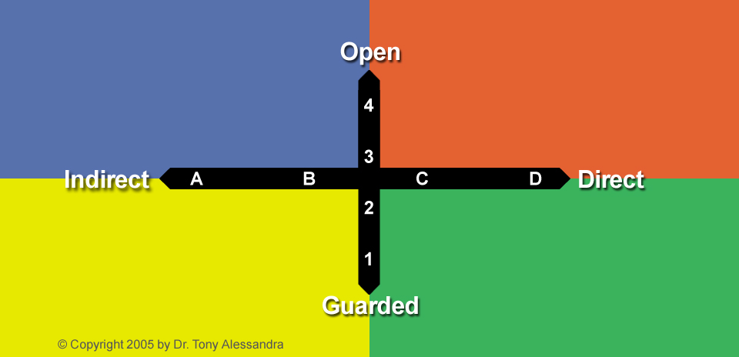
The Two Dimensions of Observable Behavior

Slide 17

Willingness to Share Feelings and Thoughts

Slide 18
Willingness to Share Feelings and Thoughts
Easier to “Read”
Easier to Get to Know
Relationships & People
Free with Use of Time

Slide 19
Willingness to Share Feelings and Thoughts
Tasks, Work & Results
Tight with Use of Time
Harder to “Read”
Harder to Get to Know

Slide 20
DECISIONS ARE BASED UPON…
FEELINGS
EVIDENCE

Slide 21
THEIR FOCUS IS ON…
OPINIONS & FEELINGS
FACTS & TASKS

Slide 22
THEIR CONVERSATIONS…
STRAYS FROM SUBJECT
STAYS ON SUBJECT

Slide 23
COMES ACROSS AS…
RELAXED & WARM
FORMAL & PROPER

Slide 24
PREFERS TO WORK…
WITH OTHERS
INDEPENDENTLY

Slide 25
FACIAL EXPRESSIONS ARE…
ANIMATED
LIMITED

Slide 26
PROVIDES NONVERBAL FEEDBACK…
OFTEN
SELDOM

Slide 27
RESPONDS POSITIVELY TO…
FEELINGS / VISIONS / CONCEPTS
REALITY / EXPERIENCES / DATA

Slide 28
Are You More Open or Guarded?

Slide 29
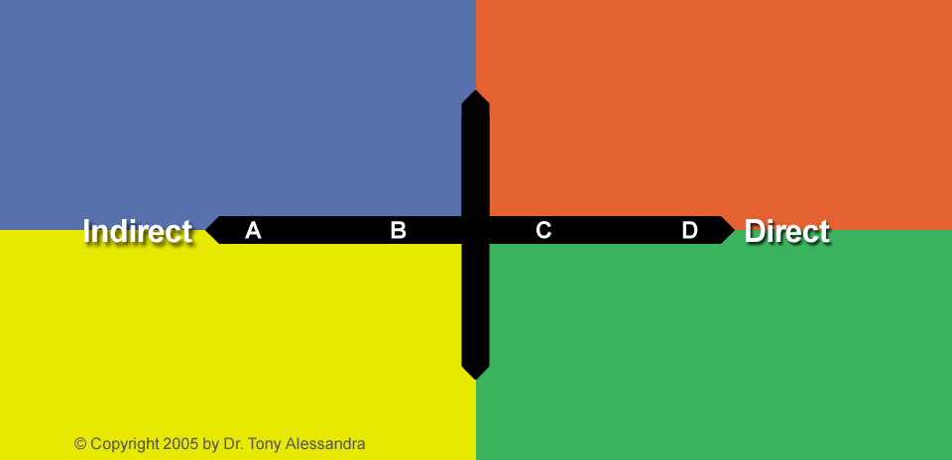
Their Natural Pace

Slide 30
Driven to Achieve, Influence and/or Control
Fast-paced / Confident
Extroverted; Talks and Tells
Readily Takes Risks
Driven by Need to Accomplish

Slide 31
Driven by a Need for Certainty and/or Security
Easy-Going / Cooperative
Introverted; Asks and Listens
Slow to Take Risks
Driven by Need to Be Certain

Slide 32
APPROACHES RISKS…
SLOWLY
SPONTANEOUSLY
CAUTIOUSLY
QUICKLY

Slide 33
DURING GROUP CONVERSATIONS…
INFREQUENTLY
FREQUENTLY
CONTRIBUTES
CONTRIBUTES

Slide 34
WHILE MAKING THEIR POINTS…
SELDOM
USES
GESTURES
GESTURES

Slide 35
STATEMENTS ARE…
OFTEN
OFTEN
QUALIFIED
EMPHATIC

Slide 36
EMPHASIZES POINTS THROUGH…
EXPLANATIONS
INTONATION AND
OF THE CONTENT
BODY LANGUAGE

Slide 37
THEIR OPINIONS ARE…
KEPT
RIGHT OUT
INSIDE
ON THE TABLE

Slide 38
OFTEN SEEN AS…
PATIENT
IMPATIENT
COOPERATIVE
COMPETITIVE

Slide 39
DEMEANOR IS…
UNDERSTATED
INTENSE
RESERVED
ASSERTIVE

Slide 40
EYE CONTACT IS…
INITIALLY
USUALLY
INTERMITTENT
SUSTAINED

Slide 41
VIEWS RULES AND POLICIES AS…
THE LETTER
WINDOWS OF
OF THE LAW!
OPPORTUNITY!

Slide 42
IN GENERAL…
LISTENS MORE
TALKS MORE
THAN TALKS
THAN LISTENS

Slide 43
OVERALL, THEY…
ASK MORE
TELLS MORE
THAN TELL
THAN ASKS

Slide 44
Are You More Direct or Indirect?

Slide 45
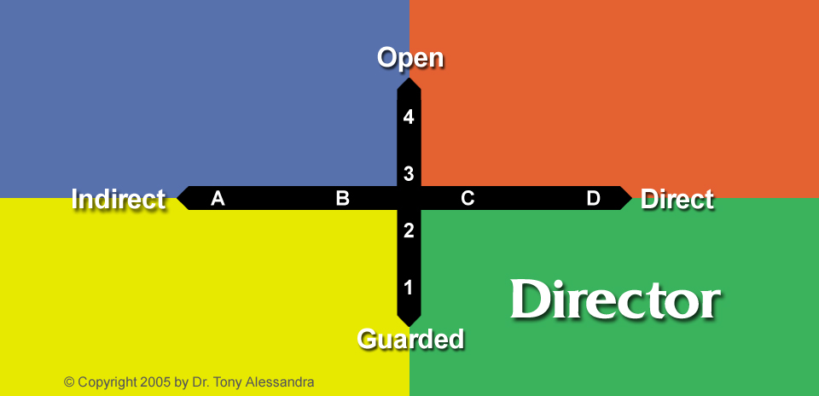
Direct and Guarded…

Slide 46
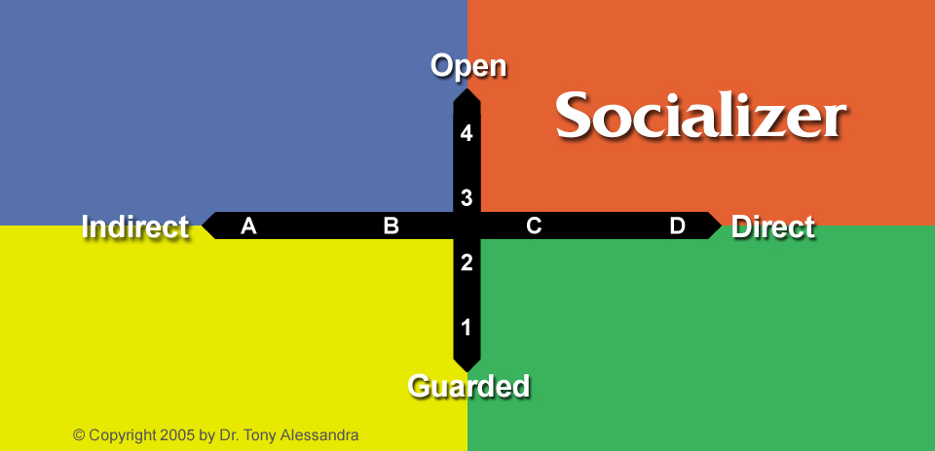
Direct and Open…

Slide 47
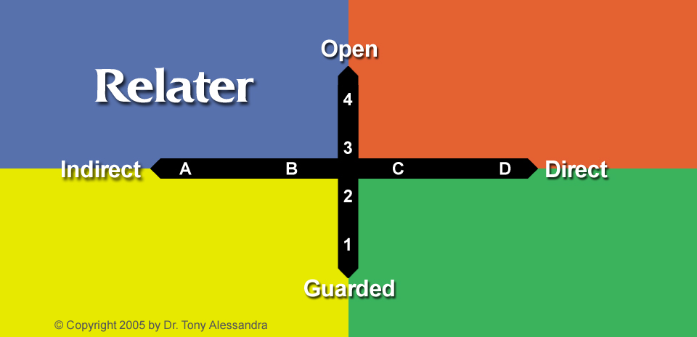
Indirect and Open…

Slide 48
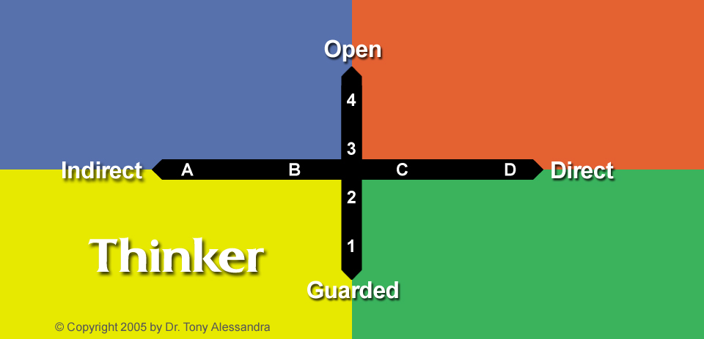
Indirect and Guarded…

Slide 49
Directors… the Dominant, Driving Style
Fast paced
Talks more than they listen
Speak with authority
Confident toward risks and change
Makes decisions … decisively
Competitive
Goals and results-oriented
Becomes dictatorial under stress

Slide 50
Directors…What Do They Do Best?
Taking charge during a crisis
Create a sense of urgency
Press for closure and concrete decisions
Figure out what needs to be done
Ensuring bottom line results

Slide 51
Directors…What’s Difficult for Them?
    Dealing with slower-paced people
    Failure to make rapid, tangible progress
    Doing the same tasks over & over
    Lots of rules and regulations
    Being diplomatic

Slide 52
What are simple actions Directors may do to increase their adaptability?
Break into groups and brainstorm.

Slide 53
Increasing Adaptability for Directors…
Slow down your pace and appear more relaxed
Use “please” and “thank you” more often
Become a more open, patient listener
Develop patience, sensitivity and empathy
Genuinely compliment others
Act less hastily; more cautiously
Identify with others within your group(s)

Slide 54
What are simple actions you might take to adapt to the style of a Director?
Break into groups and brainstorm.

Slide 55
To adapt to a Director, appear efficient and competent by:
Supporting their goals and objectives (when possible)
Keeping the relationship on a business level
Using facts, not personal feelings, during disagreements
Being precise, efficient and well organized
Recommending alternative actions with brief, supporting analysis
Leading with the main point and stick to an agenda
Stressing competitive results and growth opportunities

Slide 56
Socializers… the Influencing, Expressive Style
Fast paced
Talks a lot; jumps topics; expressive
They speak persuasively
Friendly, extroverted, energetic
Fears rejection and humility
Makes decisions … spontaneously
Seeks applause, approval and avoids routine
Becomes sarcastic under stress

Slide 57
Socializers…What Do They Do Best?
Inspire others to take action
Shifting on the fly; changing courses
Thinking quickly on their feet
Promoting products, people or ideas

Slide 58
Socializers… What’s Difficult for Them?
    Restrictions and/or routines
    Formal reports or keeping detailed records
    Re-doing something once it is finished
    Choosing only one answer or possibility
    Explaining their thought processes to others
    Not interrupting others

Slide 59
What are simple actions Socializers may do to increase their adaptability?
Break into groups and brainstorm.

Slide 60
Increasing Adaptability for Socializers…
Slow down your pace and focus your conversations
Curb your impulses to interrupt others
Become a more patient listener
Develop the logical side of your thinking
Talk more about others; shift your focus outward
Act less impulsively; more cautiously
Work at improving your time management
Follow-through on your ideas and promises

Slide 61
What are simple actions you might take to adapt to the style of a Socializer?
Break into groups and brainstorm.

Slide 62
To adapt to a Socializer, improve your interactions by:
Supporting their opinions, ideas and dreams
Don’t rush the conversation; prepare for stories and digressions
Be fun and entertaining with removing the spotlight from them
Allow your enthusiasm and animation to emerge
Summarize discussions with short list of follow-through steps
Clarify agreements in writing (even if informally)
Casually re-focusing the conversation on topics at-hand

Slide 63
Relaters… the Steady, Amiable Style
Slower pace
Listens more than they talk
They speak emotionally
Warm and friendly
Fears sudden changes and risks
Makes decisions … consultatively
Seeks stability and harmony; avoids conflict
Becomes submissive under stress

Slide 64
Relaters…What Do They Do Best?
Listening
Bringing harmony to group situations
Facilitating meetings and events
Recognizing & meeting emotional needs
Coordinating and cooperating with others

Slide 65
Relaters… What’s Difficult for Them?
    Assertive or aggressive people
    Conflict and/or competition
    Working with dictatorial or pushy people
    Using position power
    Accepting criticism (even if positive)

Slide 66
What are simple actions Relaters may do to increase their adaptability?
Break into groups and brainstorm.

Slide 67
Increasing Adaptability for Relaters…
Speed up your conversations and get to the point
Focus your conversations on the task at hand
Try to speak a little more confidently
Practice making small decisions faster
Work on sustaining eye contact longer
Learn to say “no” occasionally
Gently, but firmly, hold your ground if in disagreement
Speak your opinions more readily

Slide 68
What are simple actions you might take to adapt to the style of a Relater?
Break into groups and brainstorm.

Slide 69
To adapt to a Relater, improve your interactions by:
Being warm and sincere
Don’t rush the conversation; take your time building relationship
Be a patient, empathetic listener (they are and want same from you)
Allow your warm, sensitive side to emerge
Provide personal assurances whenever appropriate
Take notes to demonstrate that you’re getting all of the message
Provide nonverbal feedback as they speak

Slide 70
Thinkers… the Cautious, Analytical Style
Slower paced
Listens critically; talks sparingly
Speak calmly and unemotionally
Cool, introverted, analytical
Fears criticism and unpredictability
Makes decisions … deliberately
Seeks precision, processes and avoids quick decisions
Becomes withdrawn under stress

Slide 71
Thinkers…What Do They Do Best?
Perfecting
Organizing people and things
Fine-tuning ideas to increase efficiency
Focus on the logic of a possible solution
Planning to meet specified expectations

Slide 72
Thinkers… What’s Difficult for Them?
    Working in groups
    Working with unpredictable people
    Disorganized environments
    Incomplete and/or unclear directions
    Questions with no clear answer
    Sharing their feelings

Slide 73
What are simple actions Thinkers may do to increase their adaptability?
Break into groups and brainstorm.

Slide 74
Increasing Adaptability for Thinkers…
Present a more warm, playful, relaxed demeanor
Speed up your rate of speech; lead with big points
Allow time for others to tell stories and jokes
Become a more empathic listener
Develop the playful side of your personality
Occasionally share feelings and opinions with others
Practice making simple decisions quicker
When lost in details, pull back and see big picture

Slide 75
What are simple actions you might take to adapt to the style of a Thinker?
Break into groups and brainstorm.

Slide 76
To adapt to a Thinker, improve your interactions by:
Be thorough and well prepared
Greet cordially, but get straight to the task, agenda or project
Demonstrate commitment through actions, not words or promises
Be prepared to answer detailed questions
Have all data, analysis and/or information with you
Demonstrate logic in your thinking
Build case / Break news in a step-by-step manner

Slide 77
Traits of Highly Adaptable People
Confidence: the attitude of belief in one’s self, trusting your own judgment
Tolerance: open-minded state of acceptance; willingness to defer judgment on the basis of limited time, information, or experiences
Empathy: sensitivity to another’s point of view; caring approach towards others
Positive attitude: maintaining a state of positive expectations about people and situations, including a positive state of energy in your thoughts and emotions
Respect for others: desire to understand, accept, and consider both mutual and separate interests, choices and commitments
Cooperation: the desire to work with people to develop win-win results
Approachable: open to discussions of events, ideas and feelings with others

Slide 78
Attributes of High Adaptors
Resilience: learning how to cope in spite of setbacks, barriers, or limited resources; willingness to continue practicing, growing and learning
Vision: foresight, creativity, and imagination
Attentiveness: being mindful and aware of stimuli in the environment; reality-focused to conditions, events, and patterns
Competence: capability of managing tasks and being knowledgeable about required subjects and people; including use and updating of appropriate abilities
Self-correction: able to initiate and evaluate your own behaviors, seeking feedback; characterized by a problem-solving mindset and approach to matters
Objectiveness: ability to deal with facts and make decisions rationally
Tactfulness: being able to give people feedback in a kind, gentle manner

Slide 79
Their Natural Strengths…
Patience
Perseverance
Persuasiveness
Sociability
Inventiveness
Accuracy
Administration
Delegation

Slide 80
Overextension of Strengths…
Agrees too much
Talks too much
Questions too much
Controls too much

Slide 81
Weaknesses…
Acquiescent
Avoids Change
Easily Bored
Superficial
Perfectionist
Critical
Stubborn
Impatient

Slide 82
Common Occupations…
Social Worker
Teacher
Salesperson
Entertainer
Engineer
Inventor
CEO
Contractor

Slide 83
Their Decisions are…
Collaborative
Spontaneous
Deliberate
Decisive

Slide 84
What They Find Irritating…
Insensitivity
Impatience
Routine
Perfectionism
Disorganization
Unpredictability
Inefficiency
Indecision

Slide 85
What They Fear…
Sudden
Changes
Rejection by
Others
Criticism of
Their Efforts
Being Taken
Advantage of

Slide 86
Their Workspace is…
Personal
Stimulating
Structured
Busy

Slide 87
Managerial strengths…
Organizing
Motivating
Planning
Controlling

Slide 88
They Listen…
Empathically
Intermittently
Analytically
Purposefully

Slide 89
Save Them…
Conflict
Effort
Face
Time

Slide 90
What Motivates Them Internally…
The Participation
The Show
The Process
The Competition

Slide 91
Making Initial Contact …
Project warmth and focus
on building trust
Let them set the pace
and direction of meeting;
Show more animation
and enthusiasm
Appeal to their logical
side; avoid too much
social talk
Be prepared and
fast-paced; demonstrate
that you’ve done your
homework

Slide 92
While Exploring Needs…
Explore their feelings,
current practices and
relationship needs
Explore their dreams,
motivations and
aspirations
Explore their systems,
knowledge and
objectives
Explore their desired
results and time
constraints

Slide 93
Collaborating Together on Solutions…
Emphasize security,
steadiness and
reduction of risk
Emphasize excitement,
uniqueness and
decreased effort
Emphasize accuracy,
value, quality and reliability
(including pros & cons)
Emphasize efficiency,
profits and/or money
savings

Slide 94
Clarifying and Confirming Commitments…
Provide guidance,
direction & assurances;
create an action plan
Provide testimonials
and incentives;
summarize all details
Provide logical options
with documentation;
let them think
Provide options with
cost/benefit summary;
offer expert opinion

Slide 95
Assuring Complete Satisfaction…
Practice consistent,
predictable service
with personal attention
Check for usage; save
them complications
Follow a timetable for
measuring results;
deliver on all promises
Provide reminders of
your track record;
respond with quick
solutions to problems

Slide 96
During Moments of Misery May Appear…
Submissive, wishy-washy,
hesitant or apologetic
Internalizes dissatisfaction;
gets defensive
Overeager, impulsive,
Sarcastic or demanding
Disregards facts, logic
or reasonable argument
Hurt and withdrawn; may
end conversation and leave
Recites chronology of
events w/ documentation
Critical, blunt, pushy
and uncooperative
Acts like they want
to control everything

Slide 97
To Create Moments of Magic…
Provide assurances that
you’ll iron out differences
Draw them out in a
friendly way
Give personal attention;
make them feel important
Engage in a lot of verbal
give and take
Guarantees that they are
right
Move at an accurate, slow
pace to help them
“process” information
Provide tangible evidence
of progress or results
Let them feel in control of
the situation

Slide 98
Improvement Tips for Directors…
Practice “active listening”
Project a more relaxed image
Develop patience, humility, sensitivity and empathy
Verbalize the reasons for your conclusions
Become more aware of existing sanctions
Sincerely compliment others more often

Slide 99
Improvement Tips for Socializers…
Control time and emotions
Spend more time checking, verifying, specifying and organizing
Follow through on all agreements
Concentrate on the task at hand
Take a more logical approach
Complete more of what you start

Slide 100
Improvement Tips for Relaters…
Say “No” occasionally
Complete tasks without an oversensitivity to other’s feelings
Take risks by stretching beyond your comfort zone
Delegate to others
Accept changes in procedures
Verbalize feelings and thoughts

Slide 101
Improvement Tips for Thinkers…
Practice “active listening”
Openly show appreciation
Try shortcuts and time savers
Adjust more readily to change
Increase tolerance for some disorganization
Work on more timely decision making
Compromise with others
Use policies as guidelines, not laws

Slide 102
In Relationships with Directors…
Support their goals and objectives
Keep relationship businesslike and task-oriented
Recognize their ideas and accomplishments
Be precise, efficient and well organized
Provide alternate actions with brief, supporting analysis

Slide 103
In Relationships with Socializers…
Support their ideas dreams and opinions
Be entertaining and fast-paced, but don’t rush the discussion
Try not to argue… you’ll seldom win
Summarize—in writing—who is to do what, where and by when
Use testimonials and incentives to influence decisions

Slide 104
In Relationships with Relaters…
Support their feelings by showing personal interest and actively listening
Move along in an informal, slow manner
Give them plenty of time to trust you
If you disagree, discuss personal feelings
Provide guarantees and personal assurances

Slide 105
In Relationships with Thinkers…
Support their organized, thoughtful approach
Demonstrate through actions, not words
Be systematic, exact, organized and prepared
List advantages and disadvantages of any plan
Provide guarantees and proof that actions can’t backfire

Slide 106
Their Ideal Vehicle?

Slide 107
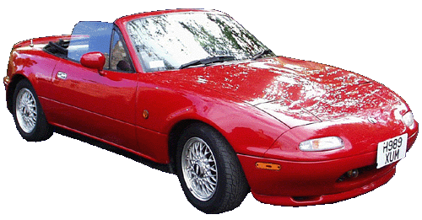
For Socializers …

Slide 108
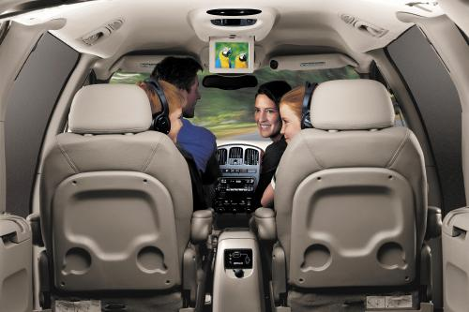
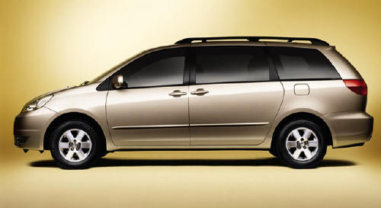
For Relaters …

Slide 109
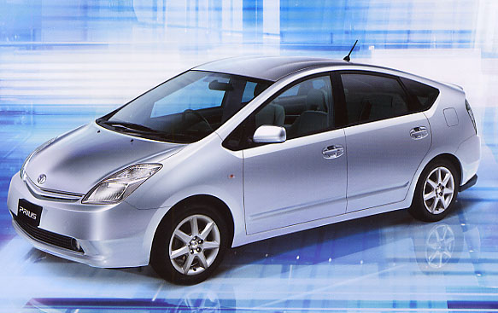
For Thinkers …

Slide 110
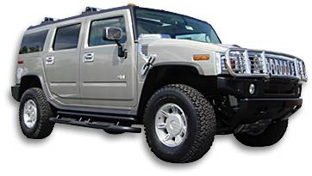
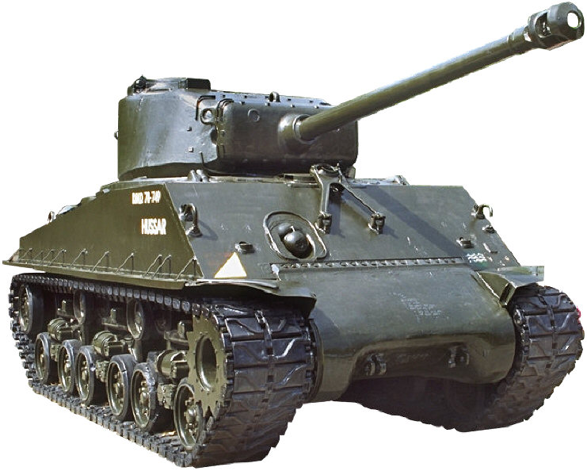
For Directors …

Slide 111

www.YourWebSite.com
Your natural behavior style
360-degree evaluation
Customized report
69-page e-workbook
YourEmail@YourURL.com ● 000-000-0000

