Slide 1
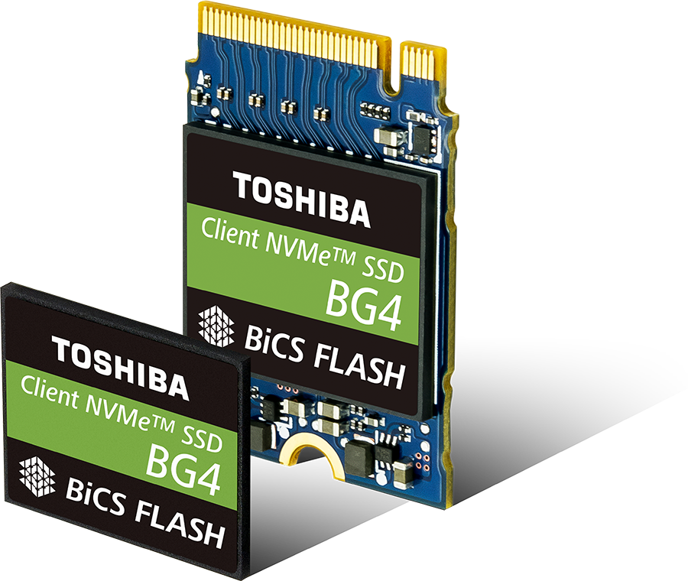
TOSHIBA BG4 NVMe SSD Series
Introduction to the All-New 4th Gen BG Series

Slide 2
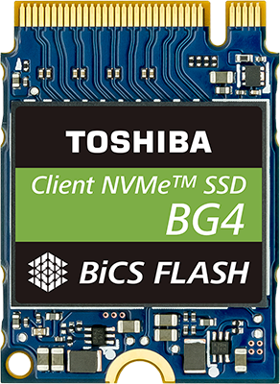
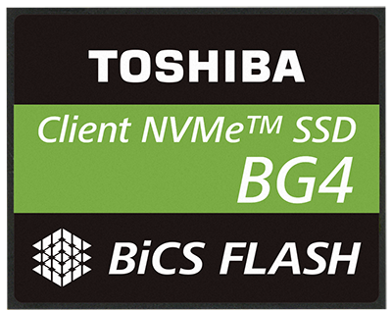
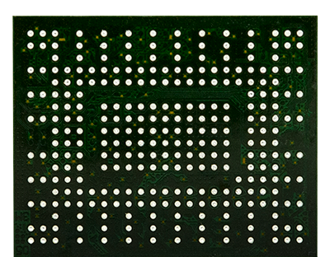
Introducing the BG4 Series
Client-Class Single Package BGA SSDs
Interface: PCIe® Gen3x4L NVMe™ 1.3b
Capacities: 128GB, 256GB, 512GB, 1024GB
Front
Back
M.2 1620
M.2 2230

Slide 3



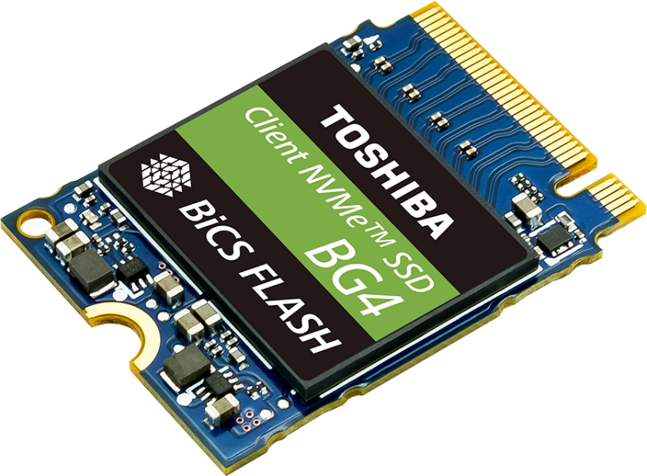
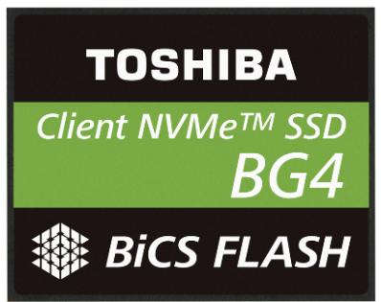
BG4 SSDs: Better By Design
2x
BIGGER
The Densest Client
SSD on the Market³
20%
153%
POWER
FASTER¹
SAVINGS⁴
Industry-Leading
Random Read Performance²
Decreased Power Consumption Improves Efficiency

Slide 4
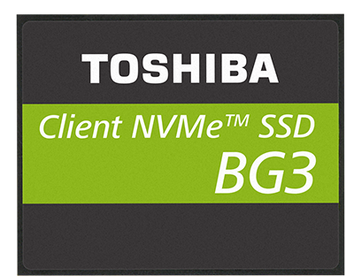
BG4 Series: New & Noteworthy
vs.
PCIe Gen3 Lanes
x2
x4
Maximum Capacity
512GB
1TB
BiCS FLASH™
64-LAYER
96-LAYER
512GB BGA Z-Height
1.5mm
1.3mm
Sequential Read⁵ | 1,500 MB/s |  | 2,250 MB/s
Sequential Write⁵ | 1000 MB/s |  | 1,700 MB/s
Random Read IOPS⁶ | 150,000 |  | 380,000
Random Write IOPS⁶ | 100,000 |  | 190,000
50% Faster
70% Faster
153% Faster
90% Faster

Slide 5

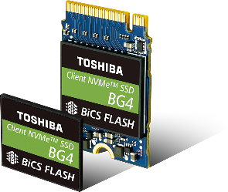

BG4 SSD Applications
Ultra-Mobile
Thin & Light Designs
2-in-1s
Boot
Servers
Arrays
Embedded
IoT Devices
In-flight Systems

Slide 6


See BG4 in Action – LIVE Demo at Embedded

