Slide 1
Platform Introduction
May 2019
Notes:
1

Slide 2
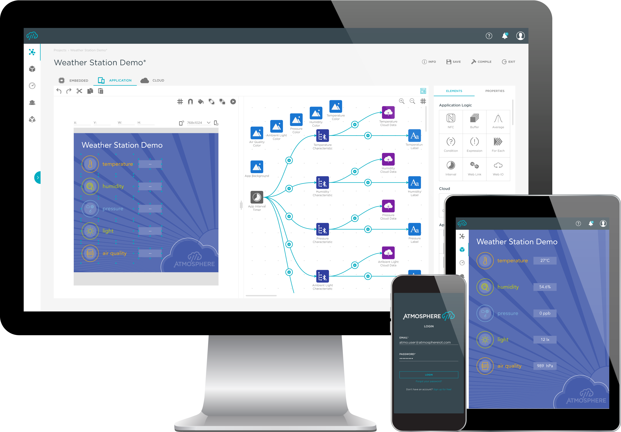
Atmosphere IoT Corp: Company Snapshot
The fastest and simplest way to build, connect and manage a complete embedded-to-cloud IoT solution
Spin off of Anaren, Inc. in January 2018
Low code IoT software development platform
Cloud-based Studio IDE for embedded, mobile and cloud
Hardware-agnostic: Integrates leading embedded platforms
Rich Library of IoT Building Blocks
4,000 registered developers in past 12 months
Highly scalable: free single user → white label enterprise accounts
Notes:
See note on second bullet

Slide 3
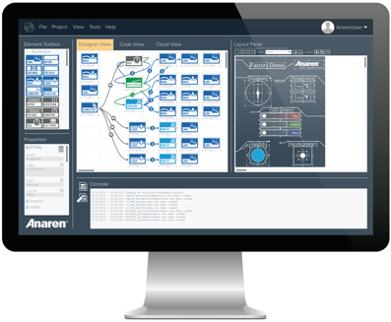
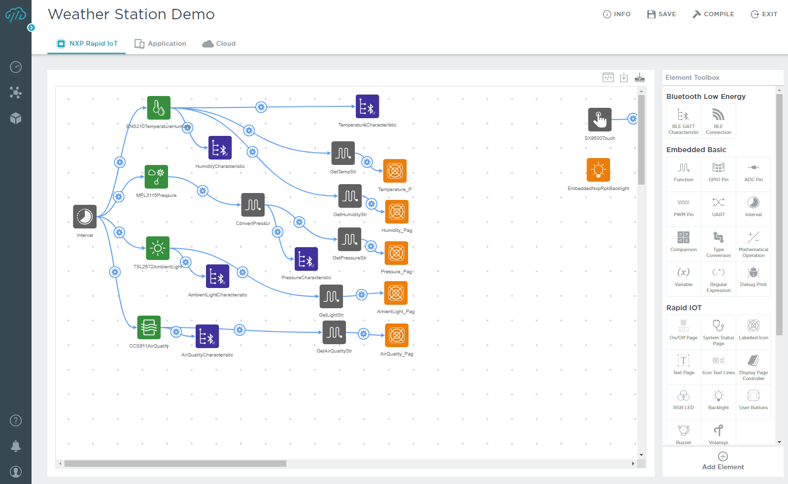
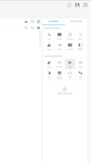
Atmosphere Studio™: Making Embedded-to-Cloud Easy
FEATURES
Web-based Integrated Development Environment (IDE) with a visual, drag and drop user interface
Simultaneous creation of embedded, mobile app and web app code
Robust libraries of sensors, modules/ICs (SDKs, drivers, APIs) and dashboard widgets
Hardware, Wireless and Cloud Agnostic:
Supports numerous embedded hardware platforms
Supports leading short-range and long-range wireless technologies
Integrate with other third-party platforms (e.g.: AWS)
Studio Embedded Code Editor
BENEFITS
Go from idea to prototype in minutes without writing code
Masks the complexity of underlying SDKs, APIs, drivers
No need for expensive, specialized programming skills
Path from building to deploying and managing devices

Slide 4
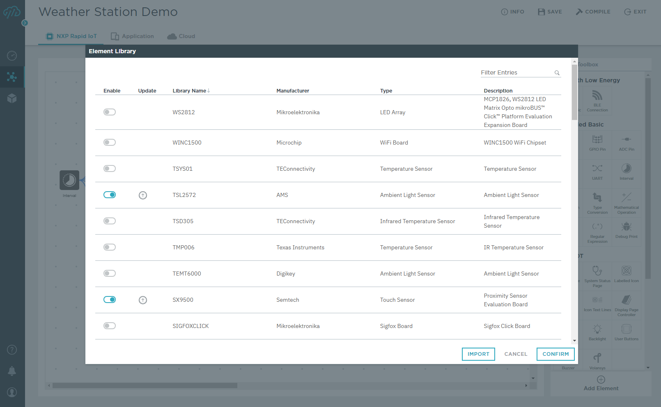
Pre-built library of iot building blocks

Slide 5
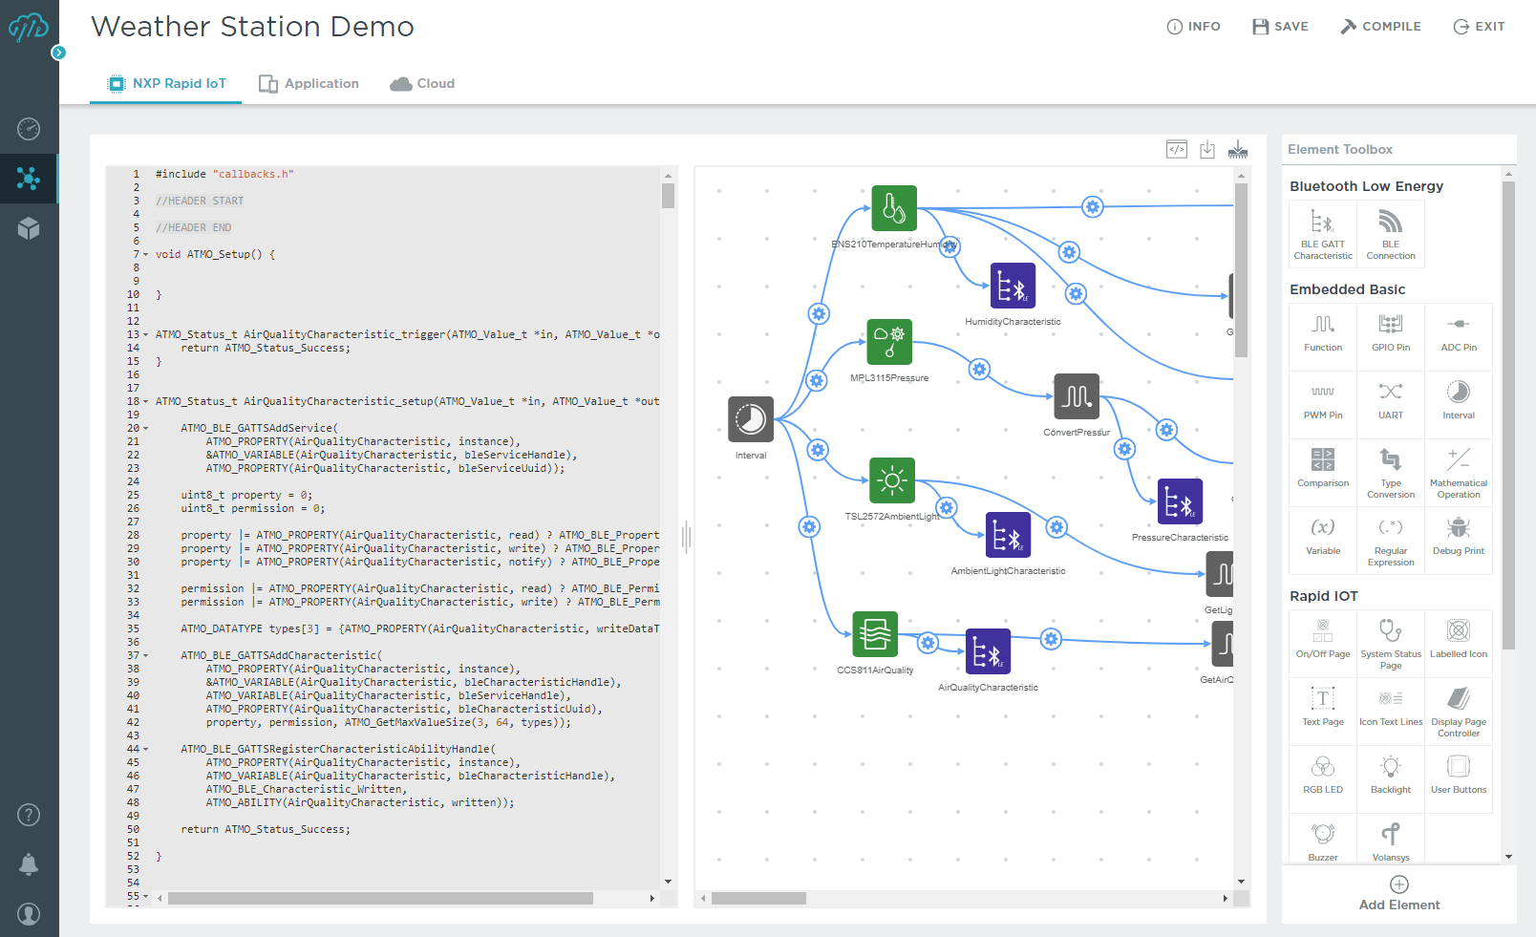
automatically generate embedded c code

Slide 6
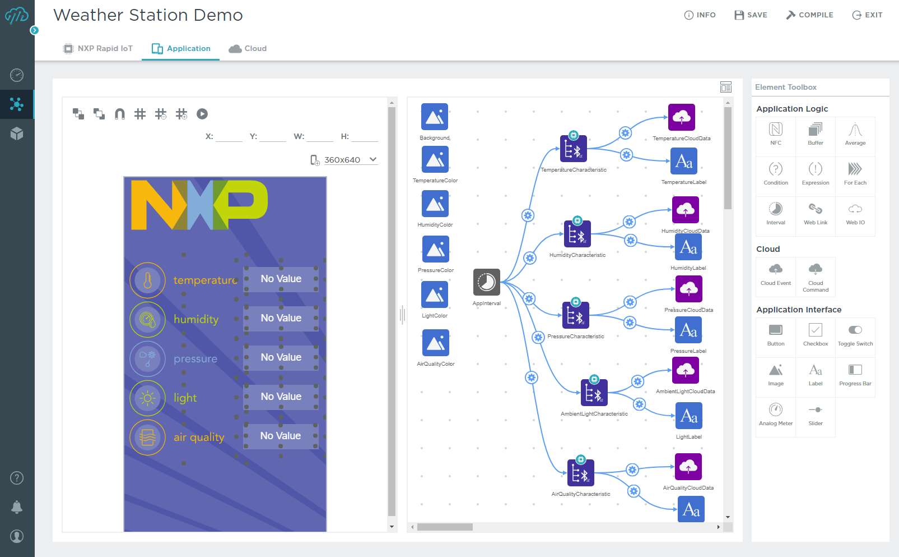
Design your mobile app simultaneously

Slide 7
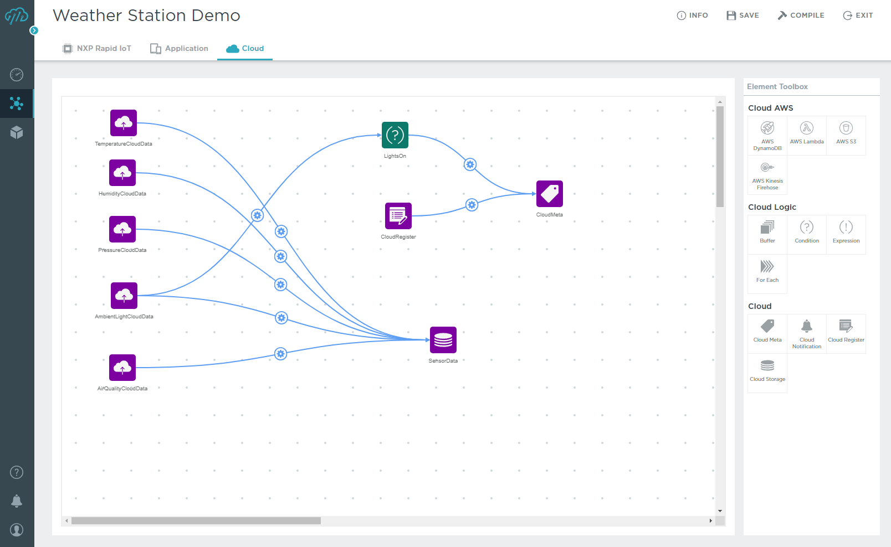
Design your cloud dashboard simultaneously

Slide 8
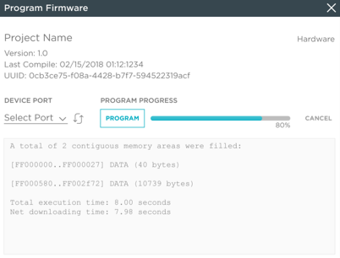
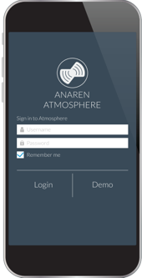
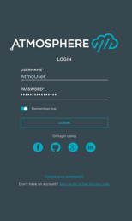
Move Seamlessly from IDE to Deploying Wireless-enabled, Cloud-Connected Devices
Program your firmware onto the device
Download your smartphone app from the Android, iTunes Stores
Provision devices, users from the Cloud
Aggregate data and create custom dashboards, alerts, permissions from the Cloud

Slide 9
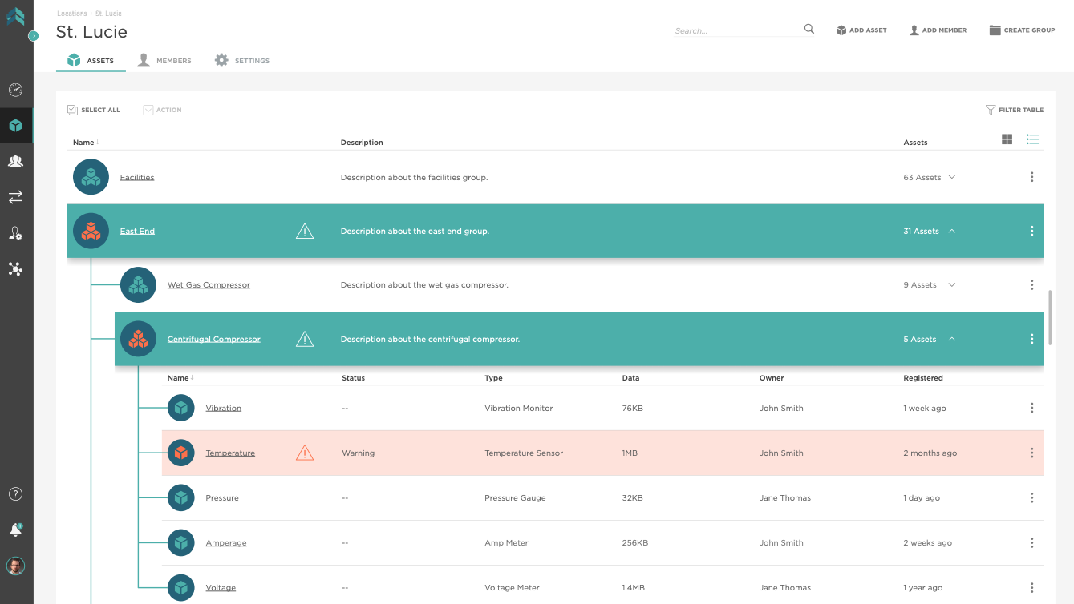
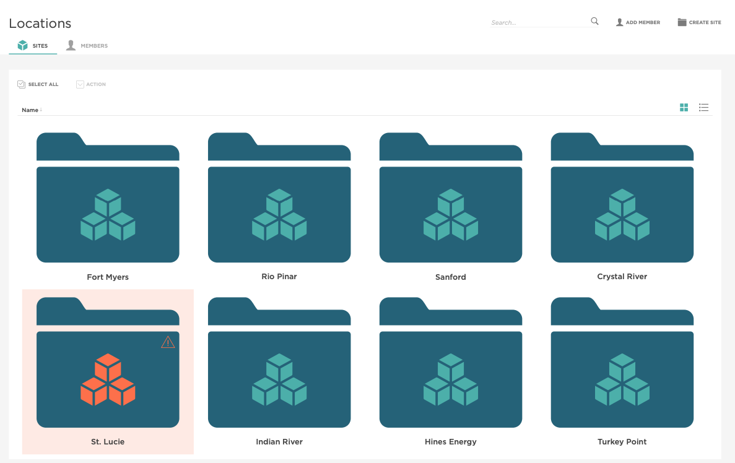
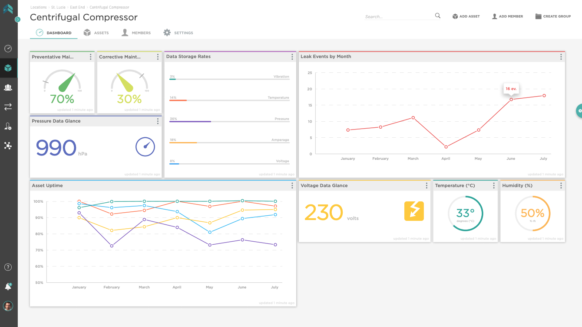
Manage Devices, Data, Users and Applications
Use Atmosphere as a central console to monitor and manage your devices, data and users
Integrate your data into a third-party application, data warehouse or cloud platform
Management Features include:
Device registering, monitoring and decommissioning
Authentication and permissions
User and Groups management
Firmware updates
Notifications: SMS, email and intra-cloud alerts

Slide 10
Remotely monitor your fleet of assets

Slide 11
Thank You.

